Slide 1
TOPIC PRESENTATION
PRESENTATOR DR.SAJIB KUMAR SARKAR IMO RANGPUR MEDICAL COLLEGE & HOSPITAL

Slide 2
ACUTE DISSEMINATED ENCEPHALOMYELITIS (ADEM)

Slide 3
DEFINITION
Acute disseminated encephalomyelitis (ADEM) is an acute demyelinating disorder of the central nervous system, in which areas of perivenous demyelination are widely disseminated throughout the brain and spinal cord and is characterized by diffuse neurological signs.
It is typically presents as monophasic disorder, encephalopathy, multifocal neurological symptoms.

Slide 4
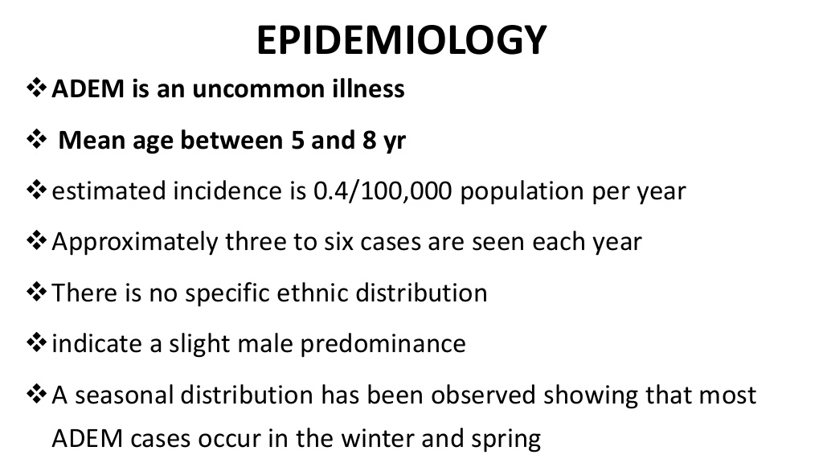

Slide 5
CAUSE
Post infectious
Post vaccinal

Slide 6
A. Post infectious
a)Viral
Measles.
Mumps.
Influenza A or B.
Hepatitis A or B.
Herpes simplex.
Human herpes virus E.
Varicella, rubella.
Epstein-Barr virus.
Cytomegalovirus.
HIV.

Slide 7
b) Others
Mycoplasma pneumoniae.
Chlamydia.
Legionella.
Campylobacter.
Streptococcus.

Slide 8
B. Vaccines
Rabies.
Diphtheria, tetanus, pertussis.
Smallpox.
Measles.
Japanese B encephalitis.
Polio.
Hepatitis B.
Influenza.

Slide 9
PATHOGENESIS
Autoimmune response
Genetic susceptibility

Slide 10
PATHOGENESIS
ADEM results from a cross reactive immune response to the infectious agent or vaccine that then triggers an inflammatory demyelinating response.

Slide 11
PATHOGENESIS
Genetic susceptibility is possibly responsible for determining the occurrence of a particular type of encephalomyelitic variant. polymorphic major histocompatibility complex (MHC) and non-MHC genes, which contribute to disease susceptibility, including those which encode for effector (cytokines and chemokines) or receptor molecules within the immune system, human leucocyte antigen class II genes have the most significant influence.

Slide 12
PATHOGENESIS
Sites of demyelination
White matter
Gray matter especially basal ganglia is also often involve
Lesser extent in spinal cord

Slide 13
PATHOGENESIS
The hallmark of ADEM is the presence of widely scattered small foci of perivenular inflammation and demyelination.
Other changes include hyperaemia, endothelial swelling, and vessel wall invasion by inflammatory cells, perivascular oedema, and haemorrhage in the small blood vessels of both white and grey matter.

Slide 14
PATHOGENESIS
As the lesions become older, the macrophages increase and lymphocytes decrease in number. At a late stage of disease foci of fibrillary fibrosis can also be seen in adjacent brain tissue.
Although postinfectious encephalomyelitis typically involves the white matter, lesions in grey matter have also been seen. Basal ganglia, thalamus, and even cortical grey matter may be involved.

Slide 15
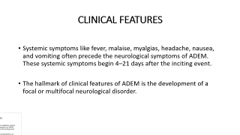
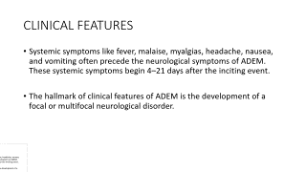
CLINICAL FEATURES
Systemic symptoms like fever, malaise, myalgias, headache, nausea, and vomiting often precede the neurological symptoms of ADEM. These systemic symptoms begin 4–21 days after the inciting event.
The hallmark of clinical features of ADEM is the development of a focal or multifocal neurological disorder.

Slide 16
CLINICAL FEATURES
The onset of the central nervous system disorder is rapid with peak dysfunction in several days. Initial clinical features include encephalopathy ranging from lethargy to coma, and focal and multifocal neurological signs like hemiparesis, cranial nerve palsies, and paraparesis, extensor planter responses, lost or hyperactive tendon reflexes, sensory loss which are consistently present.

Slide 17
CLINICAL FEATURES
Other commonly reported findings include meningismus, ataxia, and varied movement disorders. Seizure may occur in severe cases, especially in the acute haemorrhagic form of ADEM.

Slide 18
CLINICAL FEATURES
Most common polysymptomatic presentation
Acute Cerebellar ataxia
Brainstem syndrome
Optic neuritis (bilateral)
Myeloraduculitis

Slide 19
INVESTIGATIONS

Slide 20
CEREBROSPINAL FLUID
Increase pressure
Lymphocytic pleocytosis, generally 200 cells/micro liter or greater, occur in 80 % of patients.
Raised protein (50-150 mg/dl).
Oligoclonal band may be found in acute episode.
The cerebrospinal fluid may contain increased amounts of gamma globulin and IgG and raised levels of myelin basic protein.

Slide 21
MRI
Extensive changes in the brain and spinal cord, consisting of white matter hyperintensitieson T2 and fluid attenuated inversion recovery sequences with Gd enhancement on T1- weighted sequences.

Slide 22
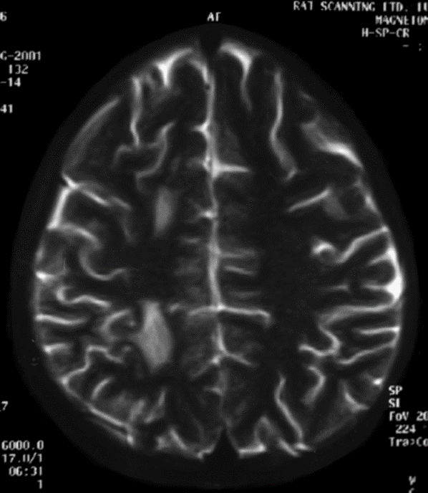
T2-weighted MRI showing multiple hyperintense lesions in the centrum semiovale of right cerebral hemisphere.

Slide 23
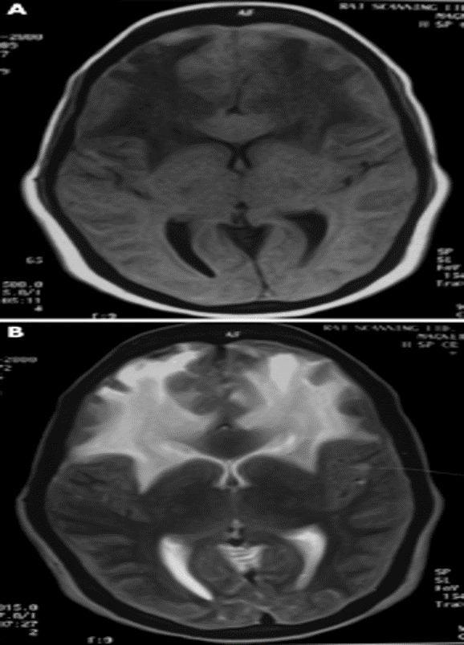
T1 (A) and T2 (B) images showing extensive bilateral demyelination of white matter of frontal lobes.

Slide 24
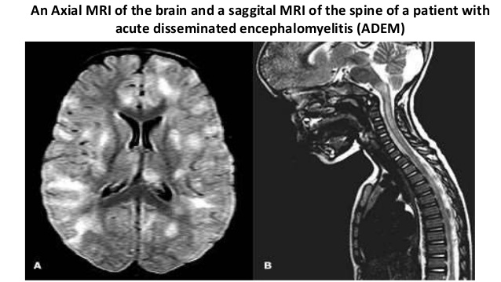

Slide 25
MRI
Demyelinating lesions of ADEM usually exhibit no mass effect and can be seen scattered throughout the white matter of the posterior fossa and cerebral hemispheres.
Involvement of the cerebellum and brainstem is more common in children.
Extensive perifocal oedema may be seen.
Though white matter involvement predominates grey matter can also be affected, particularly basal ganglion, thalami, and brainstem.

Slide 26
Electroencephalography
Electroencephalographic abnormalities are common but are usually non-specific.
At times, specific electroencephalographic pictures like spindle coma pattern and alternating pattern have been described.
It may show background slow wave activity that is typical of encephalopathy.
Seizure activity is seen.
Because of low sensitivity and specificity, electrophysiological studies are not routinely used to diagnose ADEM.

Slide 27
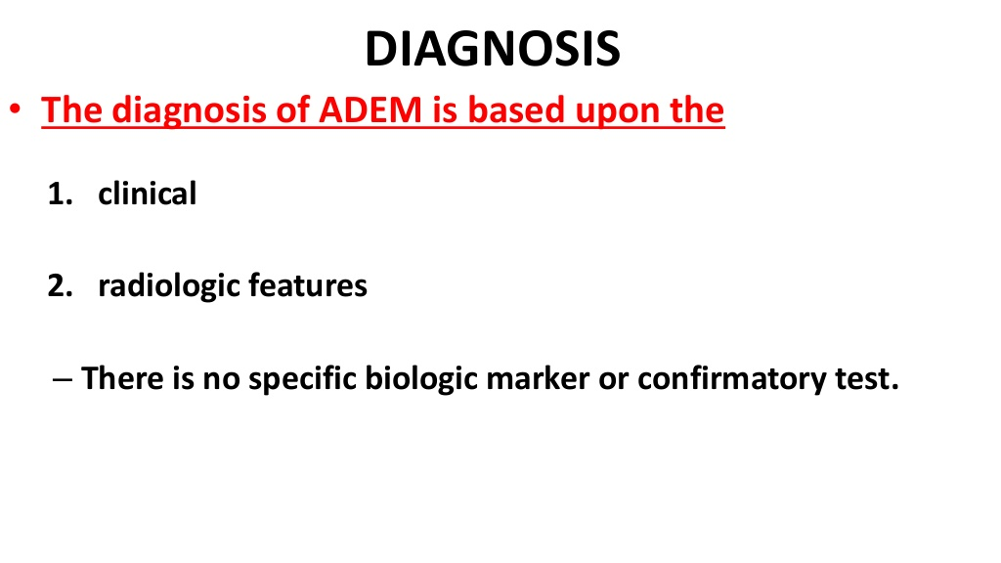

Slide 28
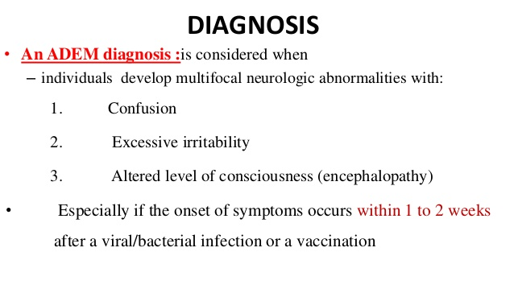

Slide 29
Relapsing/Recurrence/Multiphasic ADEM
Although ADEM is typically a monophasic illness, occasionally it can have biphasic or multiphasic course.
If it occur within 4 weeks of treatment or within the first 3 months, it is termed as relapsing ADEM.
However, some researchers view new event temporally related to the initial disease process, and thought to be related to early steroid withdrawal and hence terminology steroid dependent or pseudo-relapsing ADEM.

Slide 30
If there is another event 4 weeks after steroid withdrawal or 3 months after the first episode, and if both clinically and radiologically, the same site is involved, this entity is called recurrent ADEM.
If one or more ADEM relapses occur, including encephalopathy and multifocal deficits occur, involving new areas of the neuraxis on MRI this entity is multiphasic ADEM

Slide 31
ADEM vs MS
FEATURES | ADEM | MS
Antecedent events | Infection or Vaccination | No recognizable
Clinical characteristics | Fever,Meningism,Loss of consciousness,stupor,focal signs | Focal signs
Course | Non progressive, monophasic | Fulminant,Relapsing,Remitting, Progressive
Pathology | Widely scattered small foci of perivenular inflammation and demyelination | Larger confluent demyelinating lesions
MRI features | Diffuse, bilateral symmetrical lesions. Cerebellum,basal ganglia, thalami, and brainstem involve.The corpus callosum is usually not involved. | Periventricular black holes. Corpus callosum involvement is more characteristic. Thalamic involvement is exceedingly rare.
CSF | Oligoclonal band may be found in acute episode and disappear after recovery | Persist beyond clinical recovery,in between attacks
Prognosis | Recovery is rapid and often complete | Recovery variable

Slide 32
TREATMENT
Treatment of ADEM includes:
Supportive
Specific
High-dose intravenous methyl prednisolone
Intravenous immunoglobulin
Plasma pheresis
Physical and rehabilitation therapy

Slide 33
SUPPORTIVE CARE
Supportive care includes airway protection in patients with altered mental status and mechanical ventilation if required.
Other supportive includes: antiseizure medication in patients with seizures, correction of fluid and electrolyte disturbances.

Slide 34
SPECIFIC TREATMENT
Intravenous methyl prednisolone 10–30 mg/kg/day, up to a maximum of 1 g/day for 3–5 days. Oral corticosteroid treatment is continued with gradual tapering over 8 weeks to reduce the risk of relapses.
If high-dose corticosteroids fail, the next step will be plasma exchange (PE).A course of 4–6 PEs have been shown to be associated with moderate to marked and sustained improvement.

Slide 35
Another option IV Ig 2 gm/kg intravenously as a single dose or over the course of 3-5 days.
Any type of vaccination should be avoided during the first 6 months following recovery.

Slide 36
PROGNOSIS
Patients with ADEM presenting with peripheral involvement have been seen to have a worse prognosis and increased risk of relapse compared to those with only CNS involvement.
80% have complete recovery
Mortality rate 5-20 %
Many survivors have permanent neurologic sequelae.
The most common sequelae are focal motor deficits, could range from mild ataxia to hemiparesis.

Slide 37
THANK YOU

