Slide 1
OSMOTIC DEMYELINATION SYNDROME
DR.SAJIB KUMAR SARKAR
IMO RANGPUR MEDICAL COLLEGE HOSPITAL

Slide 2
ODS
Osmotic demyelination syndrome (ODS) is brain cell dysfunction. It is caused by the destruction of the layer (myelin sheath) covering nerve cells.

Slide 3
HISTORY
#1959: Victor and Adams first describe central pontine myelinolysis
-Sequel of alcoholism and malnutrition
#1962: Recognized that lesion can occur outside the pons- Extrapontine myelinolysis (EPM)

Slide 4
HISTORY
#1976: Tomlinson –suggested link with rapid correction of Na in hyponatremic patient was established
#1981:Kleinschmidt-De Masters and Norenburg conclusively demonstrated a link between ODS and rapid correction of Hyponatraemia

Slide 5
CAUSES
1.The most common cause is rapid correction of hyponatraemia
2.It may also occur in patient hyponatraemia affected by-
Liver disease (e.g. cirrhosis)
Liver transplant
Alcoholism
Hypokalemia
Severe burns
Malnutrition
Anorexia nervosa
HIV/AIDS
Hyperemesis gravidarum
Hyponatremia due to peritoneal dialysis
Wernicke encephalopathy

Slide 6
Lesions in ODS
Pons
Cerebellum
Lateral geniculate body
thalamus
Putamen
Cerebral cortex or subcortex

Slide 7
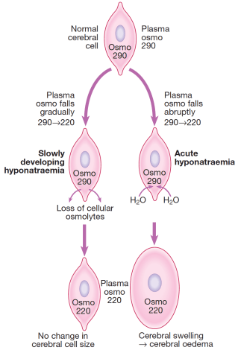
PATHOGENESIS

Slide 8
PATHOGENESIS
When hyponatraemia developes gradually,cerebral neurons have time to respond by reducing intracellular osmolarity –
i)Through excreting potassium out of cell
ii)Reducing synthesis of intracellular organic
osmolytes :inositol,betaine and glutamine

Slide 9
Thus they can remain relatively isotonic with their surroundings and reduce water movement within cells and symptoms are avoided.
This process takes about 24-48 hours.

Slide 10
Correction of the hyponatremia with intravenous fluids, the extracellular tonicity increases, followed by an increase in intracellular tonicity.

Slide 11
When the correction is too rapid (>8-10 mmol/L in 24 hours or 18 mmol/L in 48 hours) there is an abrupt increase in extracellular osmolarity which can lead to water shifting out of neurons,abruptly reducing their volume and causing them to detach from their myelin seaths.

Slide 12
This causing myelinolysis and can produce permanent structural and functional damage to mid brain structures and is generally fatal.

Slide 13
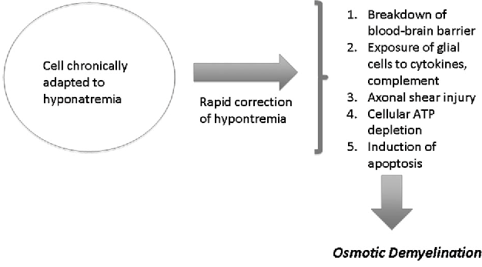

Slide 14
CLINICAL FEATURES
Can developed 1 or more days after overcorrection of hyponatraemia

Slide 15
CLINICAL FEATURES
Central pontine myelinolysis
Paraparesis
Quadriparesis
Dysphagia
Dysarthria
Diplopia
Locked-in syndrome

Slide 16
CLINICAL FEATURES
Extra pontine myelinolysis
Ataxia
Mutism
Perkinsonism
Dystonia
Catatonia

Slide 17
DIAGNOSIS
Clinical suspicion
Any patient presenting with new onset neurological symptoms with recent rapid increase in serum Sodium.
Presence of risk factors
Diagnosis is clinico- radiological
No role for tissue examination

Slide 18
MRI
Trident shaped/spreading bushfire pattern in central pons
Signal characteristics of affected region include
T1:mild or moderately hypointense
T2:hyperintence,sparing the periphery and corticospinal tract
Flair: Hyperintence
DWI: Hyperintence
Radiological findings donot improve over time,despite complete or nearly complete clinical recovery.

Slide 19
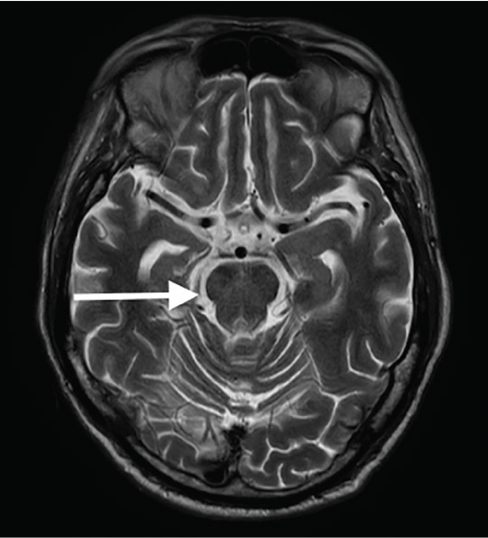

Slide 20
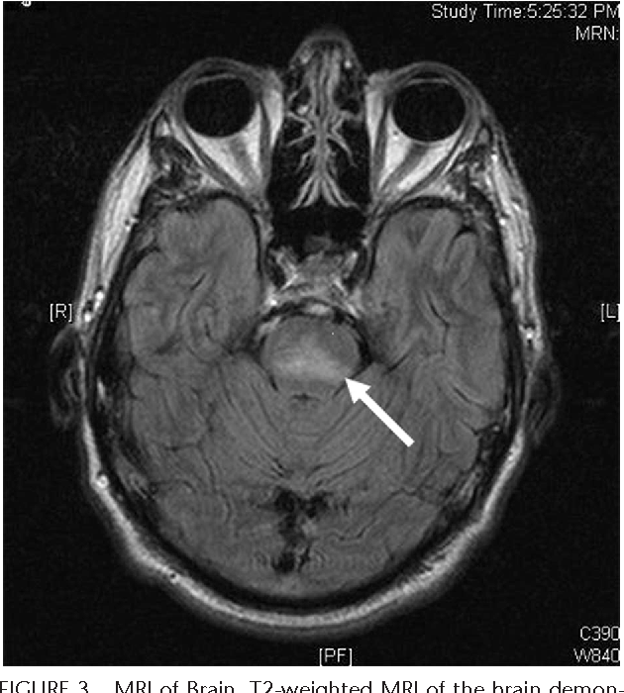

Slide 21
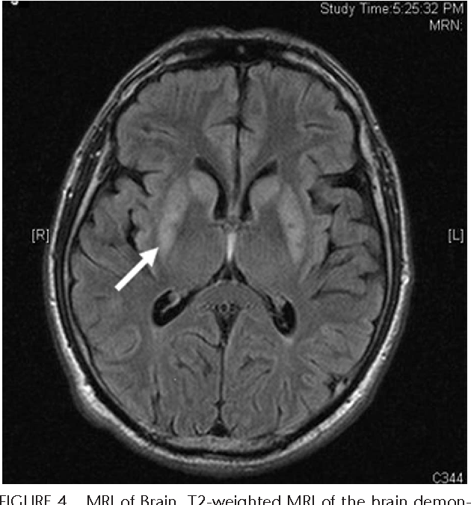

Slide 22
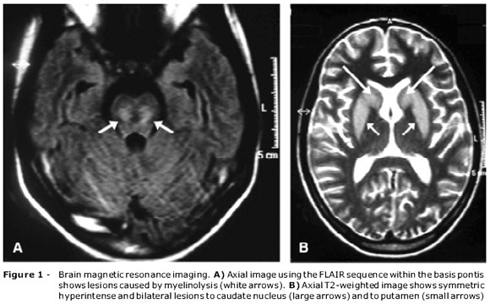

Slide 23
MANAGEMENT
Prevention
Re-lowering serum sodium
Supportive care
Plasmapheresis

Slide 24
PREVENTION
Rate of sodium correction to avoid ODS
< 8-10 mmol/L per 24 hours
< 18 mmol/L per 48 hours

Slide 25
Re-lowering serum sodium
Goal of therapy
-Rate of lowering sodium is 1 mmol/L per hour
-Target a rate of correction of < 8 mmol/L in 24 hour
period and < 16 mmol/L in 48 hour period
5% DA
-lowers serum sodium by approximately 2 mmol/L
-Infusion should be repeated until therapeutic goal
DDAVP,2 mcg intravenously or subcutaneously q6h

Slide 26
SUPPORTIVE CARE
Ventilator
Physiotherapy
Antiperkinsonism drug

Slide 27
PROGNOISIS
Some patient die and most survive.Of the survivors
1/3 are disabled but able to live independently
1/3 severely disabled-severe ataxia, spastic quadriparesis, locked-in syndrome

Slide 28


