Slide 1
FIBROCALCULOUS PANCREATIC DIABETES
DR.SAJIB KUMAR SARKAR
IMO
RANGPUR MEDICAL COLLEGE,HOSPITAL

Slide 2
DEFINITION
Fibrocalculous pancreatic diabetes is a form of diabetes secondary to nonalcoholic chronic pancreatopathy of uncertain etiology,predominantly seen in tropical developing countries.

Slide 3
DIFFERENT NAMES
Tropical chronic pancreatitis
Tropical calcific pancreatitis
Tropical pancreatic diabetes
Juvenile pancreatitis syndrome
Endemic pancreatic syndrome
Nutritional pancreatitis

Slide 4
HISTORICAL BACKGROUND OF FCPD
Zuidema’s first description from Indonesia
Gee Varghese’s first study from
kerala.World’s one of the largest series
around 1700 patients cases- considered as
father of pancreatic diabetes.
Existence of FCPD in
Brasil,Kenya,Nigeria,Thailand,Bangladesh,
Sri Lanka
1959
1960
1962-1981

Slide 5
FCPD-INTERNATIONAL STATUS
WHO study group identified
malnutrition related diabetes mellitus
(MRDM) as a separate type of DM
distinct from Type 1 and Type 2 DM.Two
subtypes were recognized under this.
- Fibrocalculous pancreatic diabetes (FCPD)
-Protein deficient diabetes mellitus (PDDM)
ADA expert committee eliminated MRDM and FCPD
has reclassified under other specific types as a disease
of the exocrine pancreas
1985
1997

Slide 6
ETIOLOGY AND PATHOGENESIS
The exact aetiopathogenetic mechanisms still remain elusive.
The following hypotheses have been proposed-
Malnutrition
Cassava toxicity (Cyanogen toxicity)
Familial and genetic factors
Micronutrient deficiency and oxident stress

Slide 7
MALNUTRITION
Protein calorie malnutrition is present in many patients with FCPD.
But many areas in the world with high prevalence of malnutrition has very low prevalence of FCPD.
Malnutrition thus could well be the effect rather than the cause of the disease since chronic pancreatitis with consequent malabsorption could itself lead to malnutrition.

Slide 8
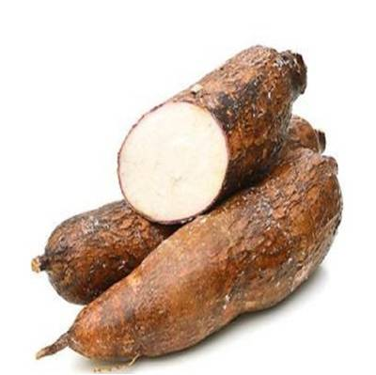
CASSAVA TOXICITY (Cyanogen Toxicity)
-Cassava (tapioca, Manihot esculenta) is a tuber consumed as a staple food by poor people in some parts of the world.
-Contain cyanogenic glycosides such as linamarin and lotaustralin.

Slide 9
Cyanide is normally detoxified in the body by conversion to thiocyanate, but this detoxification requires sulphur.
In malnurished, sulphur containing amino acids like methionine and cystine are deficient and the theory is that when these patients consume cassava, they develop free radical injury and then pancreatitis.

Slide 10
FAMILIAL AGGREGATION
Recent study shows about 8% of patients with FCPD were shown to have evidence of familial aggregation.
There was evivence of vertical transmission of FCPD from the parients to the offspring.
There was evidence of horizontal transmission of FCPD among siblings.
*** Familial aggregation suggests but doesnot necessarily prove.

Slide 11
GENETIC FACTORS
Serum protease inhibitor kazal type 1
(SPINK 1) / Pancreatic secretory trypsin inhibitor (PSTI) mutation.
-In the normal pancreas,a number of mechanism work synergistically,preventing the premature activation of trypsinogen to trypsin.

Slide 12
SPINK 1 / PSTI is a potent protease inhibitor and exerts a major protective mechanism preventing inappropriate activation of pancreatic digestive enzyme cascade by inhibiting upto 20% of potential trypsin activity.
Mutations of SPINK 1 gene are significantly associated with TCP.

Slide 13
MICRONUTRIENT DEFICIENCY AND OXIDANT STRESS
A state of defective ability to scavenge free radicals enhance the susceptibility of organ damage.
Most of the scavenging enzymes and antioxidant vitamines (Vit A,B-carotene, Vit C,Vit E) are nutritionaly dependent and deficiency of these augment free radical induced injury.

Slide 14
CLINICAL PRESENTATION
The clinical picture of FCPD consists of the following four cardinal features-
Abdominal pain
Pancreatic calculi
Maldigestion leading to steatorrhea
Diabetes

Slide 15
Others included-
Usually poor people
Lean patient (Undernutrition)
Young age
Usually non ketotic
Usually requires insulin for diabetes
control

Slide 16
FCPD
Sex ratio M:F (%) | 70 : 30
Age of onset | 2nd and 3rd decade
Socioeconomic status | Usually poor, may occur in other as well
Course of disease | Aggressive and accelerated
Diabetes | Occurs in > 90 %
Pancreatic calculi | Occurs in > 90%
Location of calculi | Always in large duct
Ductal dilatation | Usually marked
Fibrosis of gland | Marked
Alcoholism | Absent by definition
Prevalance of pancreatic cancer | High

Slide 17
ABDOMINAL PAIN
Predominant symptom.
Usually the presenting complaint in 30%–90% of patients.
Typically very severe,upper abdominal in location, radiates to the back, and is relieved by stooping forward or lying in a prone position.
The severity tends to decrease and it becomes less frequent as the disease progresses and it may disappear with onset of exocrine insufficiency and/or diabetes.

Slide 18
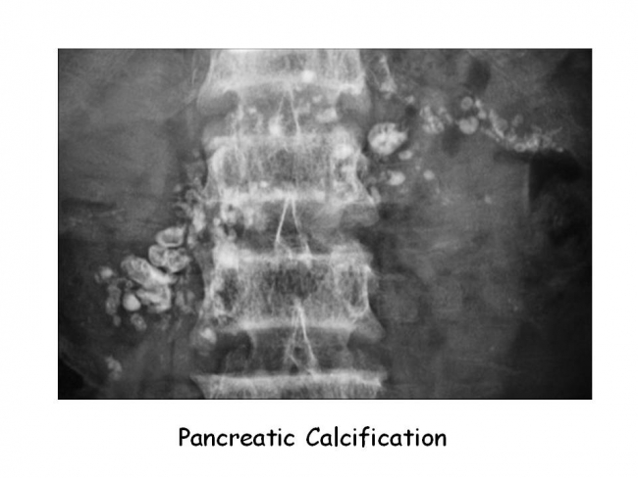
PANCREATIC CALCULI

Slide 19
PANCREATIC CALCULI
Intraductal in location.
Seen mostly on the right side of first and second lumbar vertebra on plain abdominal radiography.
May be solitary or multiple, and sometimes the entire pancreas may be studded with calculi.
Tend to be large, dense, and rounded with well defined edges in contrast to the small, speckled, ill defined stones in alcoholic chronic pancreatitis.

Slide 20
MALDIGESTION / STEATORRHEA
Patients with severe exocrine pancreatic insufficiency complain of passing bulky, frothy, or frankly oily stools.
However, overt steatorrhoea is only present in about 20% of patients with TCP.
The low frequency of steatorrhoea is attributed to the low fat intake in the diet.
When the fat intake of the diet was experimentally increased, 76% of TCP patients developed steatorrhoea.

Slide 21
DIABETES
It is an inevitable consequence commonly occurring a decade or two after the first episode of abdominal pain.
In lean and undernourished individuals, the diabetes tends to be more severe and polyuria and polydipsia are the major presenting complaints.
In the better nourished patients, the symptoms may be insidious and the diagnosis of FCPD is usually made during investigations for pain in the abdomen.

Slide 22
Diabetes is usually very severe with a fasting blood glucose from 11.1–22.2 mmol/L and often requires the use of insulin for control.
Unless there is a high index of suspicion, the diagnosis is often delayed or missed.

Slide 23
One of the characteristic clinical features of FCPD is that despite requiring insulin for control, patients rarely become ketotic on withdrawal of insulin.

Slide 24
DIAGNOSTIC CRITERIA FOR FCPD
(MOHAN et al.1985)
Occurrence in a "tropical" country.
Diabetes by WHO criteria.
Evidence of chronic pancreatitis:
  Pancreatic calculi on X-ray
  or at least three of the following:
    - Abnormal pancreatic morphology by sonography
    - Chronic abdominal pain since childhood
    - Steatorrhoea
    - Abnormal pancreatic function test.
Absence of other causes of chronic pancreatitis. i.e. alcoholism, hepatobiliary disease or primary hyperparathyroidism etc.

Slide 25
FCPD AND KETOSIS RESISTANCE
Partial preservation of B cell function
Decreased glucagon reserved
Reduced supply of nonesterified fatty acid (NEFA)
Resistance to subcutaneous adipose tissue lipolysis by epinephrine
Carnitine deficiency

Slide 26

INVESTIGATION

Slide 27
INVESTIGATIONS
If pancreatic calculi are present on plain abodominal radiography,the diagnosis is straightforward.
However calculi developed after several years of abdominal pain and about 10% of patients donot developed calculi.Hence the need for other diagnostic markers.

Slide 28
INVESTIGATIONS
The investigation for a suspected case of FCPD without pancreatic calculi are as follows :
Tests of pancreatic structure
-Ultrasonography
-Computed tomography
-ERCP
-Endoscopic ultrasonography
Tests of pancreatic function
-Exocrine pancreatic function
-Endocrine pancreatic function

Slide 29
By USG and CT of abdome,it is possible to evaluate the size of the pancreas and also confirm intraductal location of calculi and the degree of fibrosis and ductal dilatation.Imaging of smaller stone and diagnosis of pseudocyst is better on CT.
ERCP may show ductal tortuosity and dilation, stenosis, obstruction, cyst formation, and the presence of calculi in the main pancreatic duct, side branches, and ductules.
Endoscopic ultrasonography is an exciting new tool for diagnosis of chronic pancreatitis, especially at a relatively early stage.

Slide 30
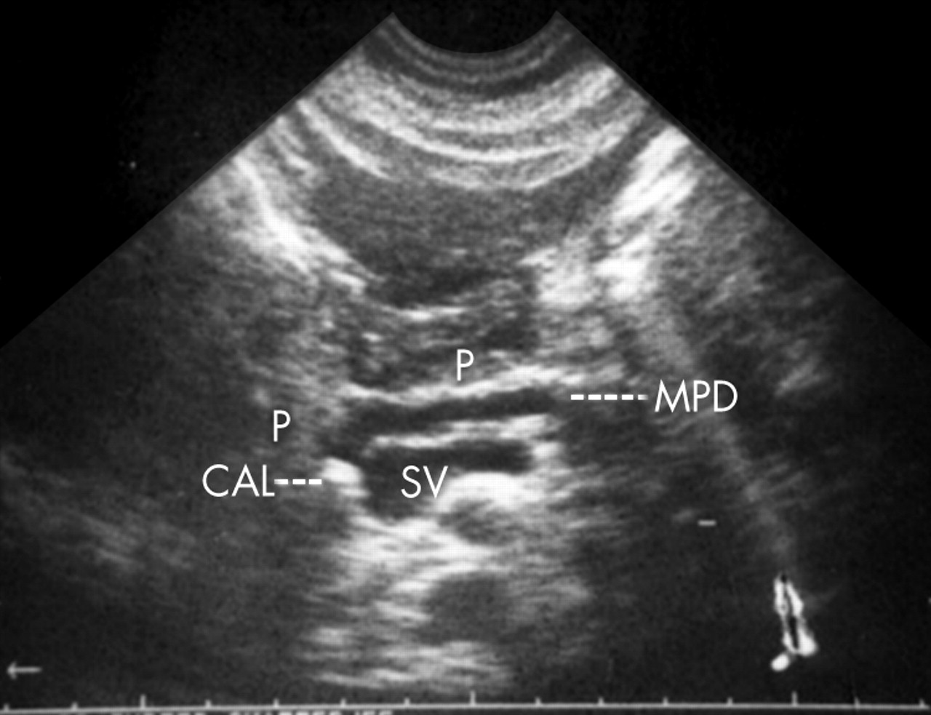
USG OF PANCREAS

Slide 31
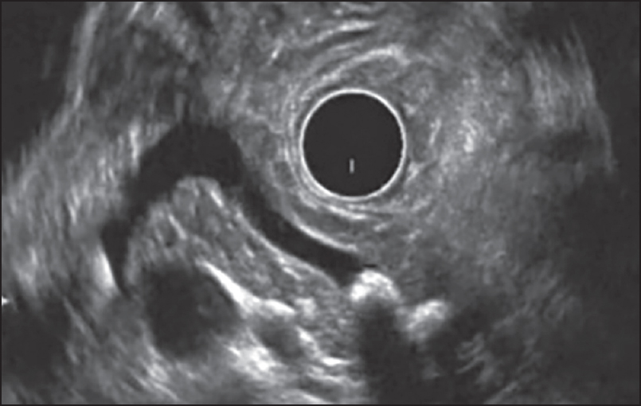
ENDISCOPIC USG OF PANCREAS

Slide 32
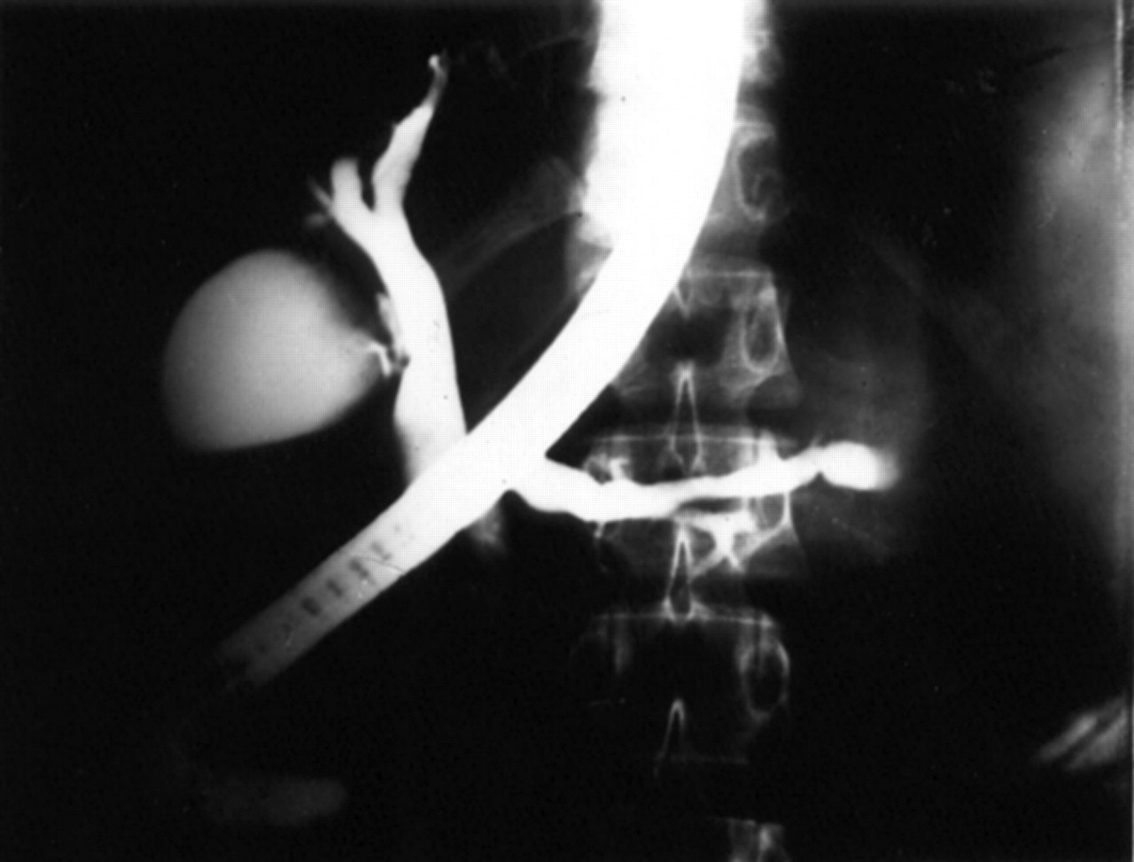
ERCP

Slide 33
PANCREATIC EXOCRINE FUNCTION TEST
Pancreolauryl test
Pancreatic esterases cleave fluorescein dilaurate after oral ingestion.Fluoresceinis absorbed and quantified in urine.
Faecal elastase
Immunoassay of pancreatic enzymes on stool sample

Slide 34
PANCREATIC ENDOCRINE FUNCTION TEST
C-peptide assay

Slide 35
COMPLICATIONS
Complications due to chronic pancreatitis
-Pancreatic carcinoma
-Cysts and abscess
-Biliary obstruction
-Pancreatic ascites
-Splenic vein thrombosis

Slide 36
Complications related to diabetes
    ***Microvascular > Macrovascular
    - Retinopathy
    - Microalbuminuria
    - Neuropathy
    - Nephropathy
    - Coronary artery disease
    - Peripheral vascular disease

Slide 37

MANAGEMENT

Slide 38
MANAGEMENT
Abdominal pain
  Analgesics
  Pancreatic enzyme supplementation
  Antioxidants
Malabsorption
  Pancreatic enzyme supplementation
Diabetes
  Insulin
  More liberal calorie and protein intake.

Slide 39
Surgery
longitudinal pancreaticojejunostomy
Distal pancreaticojejunostomy
Subtotal pancreatectomy
Pancreatic duodenectomy
Extracorporeal shock-wave lithotripsy
Endoscopic stone removal

Slide 40
TAKE HOME MESSAGE
In any young patient with newly detected diabetes,advice a plain X ray abdomen for pancreatic calculus.

Slide 41



