Slide 1
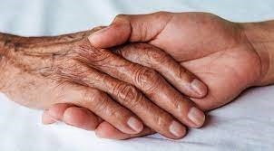
PALLIATIVE CARE
DR.MD.MAHMUDUL HASSAN
ASSISTANT REGISTRAR ,MEDICINE
RANGPUR MEDICAL COLLEGE HOSPITAL

Slide 2
Questions
(SN)Mx of neuropathic pain in cancer patient?
Mx of Cancer pain?
Mx of pain in terminally ill patient?
Mx of metastatic bone pain?
Discuss the principle of palliative care.
Role of opiod in palliative care.
Mx of a dying patient?
SN-Terminal care
Breaking a bad news.

Slide 3


Slide 4
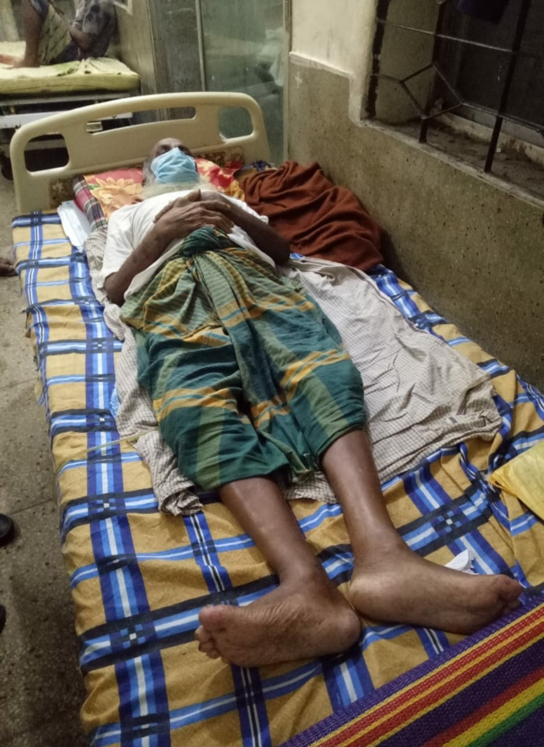
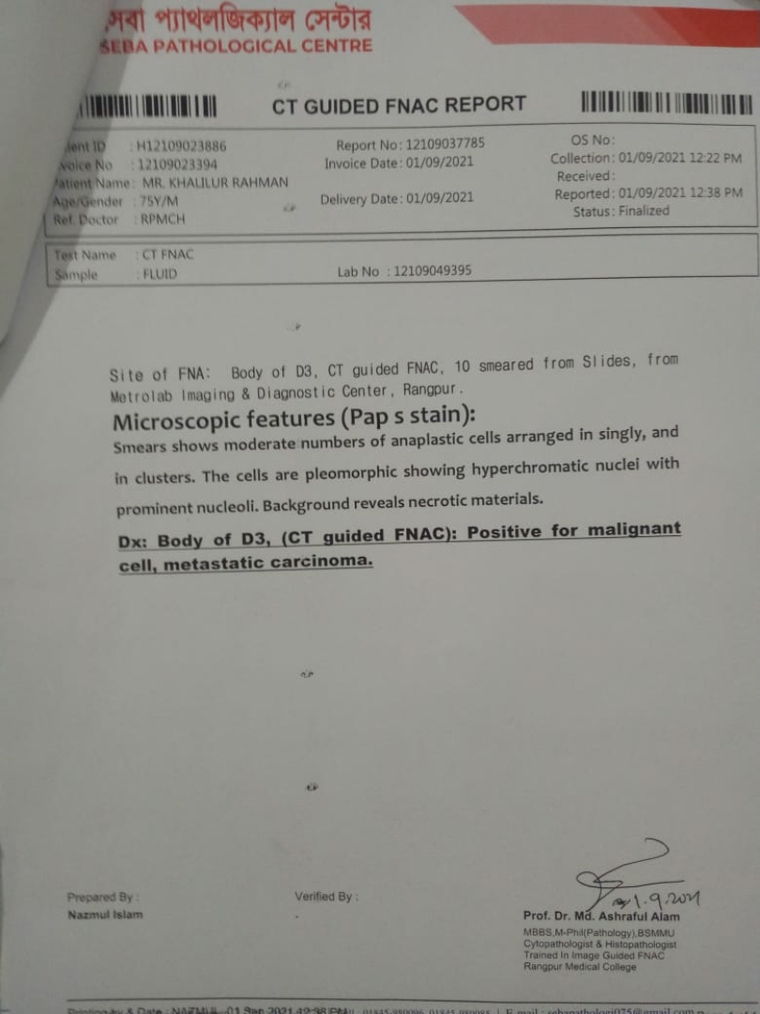
Mr.Khalilur Rahman, 75 years

Slide 5
Palliative care
Palliative care is a crucial part of integrated, people-centred health services.
It is estimated that globally only 14% of patients who need palliative care receive it.

Slide 6
Palliative Care cont….
Palliative care is the active total care of patients who have advanced,progressive ,life shortening incurable disease.

Slide 7
It is based on needs and not on diagnosis.
It is required in non malignant and malignant diseases.
Palliative may be applied to any chronic disease state.

Slide 8
End of life care
refers to the care of patients with far advanced, rapidly progressive disease that will soon prove fatal.(Davidson)
“The End of life or terminal phase is defined as the period when day to day deterioration, particularly of strength, appetite and awareness, are occurring”.
Oxford Handbook of Palliative Care, Page No. – 73

Slide 9
Principles for End of Life Care
● Aim is quality of care and quality of life
● Communication with the patient and family
● Not aiming to prolong or shorten life

Slide 10
While palliative care can and should be delivered at any stage of an incurable illness alongside optimal disease control, the focus of end-of-life care is on quality of life rather than prolongation of life or cure.

Slide 11
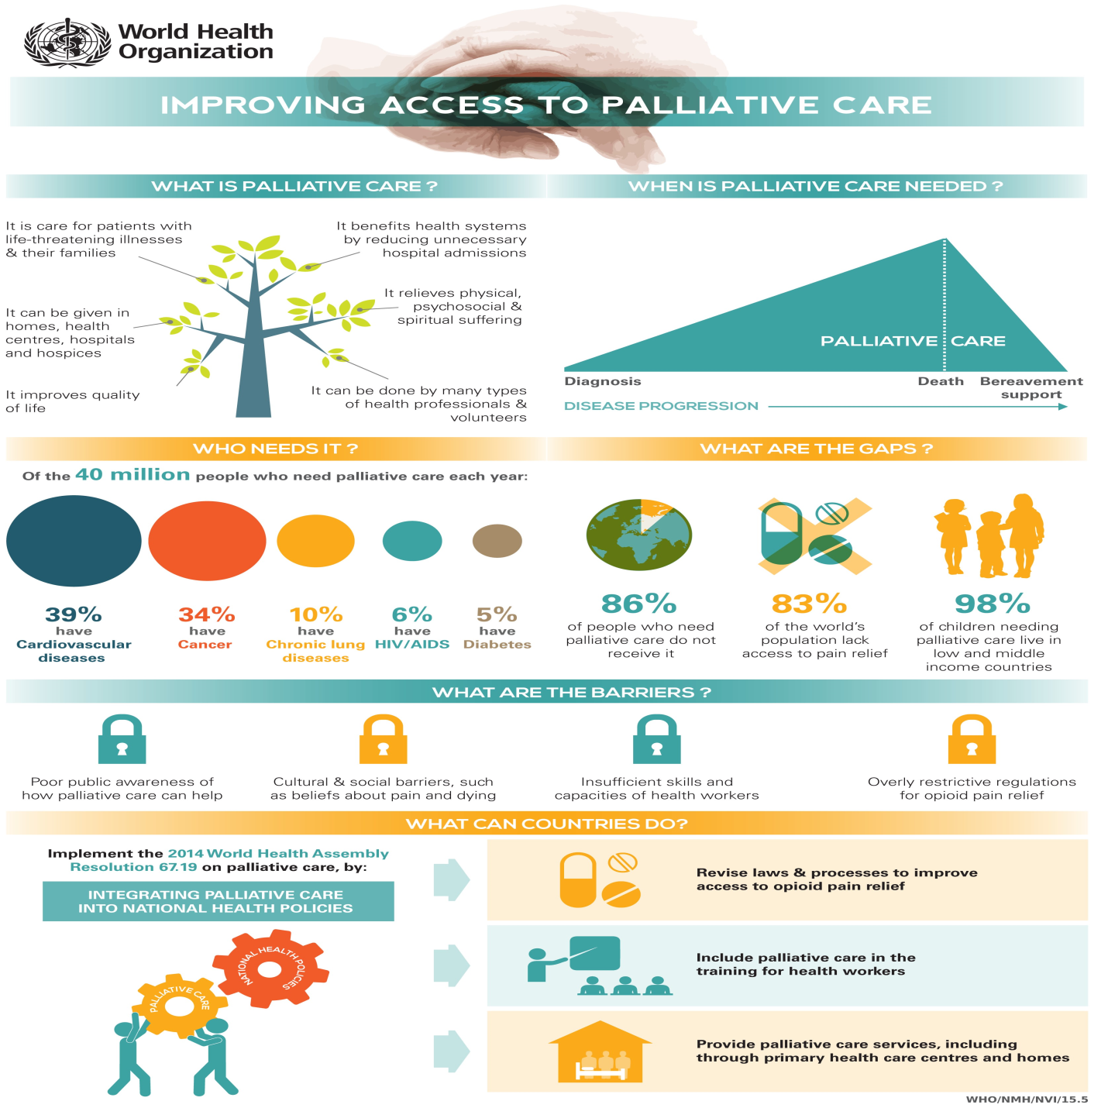
Gaps and Barriers of palliative care

Slide 12
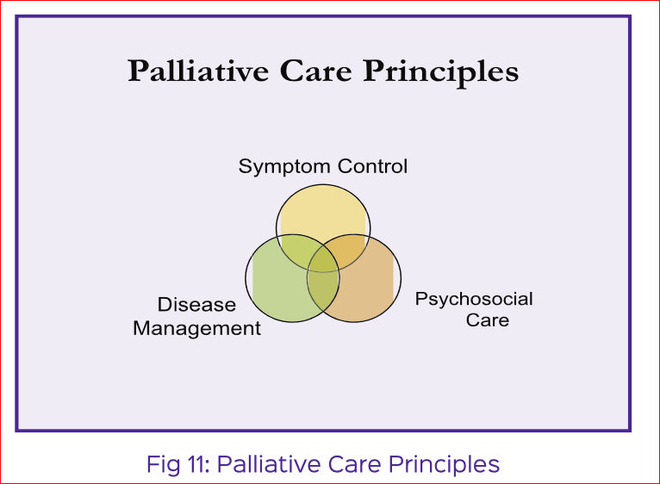
Principles of palliative care

Slide 13
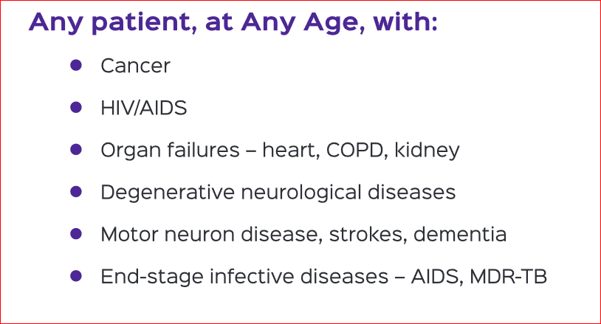
Who needs palliative care

Slide 14
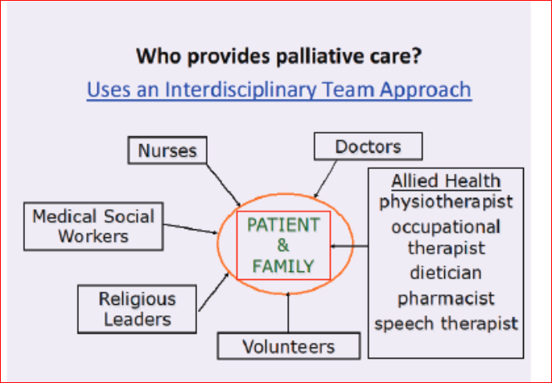
Who provides palliative care

Slide 15
Goals of Palliative care
Managing physical,pshchological,social and spiritual problems to provide excellent symptom control.
Enabling patients to be cared for and to have the best chance of dying in their preferred place.
Kumar and Clark’s Clinical Medicine 10th edition

Slide 16
Enabling the acceptance of death as a normal process when life prolonging treatments no longer improve or maintain quality of life.
Providing the opportunity to say goodbye and reduce complicated grief.
Kumar and Clark clinical medicine 10th edition

Slide 17
When should start palliative care
It should be started as early as possible at diagnosis.

Slide 18
Key points of palliative care
Patients should always be involved in decisions about their care.
Quality of life is increased when treatment goals are clearly understood by everyone,including patient and carer.

Slide 19
The MDT provide a high standard of care but there must be realism and honesty about what can be achieved
End of life care is delivered in all settings:the patients’s usual place of residence,hospitals and hospices.

Slide 20
Key points of palliative care cont…..
Care at home should be encouraged for as long as possible,even if the patient’s preferred place of death is elsewhere.
Discussions must be made known to everyone involved in the patient’s care.
Kumar and Clark’s Clinical Medicine 10th edition

Slide 21
Key components of a modern palliative care service
Management based on needs,not on diagnosis,the symptoms burden of non malignant disease often equals that of cancer.
Care is independent of the patient’s location. If possible,avoiding unwanted admissions to hospital.
Rehabilitation for people with advanced disease.

Slide 22
Support for carers.
Bereavement care for people with complicated grief.
Advice for other clinicians,dissemination of palliative care knowledge.
Education (surrounding palliative and end of life care )for clinicians of all disciplines and all levels.
Kumar and Clark’s clinical medicine 10th edition

Slide 23


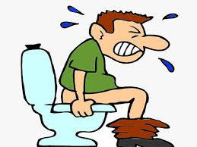
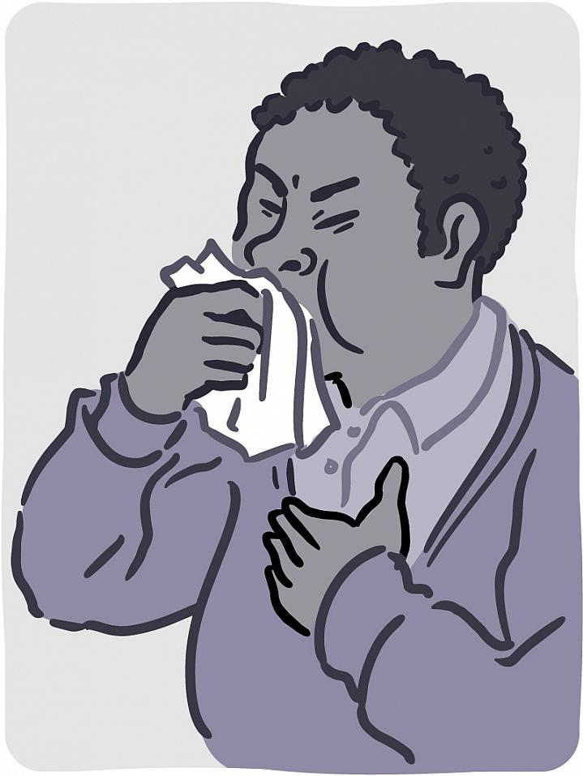
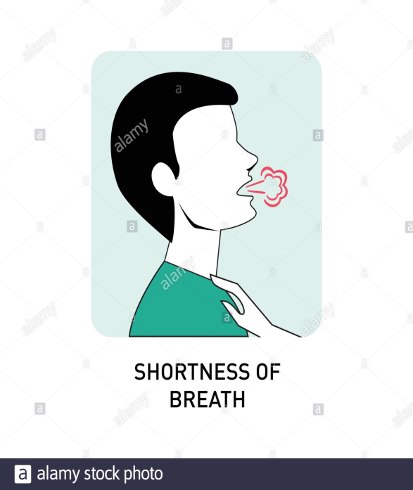
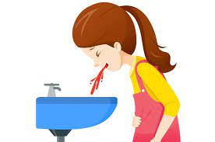
SYMPTOM MANAGEMENT IN PALLIATIVE CARE

Slide 24
Principles of Symptom Management:
a) Good symptom management is an essential and crucial part of palliative care. A general principle of symptom management is to 1. Evaluation: Diagnosis of each symptom before treatment 2. Explanation: Explanation to the patient before treatment 3. Management: Individualized treatment 4. Monitoring: Continuing review of the impact of treatment 5. Attention to detail: No unwarranted assumptions

Slide 25
b) Good assessment needs good communication . Steps of good communication: ● Make eye contact with the patient ● Introduce yourself and your role ● Explain what you want to do ● Use words which patient can understand ● Explain to patient how much you can help and how quickly the treatment will work

Slide 26
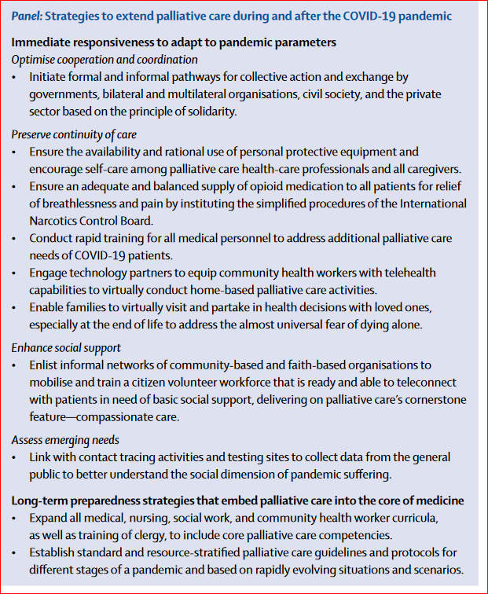
Palliative care in Covid-19

Slide 27
PAIN
Pain is a common problem in palliative care. About two-thirds of patients with cancer experience moderate or severe pain.
Many of these are of a mixed aetiology and about half of patients with cancer-associated pain have a neuropathic element.

Slide 28
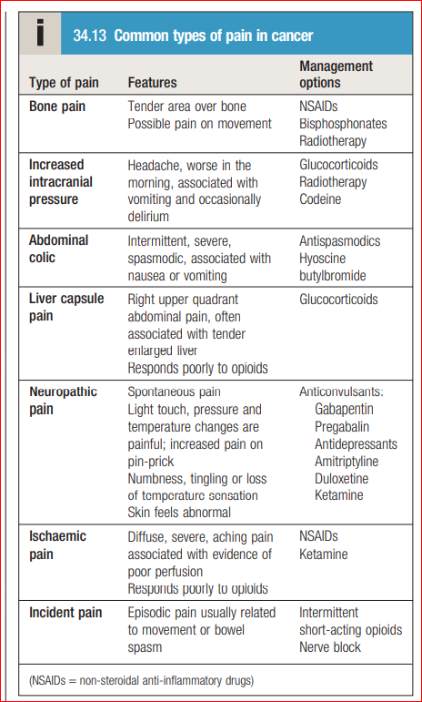
Management: pharmacological treatment

Slide 29
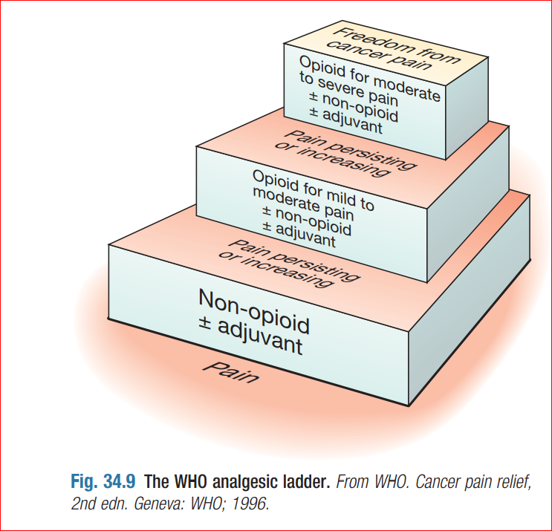
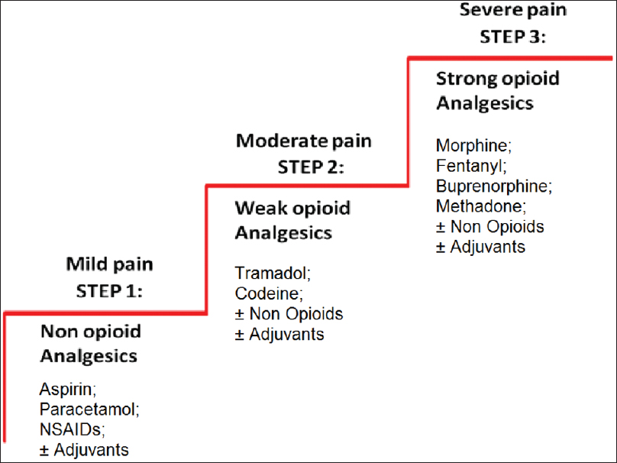
WHO Analgesic Ladder

Slide 30
Management: non-pharmacological treatments
Neurodestructive interventions
Radiotherapy
Physiotherapy
Psychological techniques
Stimulation therapies
Complementary and alternative therapies

Slide 31
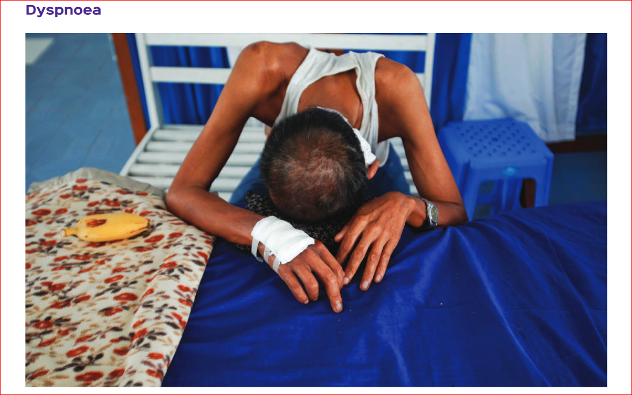
Breathlessness

Slide 32
Pharmacological management of breathleness
● If bronchospasm - bronchodilators ● Steroids - alleviating bronchospasm and reduce inflammation ● Nebulized with N/S may liquidize tenacious secretions and aid expectoration ● Opioids - decreasing respiratory effort and breathlessness.

Slide 33
● Anxiolytics - panicked patients with hyperventilation and fear of suffocation
● Oxygen - in palliative care patients, oxygen should be restricted to those with severe hypoxaemia (e.g. SpO2 ≤90%) or those who report significant relief of breathlessness from oxygen.
● Palliative radiotherapy to reduce the effect of tumour load in patients with malignant disease.

Slide 34
Nonpharmacological management of breathleness
● Elevate head of bed ● Bedside fan ● Relaxation exercises ● Breathing exercises ● Diaphragmatic and Pursed Lip Breathing ● Play therapy ● Avoid crowding the patient ● Eliminating irritants such as smoke or allergens ● Maintain calm, quiet environment

Slide 35
Cough
a) Treat reversible causes of cough e.g. Stop smoking, treat asthma/COPD
b) Non-pharmacological: ● Patient should stay in a ventilated place, without cigarette smoke or kitchen smoke. ● Offer the patient traditional cough medicines like honey, lemon to steam.

Slide 36
● Tenacious or thick secretions can be loosened with nebulised saline thus allowing the patient to remove them by coughing ● Cough lozenges can sooth the throat and alleviate a dry, irritating cough.

Slide 37
c) Pharmacological ● For Productive/wet cough: Antimuscarinic drugs (e.g. ipratropium (nebulized) or glycopyrronium (SC) or hyoscine (SC)), Cough suppressants, Corticosteroids ● For dry cough: Cough suppressants
● Patients with a persistent dry cough benefit from opioids. Morphine may be used.

Slide 38
HICCUP
a) Non-drug treatment: ● Small and frequent meals rather than large meal at a time ● inhalation of smelling salts ● eating dry granulated sugar ● holding of breath ● rebreathing into a bag etc.

Slide 39
b) Drug treatment: ● Reduce gastric distension by prokinetic agents like metoclopramide, domperidone. ● Antiflatulant, antacid, PPI to improve reflux and distension ● nifedipine, baclofen for relaxation of smooth muscle ● dexamethasone at high dose or phenytoin may suppress central irritation from intracranial tumour. ● chlorpromazine in intractable cases.

Slide 40
Fatigue
More than 90% of terminally ill patients experience fatigue and/or weakness.
Reversible causes of fatigue, such as anemia and infection, should be treated.
However, at the end of life, it must be realistically acknowledged that fatigue will not be “cured.”

Slide 41
Discontinuing medications that worsen fatigue including cardiac medications,benzodiazepines, certain antidepressants, or opioids if the pain is well-controlled.
Glucocorticoids(dexamethasone ) can increase energy and enhance mood.
Fatigue related to anorexia, megestrol (480–800 mg) can be helpful.
L-carnitine may improve fatigue.Methylphenidate-CNS stimulant(k&C).

Slide 42
PALLIATIVE SEDATION
Patients with severe symptoms, such as pain or dyspnea, uncontrolled seizures that cannot be relieved by conventional interventions ,then palliative sedation should be considered as an intervention of last resort.

Slide 43
Typically, palliative sedation should be introduced only after the patient and family have been assured that all other interventions have been tried, and after the patient and their loved ones have been able to “say goodbye.”
Palliative sedation can be achieved by significantly increasing opioid doses until patients become unconscious, then putting them on a continuous infusion.

Slide 44
Palliative sedation cont…..
Midazolam
Propofol
Less commonly used - levomepromazine, chlorpromazine, and phenobarbital.

Slide 45
Insomnia
Occurs in 19–63% of patients with advanced cancer.
Some 30–74% of patients with other end-stage conditions, including AIDS, heart disease, COPD, and renal disease, experience insomnia.

Slide 46
Mx
Improvement of sleep hygiene (encouragement of regular time for sleep, decreased nighttime distractions, elimination of caffeine and other stimulants and alcohol).
Treatment of anxiety and depression.
For patients with depression who have insomnia and anxiety, mirtazapine(newer antidepressant)can be helpful.

Slide 47
Palliative insomnia cont…
When benzodiazepines are prescribed, short-acting ones (such as lorazepam) are favored over longer-acting ones (such as diazepam).

Slide 48
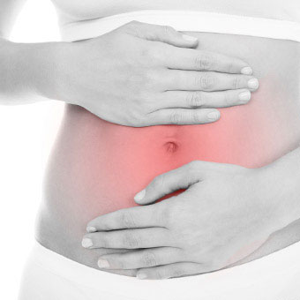
Constipation
Constipation is reported in up to 70–100% of patients requiring palliative care.

Slide 49
Constipation is subjective.
● Offer the patient to drink frequently. ● Encourage the patient to eat a lot of vegetables and fruits, fibrous food such as sweet potatoes, banana, etc. ● Drink one teaspoon of ordinary cooking oil before breakfast.

Slide 50
● Encourage the patient to mobilize
● If it is difficult to pass stool, enema with grease or paraffin oil into the rectum.

Slide 51
● If fecal impaction - digital rectal exam. Manually disimpact as needed. ● Osmotic laxatives (use only in patients who are well-hydrated): ● Mineral oil 5-30 ml at bedtime orally.

Slide 52
Constipation cont….
Stimulant(senna,bisacodyl) and osmotic laxatives(lactulose), stool softeners(docusate sodium), fluids, and enemas are the mainstays of therapy .

Slide 53
Nausea and vomiting
Non-drug measures in N/V
● Have fresh air with a fan or open window ● Keep mouth clean and do oral care after each
episode of vomiting ● Relaxation & distraction ● Bed rest to avoid vestibular stimulation ● Nursing in the upright position

Slide 54
● Avoid situations which induce N&V ● Avoid smells ● Frequent small meals ● Food selection ● Suitable distractions

Slide 55
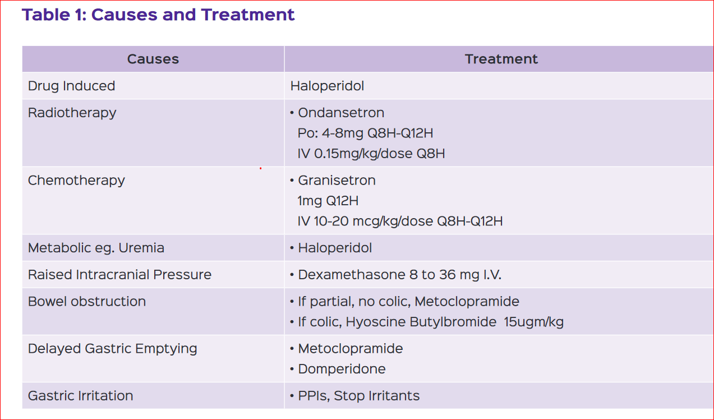

Slide 56
Weight loss
Causes- reduced appetite or the effects of drug , or as a consequence of low mood and anxiety.
Treatment - exercise to maintain muscle mass and strengthen muscles, an adequate calorie intake and providing nutritional supplements.
Glucocorticoids can temporarily boost appetite and general well-being but may cause false weight gain by promoting fluid retention.

Slide 57
Anxiety and depression
Anxiety and depression are common in palliative care
If antidepressants are required, citalopram and mirtazapine are good choices since they are generally well tolerated in patients with advanced disease.

Slide 58
Delirium and agitation
Many patients become confused or agitated in the last days of life.
Up to 85% of patients dying from cancer may experience terminal delirium.
It is important to identify and treat potentially reversible causes.
It is important to distinguish between behavioural change due to pain and that due to delirium, as opioids will improve one and worsen the other.

Slide 59
Dehydration
A patient with a major stroke, who is unable to swallow , will develop renal impairment and thirst if not given fluids and should be hydrated.
When a patient has been deteriorating and is clearly dying, parenteral hydration needs very careful consideration and it is very important to manage this on an individual basis.

Slide 60
Withdrawing AND Withholding of Life-Sustaining Treatment
For centuries, it has been deemed ethical to withhold or withdraw life-sustaining interventions.
In theory, patients’ right to refuse medical therapy can be limited by four countervailing interests: (1) preservation of life, (2) prevention of suicide, (3) protection of third parties such as children, and (4) preservation of the integrity of the medical profession.

Slide 61
Withholding and withdrawing acutely life-sustaining medical interventions from terminally ill patients are now standard practice.
More than 90% of American patients die without cardiopulmonary resuscitation (CPR), and just as many forgo other potentially life-sustaining interventions

Slide 62
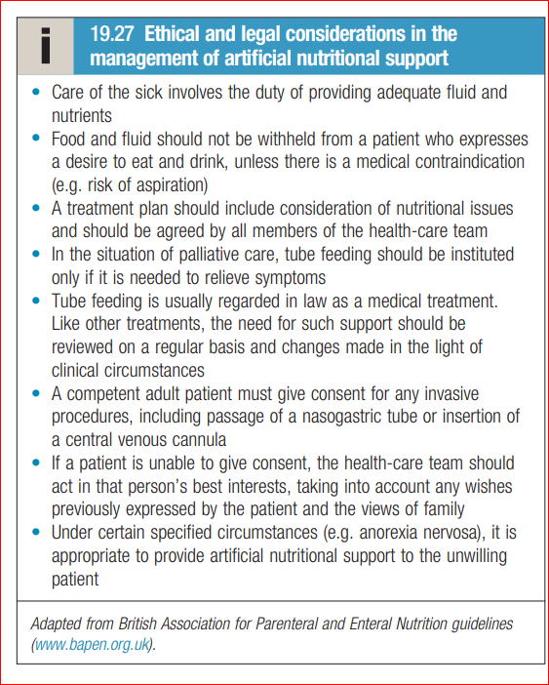
Artificial nutrition at the end of life

Slide 63
Double Effect
The most important point here is the “Intention”.
The doctrine of double effect states that a harmful effect of treatment, even resulting in death, is permissible if it is not intended and occurs as a side effect of a beneficial action.

Slide 64
In terminally ill patient in severe pain and distress may receive medication, which has known harmful side effect.
However, our intention is to provide relief from severe pain and distresses long, as there is a balance.
And the benefit in that case outweighs the harm.

Slide 65
Summary
Palliative care is a crucial part of integrated, people-centred health services.
Globally only 14% of patients who need palliative care receive it.
It is based on needs and not on diagnosis.
It is required in both non malignant and malignant diseases and may be applied to any chronic disease state.
● Aim of end of life care is quality of care and quality of life not to prolong or shorten life.

Slide 66


Slide 67


