Slide 1
Fundoscopic findings and differentials
DR.SAJIB KUMAR SARKAR
REGISTRAR
DEPARTMENT OF MEDICINE
RANGPUR MEDICAL COLLEGE HOSPITAL

Slide 2
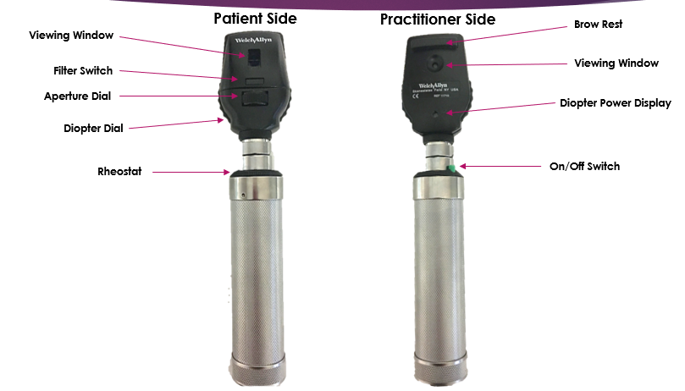
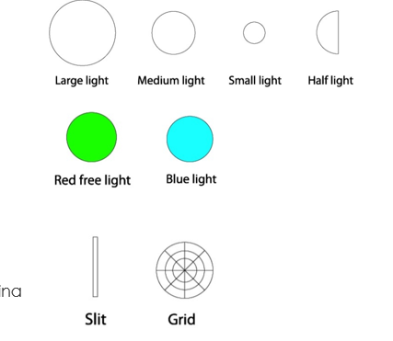
Parts of opthalmoscope

Slide 3
What we look for
Optic disc
Color
Margine
Cup : Disc
Neovascularization
Blood vessels
Arterioloar / Venous crossing
Spontaneous arteriolar palsation
Spontaneous venous palasation

Slide 4
What we look for
Retina
Different colors and appearance
Macula

Slide 5
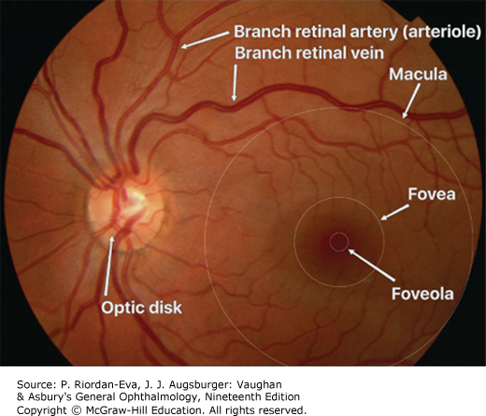
Normal findings

Slide 6
Normal features
Optic disc:
Located nasal to geometric axis, pale pink in color, circular in shape, regular edge.
Cup disc ratio : 0.3-0.5
Vessels :
Vein : darker and wider
Artery: Less dark, thin, central reflex is wide
Macula : 2 Disc diameter temporal to the edge of optic disc. The major branch retinal vessels define the boundaries of the macula.
A small pinpoint white reflection or “reflex” marks the central fovea. This is surrounded by a more darkly pigmented and poorly circumscribed area called the foveola.

Slide 7
How to describe
On opthalmologic examination of this gentle man/woman reveals
Fundal glow/Red reflex present
Disc is.......
Cup disk ratio (C:D) ....
Vessels count.....
If exudates or haemorrhage present : Theres is multiple/single hard/soft exudate/haemorrhage present on …….. O’ Clock position, 1/2 disc diameter nasal/temporal to the edge of disc on right/left eye. Macula is normal/abnormal.
Any other finding if present then describe like A/V nipping, roth’s spot with position.

Slide 8
Retinal abnormality in the form of different colors
White
Cotton wool spot
Chorioretinal atrophy
Yellow
Hard exudates
Drusen

Slide 9
Retinal abnormality in the form of different colors
Red
Microaneurysms
Blot haemorrhage
Deep large haemorrhage
Flame haemorrhage
Black
Retinal pigment hypertrophy

Slide 10
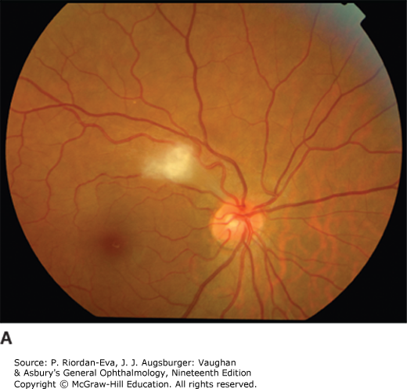
Findings :
Cotton-wool spot located at 9 o’clock position, about one and half disc diameter temporal to the edge of disc

Slide 11
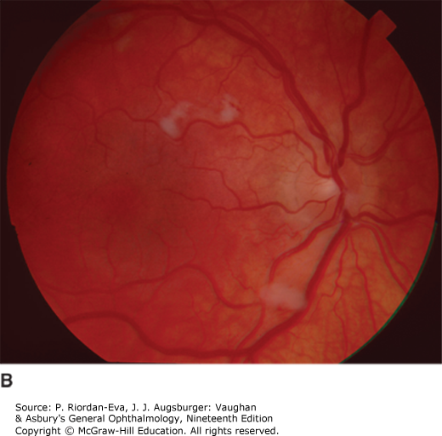
D/D:
Malignant hypertension
Central retinal vein occlusion
Central retinal artery occlusion
Occasionally DM
Severe anaemia
SLE
Leukaemia
Human immunodeficiency virus infection.
Giant cell arteritis.

Slide 12
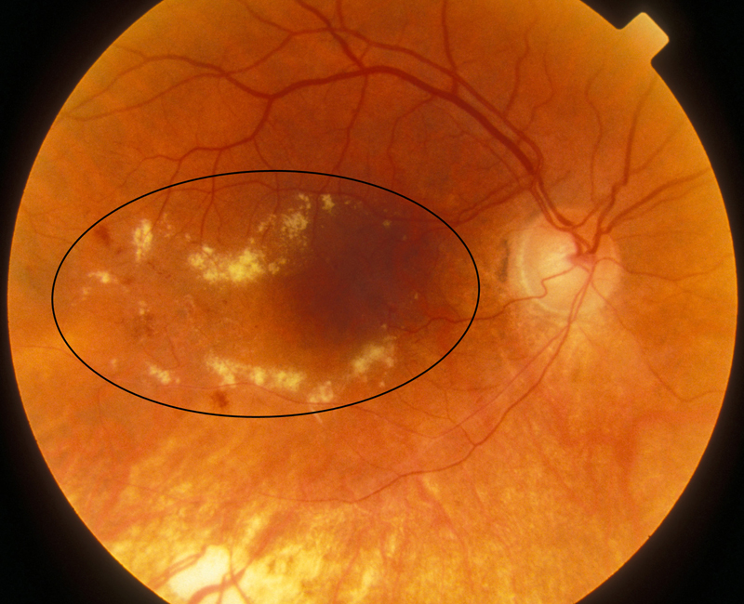
Findings:
Hard exudates at 7,8,9 o’clock position, one and half DD temporal to optic disc.
D/D :
Diabetic retinopathy
Hypertensive retinopathy
Choroidal neovascularization

Slide 13
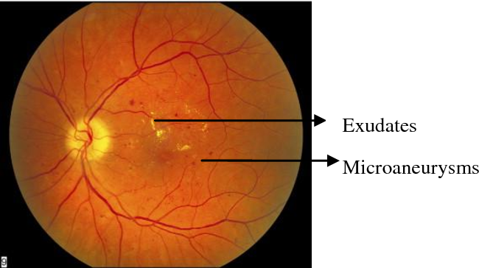
Findings:
Microaneurysm of capillaries at 2,3,4,10 o’clock position, one DD temporal to edge of disc.
Also there is hard exudate
D/D :
Diabetic retinopathy
Hypertensive retinopathy
Atherosclerosis
SLE
Polyarteritits nodosa
Sickle cell anaemia
Leukaemia

Slide 14
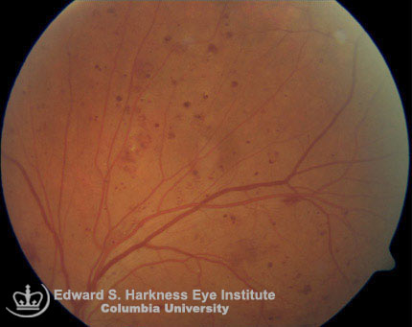
Findings:
Multiple dot and blot haemorrhage scattered throughout the retina.
D/D :
Diabetic retinopathy
Hypertensive retinopathy
CRVO
Peripapillary hemorrhage in patients with normal tension glaucoma

Slide 15
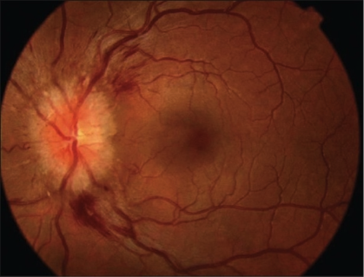
Findings:
Flame shaped haemorrhage on 8 and 10 o’clock position, at temporal side and adjacent to optic disc.
D/D :
Hypertensive retinopathy
Retinal vein occlusion
NPDR
Retinal vasculitis
Concussion trauma
Blood dyscrasia

Slide 16
Scenario and findings

Slide 17
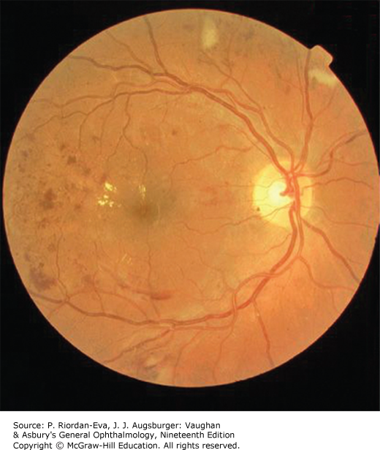
A 62 years old man with DM for 12 years presents with raised blood glucose level for last 3 months in spite of intensive diet and exercise.
He is taking glimepiride 4 mg and metformin 1.5 gm daily.
He also complaints of numbness and tingling sensation of both hands and feet and blurring of vision.
His fundoscopy ….

Slide 18
Findings:
Microaneurysm at 9,10,12 o’clock, cotton wool exudate at 2, 12 o’clock, hard exuadate at 9 o’clock, flame haemorrhage at 7,8,9 o’clock position.
No neovascularization
No AV nipping
Optic disc is normal
Dx:
Non proliferative diabetic retinopathy
D/D:
Hypertensive retinopathy (III)
CRVO
Blood dyscrasia

Slide 19
Typical findings of Diabetic retinopathy
Microaneurysms
Dot haemorrhage
Venous beading
Cotton wool spot
Hard exudate
Flame shaped haemorrhage
Exudative maculopathy
Neovascularization and fibrous proliferation

Slide 20
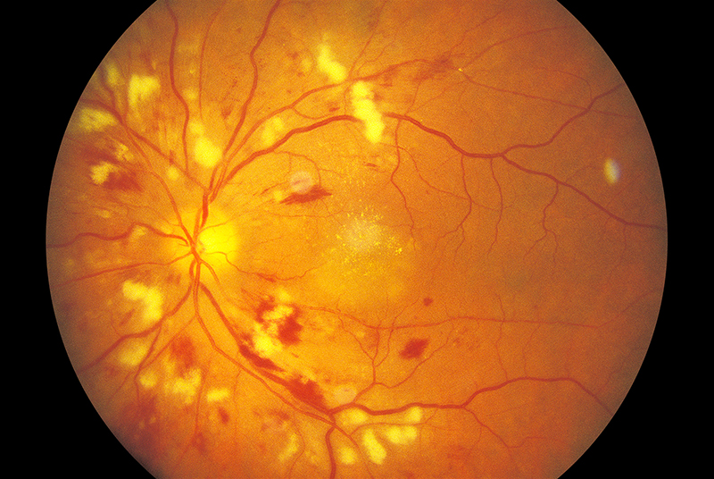
52 years old non diabetic man presented with elevated blood pressure for 3 months. He is hypertensive for 10 years.
Fundoscopy….

Slide 21
Findings:
Multiple cotton wool exudates and flame shaped haemorrhage at 6,7,8,9,10,12 o’clock position, hard exudates at macula.
Arterio-venous nipping at 6 o’clock position
Optic disc is normal
No neovascularization
No microaneurysm
Dx:
Hypertensive retinopathy (III)

Slide 22
D/D:
NPDR
CRVO
Blood dyscrasia
SLE

Slide 23
Typical findings of hypertensive retinopathy
Arteriolar thickening, tortuosity, Increased reflectiveness
Arterio-venous nipping
Cotton wool exudates, flame shaped or blot haemorrhage
Papilloedema

Slide 24
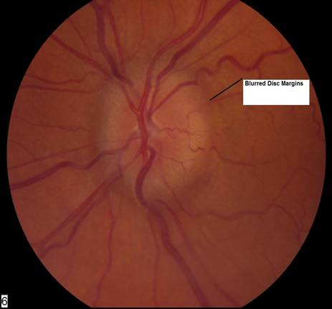
A young obese normotensive, non-diabetic lady presented with buzzing in the left ear for 3 months, headache and diplopia for 2 months. He had a history of single episode of convulsion.
On examination there is bradycardia and raised BP.
MRI of the brain shows an abnormality in frontal lobe.
Fundoscopy shows…..

Slide 25
Findings:
Optic disc swollen, margin is blurred.
No abnormality in retina and blood vessels.
Dx:
Papilloedema due to ICSOL
D/D:
Idiopathic intracranial hypertension
Cerebral venous sinus thrombosis

Slide 26
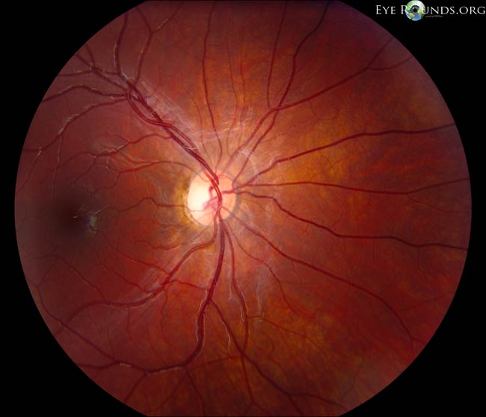
A 35 years old non diabetic, normotensive lady came to Neurology clinic with progressive weakness and stiffness of both lower limbs, unsteady gait and lost of vision for 10 days. She has occasional nocturnal enuresis and had a history of an episode of visual loss 5 months back for which she visited doctor but found nothing abnormality in her eye. She also had several bad falls.
MRI revealed a multifocal white matter disease - areas of increased T2 signal in both cerebral hemispheres. Spinal tap revealed the presence of oligoclonal bands in CSF.
Fundoscopy of this patient is supplied.

Slide 27
Findings:
Optic disc : Pale
Margine : Clear
Reduction of number of capillaries in the disc
Dx:
Primary optic atrophy due to Multiple sclerosis

Slide 28
D/D:
Friedreich ataxia
ICSOL
Neurosarcoid

Slide 29
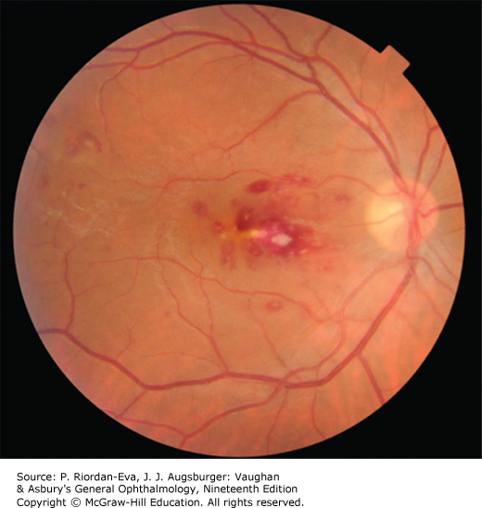
A 25 years old male with known rheumatic mitral valve disease has presented with fever, night sweat, arthralgia, weight loss and breathlessness for the past 2 months.
On auscultation of precordium there is a mid diastolic murmur,.
Auscultation of chest there is bi-basal fine crepitation.
There is mild splenomegaly.
Fundoscopy of this patient is….

Slide 30
Findings:
Red with white-centered retinal hemorrhages located approximately one disc diameter temporal to the edge of the disc .
Dx:
Roth’s spot due to infective endocarditis
D/D:
Leukaemia
SLE

Slide 31
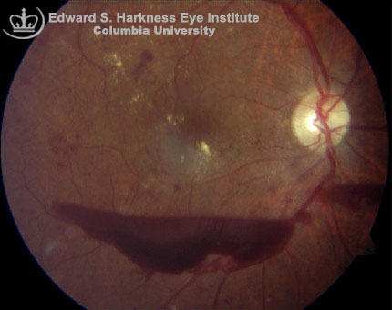
A 45 years old hypertensive woman developed sudden severe thunderclap headache with vomiting for several times 3 days back when she was quarreling with her neighbor.
Admission BP 150/90 mm Hg.
Fundoscopy reveals….

Slide 32
Findings:
Haemorrhage with cresentric shape or upward concavity.
Dx:
Subhyaloid haemorrhage due to SAH
D/D:
Blood dyscrasia
Trauma
Hypertension
DM

Slide 33
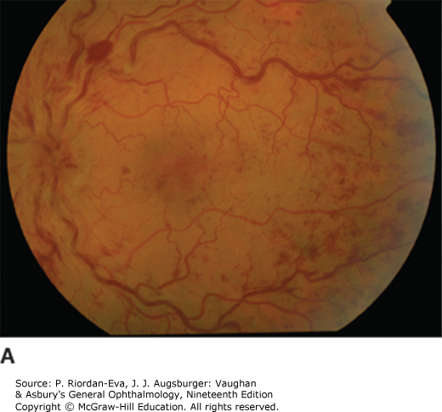
A middle aged male presented with painless loss of vision in his left eye.
No H/O fever, arthralgia, weight loss.
Bony tenderness is absent.
He is hypertensive, non diabetic.
His BP is 160/95 mm Hg.
Fundoscopy of this patient….

Slide 34
Findings:
Dot, blot and flame shaped hemorrhage in all four quadrants
Dilated tortuous veins
Optic disk edema.
Dx:
Central retinal vein occlusion

Slide 35
D/D:
Hypertensive retinopathy
Atherosclerosis
Hyperviscosity syndrome
Hypercoagulable state
SLE

Slide 36
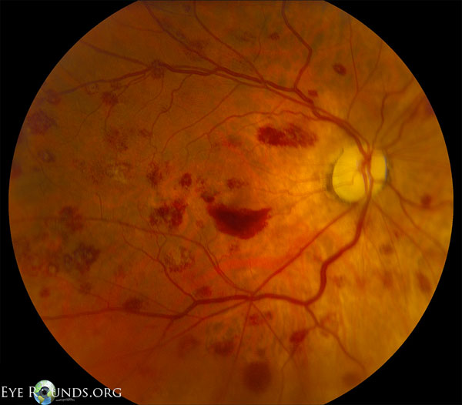
25 years old male presented with fever, gum bleeding and muco cutaneous bleeding.
He has bone tenderness.
Fundoscopy reveals…
many central and paracentral superficial hemorrhages, some with a white center (Roth spots). No macular edema
Dx:
AML

Slide 37
miscellaneous

Slide 38
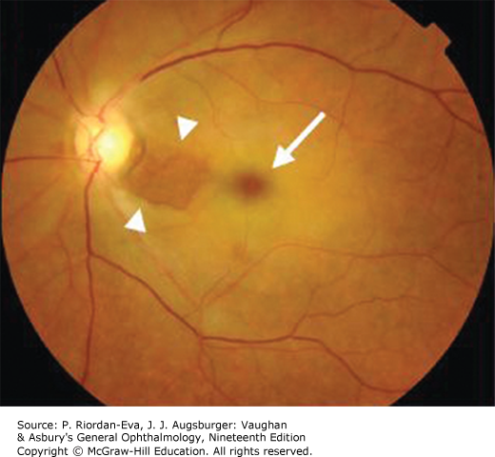
Findings:
Retina is pale
Aarterioles are thin and scanty
There is a cherry red spot at the macula
Dx:
Central retinal artery occlusion
D/D:
Hypertension
DM
Atherosclerosis
GCA

Slide 39
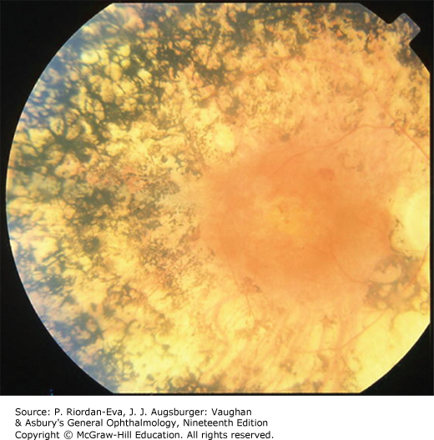
Findings:
Multiple areas of black pigmentation like bone spicules with varriable size and shape, some are criss cross pattern, at the periphery of fundus.
Arteriolar narrowing.
Macula is normal.
No haemorrhage or exudates.
Dx:
Retinitis pigmentosa
D/D:
Choroido- retinitis
Lasser photocoagulation scar

Slide 40
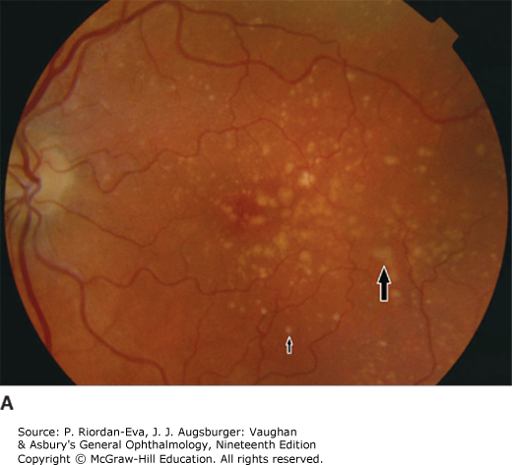
Findings:
Multiple discrete, round, pale yellow dots of variable size and shape scattered around the macula.
Dx:
Drusen

Slide 41
question

Slide 42
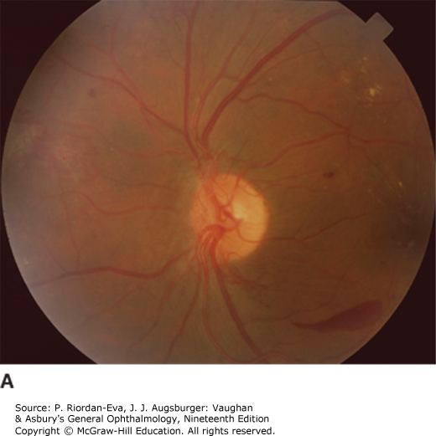
Problem 1
A) 3 positive findings?
B) What is the Dx?
C) Mention 6 relevent investigations?
D) Treatment?

Slide 43
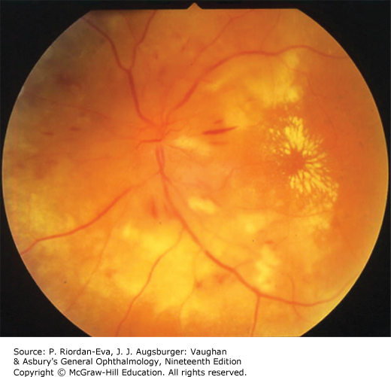
Problem 2
A) 4 positive findings?
B) What is the diagnosis?
C) What clinical signs you look for?
D) Mention 6 investigations for aetiological diagnosis.
E) Name 3 pathophysiological changes leading to these retinal characteristics.

Slide 44
Reference
Vaughan & Asbury's General Ophthalmology, 19e
Davidson’s Principles and Practice of Medicine, 23e
Internet

Slide 45


