Slide 1
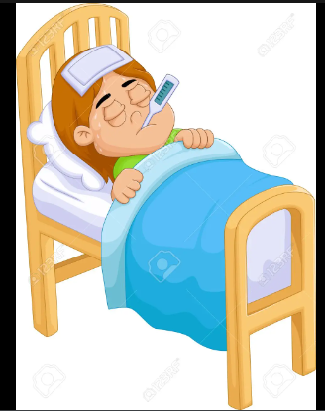
FEVER:
Still To Be Known
DR. RUKHSANA HOSSAIN
MD STUDENT , THESIS PART
DEPT. OF MEDICINE , RpMCH

Slide 2

Scenario- 1

Slide 3
A 20 year old young girl presented with fever , vomiting , frequency of micturition for 7 days
O/E :
Temp.- 101°F
Pulse – 120/min
BP – 100/60 mm of Hg
Investigation profile :
CBC- Neutrophilic leucocytosis
Urine R/E – Pus cell : plenty

Slide 4
Scenario- 2

Slide 5
A 44 year old man with fever for 7 days , cough for same duration & shortness of breath for 4 days
O/E :
patient is ill dyspnic
Temp. 100° F
Pulse 102 / min
R. R – 28/ min
SPO2 – 78 % on air
Investigation profile:
CXR P/A VIEW : bilateral peripheral consolidation
CBC- Lymphopenia ,high ESR
CRP – 170 mg/L

Slide 6
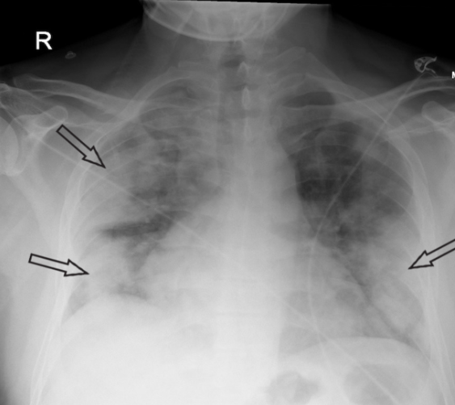
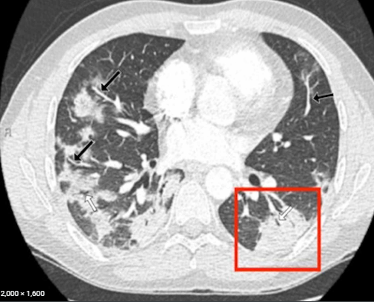

Slide 7
Scenario- 3

Slide 8
A 28 years old young women presented with fever 2 months, multiple joint pain for same duration, with recurrent oral ulcer & hair loss
O/E :
Patient is ill looking
Temp. 101°F
BP – 100/60 mmHg
Malar rash ,discoid rash
Joint are swollen & tender
Investigation profile :
CBC – Pancytopenia ,high ESR
CRP- Normal
ANA – Positive
Anti-DS DNA Ab - Positive

Slide 9
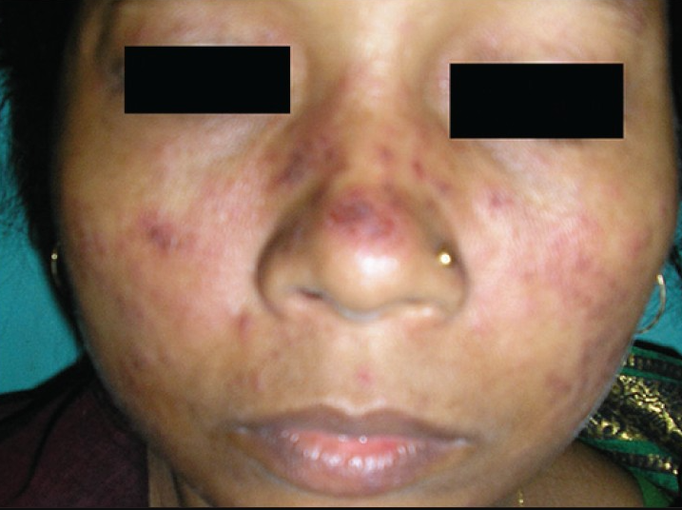

Slide 10
Scenario- 4

Slide 11
A 50 year old man with fever for 3 months , Low back pain for 2 months , loss of appetite for same duration
O/E :
Patient is irritable
Temp. 103 °F
Anaemia – moderate
Bony tenderness - present
Investigation profile
CBC : Hb- 6 gm /dl , ESR 120 mm in 1st hour
PBF – Anaemia with rouloux formation
S. Creatinine – 3.2 mg/dl
X-RAY Skull – multiple lytic lesion

Slide 12
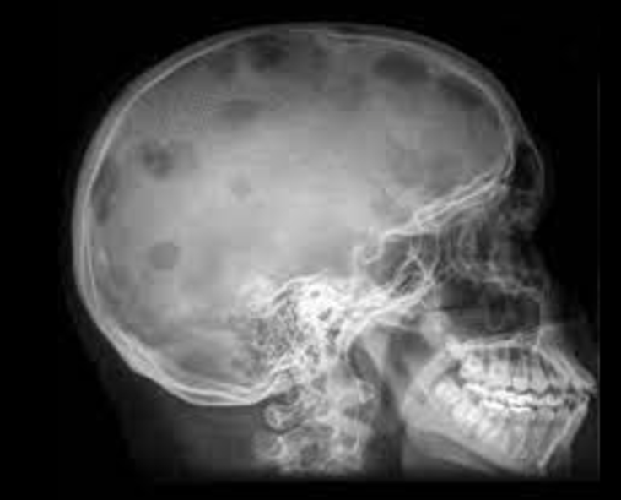
Notes:
Other causes of osteolytic lesion –M. myeloma , 2ndaries , lymphoma , hyperthyroidism , lymphoma ,histiocytosis X , Gaucher’s disease , fibrous dysplasia

Slide 13


Slide 14
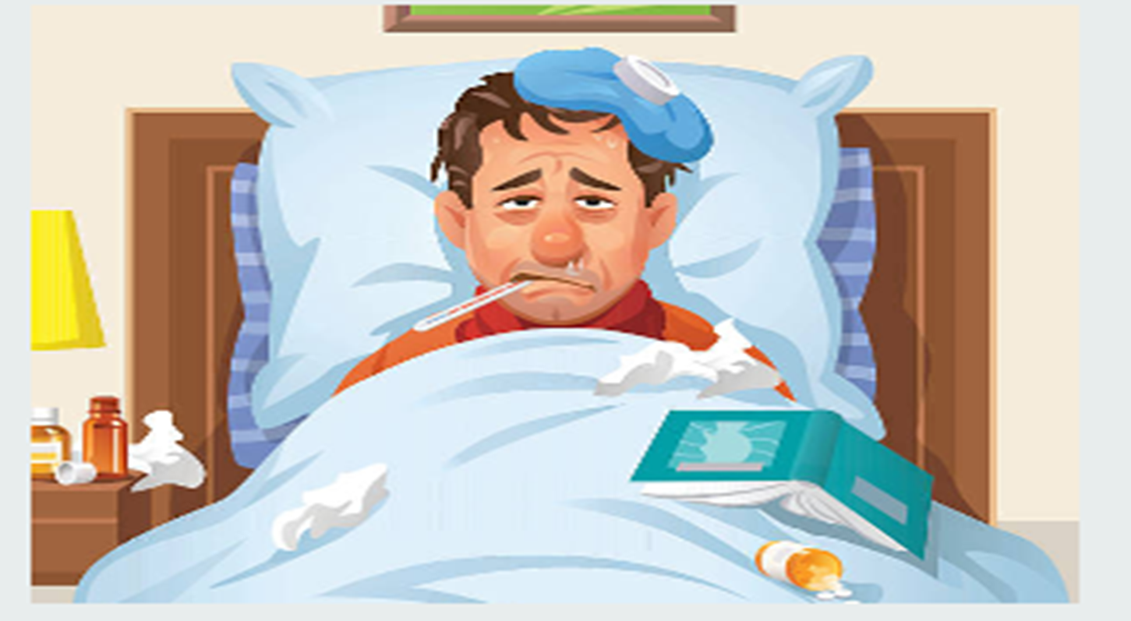
FEVER

Slide 15
Introduction
Fever itself is not a disease
  but it is the hallmark manifestation of many diseases
    in response to infection or inflammation
Notes:
A normal body temp. is maintained by the hypothalamic thermo-regulatory setpoint

Slide 16
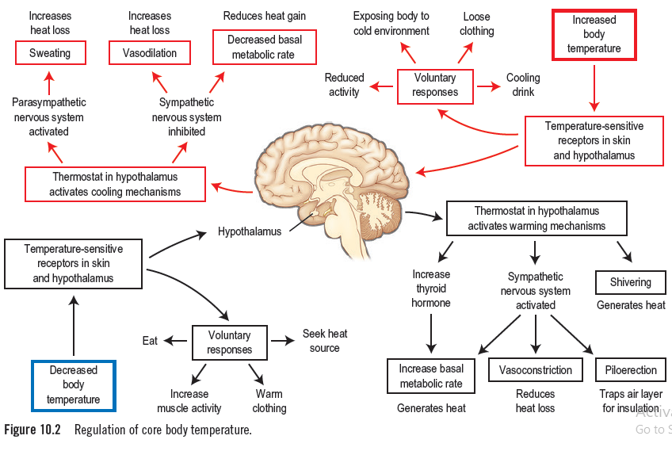

Slide 17
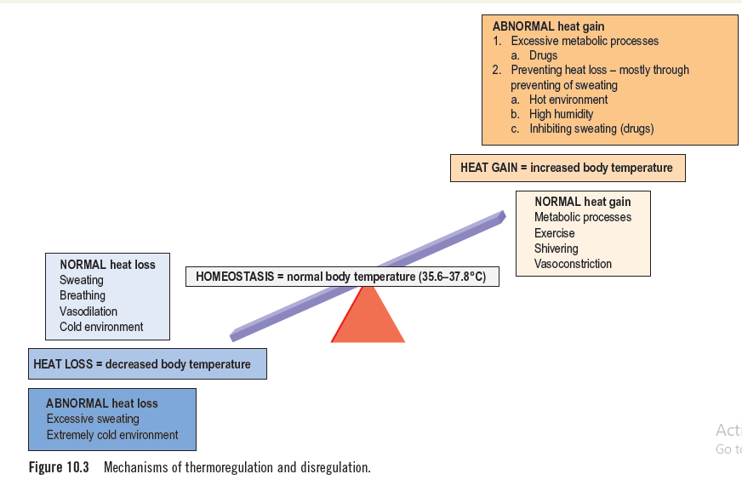

Slide 18
The normal core temperature varies with some characteristics
Time of the day (known as diurnal variation),
Age,
Gender,
Height,
Time in the menstrual cycle,
Exercise and meals.

Slide 19
Normal body temperature
In 18–40 years of age,
The mean oral temperature (97.5 - 98.9° F ),
6 A.M- 97.5 ° F
4-6 P.M.- 98.9° F
The maximal normal oral temperature
6 A.M. - 98.9 °F
4 P.M. - 99.9 °F
REFERENCE : HARRISON’S PRINCIPLES OF INTERNAL MEDICINE, 20th edition

Slide 20
Rectal temp. are generally 0.7°F higher than oral
( 98.2-99.6°F )
Tympanic membrane values are 1.6°F lower than rectal
( 96.6-98 °F )
REFERENCE : HARRISON’S PRINCIPLES OF INTERNAL MEDICINE , 20th edition

Slide 21
In women who menstruate
A.M. temperature is lower during the 2 weeks before ovulation.
1°F rises with ovulation &
persist this level until menses occur.
REFERENCE : HARRISON’S PRINCIPLES OF INTERNAL MEDICINE , 20th edition

Slide 22
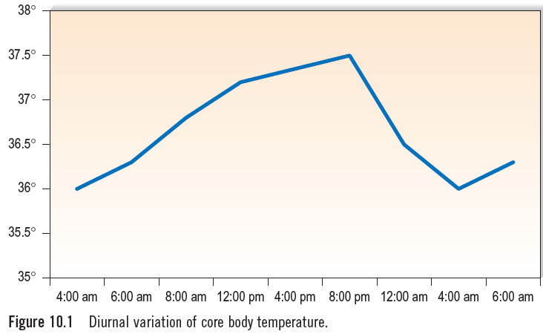
Reference : Hutchison’s clinical methods , 24th edition

Slide 23
What happens if the hypothalamic set point is elevated
Fever?
Hyperpyrexia?

Slide 24
Fever
Elevated body temperature above the upper limit of normal range
Must increase in the hypothalamic set point (e.g. 97.5°F - 98.9° F )
REFERENCE : HARRISON’S PRINCIPLES OF INTERNAL MEDICINE ,20th edition

Slide 25
FEVER | HYPERPYREXIA | HYPERTHERMIA
Fever is an elevation of body temp. that exceeds normal daily variation & occurs in conjunction with an increase in the hypothalamic set-point Occurs in response to pyrogens Hypothalamic thermo-regulatory set point is elevated Anti-pyretics reduce body temperature | Hyperpyrexia is a fever of >106°F Occurs in response to pyrogens Hypothalamic thermo-regulatory set point is elevated Anti-pyretics reduce body temperature | Hyperthermia is an uncontrolled increase in body temp. that exceeds the body’s ability to lose heat Occurs due to excess heat production or excess exogenous heat. No role of pyrogens Hypothalamic thermo-regulatory set-point remain unchanged Anti-pyretics doesn’t work
Notes:
Physical cooling with sponging, fans ,coolong blankets , even ice baths with i.v fluids .internal cooling can be achieved by gastric or peritoneal lavage with iced saline

Slide 26
Hypothalamic fever
Elevated temp. caused by abnormal hypothalamic function
Most patients with hypothalamic damage have subnormal , not supra-normal body temp.
E.g. Local trauma
Haemorrhage
Tumour
Intrinsic hypothalamic malfunction
REFERENCE : HARRISON’S PRINCIPLES OF INTERNAL MEDICINE ,20th edition

Slide 27
Conditions with infection but fever may not be present
Newborns
Elderly patients
Patients with CKD / CLD
Patients taking glucocorticoids
Patients being treated with anti-cytokine therapy
REFERENCE : HARRISON’S PRINCIPLES OF INTERNAL MEDICINE ,20th edition

Slide 28
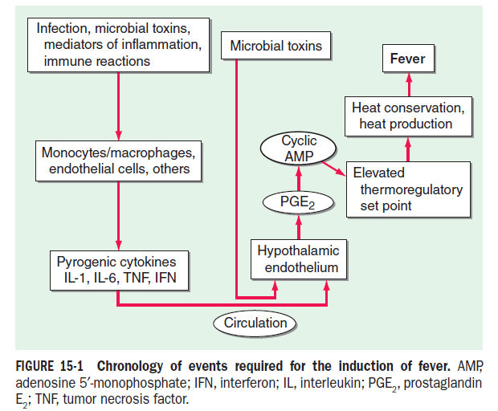
REFERENCE : HARRISON’S PRINCIPLES OF INTERNAL MEDICINE , 20th edition
Notes:
Myeloid and endothelial cells are the primary cell types that
produce pyrogenic cytokines. Pyrogenic cytokines such as IL-1, IL-6,
and TNF are released from these cells and enter the systemic circulation.
Although these circulating cytokines lead to fever by inducing
the synthesis of PGE2, they also induce PGE2 in peripheral tissues. The
increase in PGE2 in the periphery accounts for the nonspecific myalgias
and arthralgias that often accompany fever. It is thought that some
systemic PGE2 escapes destruction by the lung and gains access to the
hypothalamus via the internal carotid. However, it is the elevation of
PGE2 in the brain that starts the process of raising the hypothalamic set
point for core temperature.

Slide 29
Patterns of fever
1. Continuous fever
2. Step ladder fever
3. Intermittent fever
4. Remittent fever
5. Relapsing fever
Quotidian
Tertian
Quartan
6. Inverse fever
7. Night sweats
8. Temperature pulse dispariety
Reference : Hutchison’s clinical methods ,24th edition

Slide 30
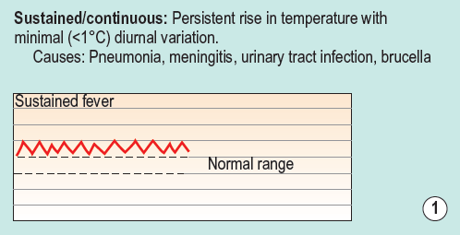
Pneumonia
Meningitis
UTI
Brucella
Reference : Hutchison’s clinical methods ,24th edition

Slide 31
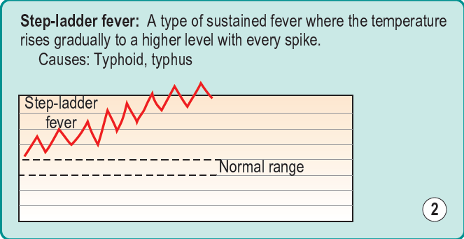
Where the temp. rises gradually to a higher level with every spike
Typhoid
Typhus
Reference : Hutchison’s clinical methods , 24th edition

Slide 32
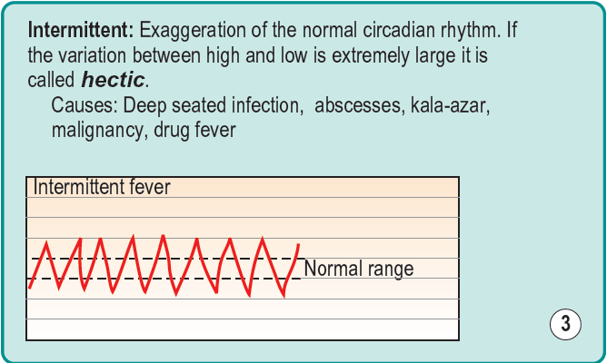
Fever present only for several hours during the day
Deep seated infection
Abscesess
Kala-azar
Malignancy
Drug fever
Reference : Hutchison’s clinical methods ,24th edition

Slide 33
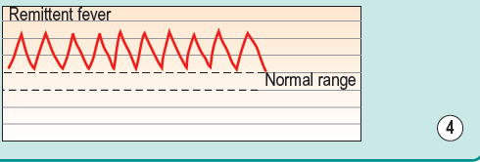
Temp. fluctuation is >2°C & never touches the baseline
Tuberculosis
Infective endocarditis
Many viral and bacterial infections
Reference : Hutchison’s clinical methods ,24th edition

Slide 34
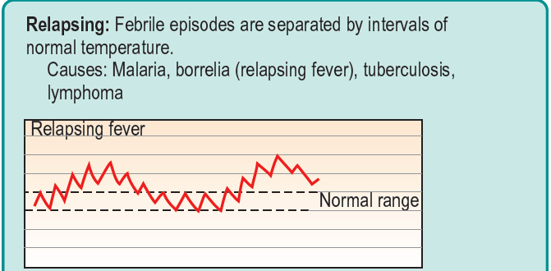
Malaria
Relapsing fever
Tuberculosis
Lymphoma
55
Reference : Hutchison’s clinical methods ,24th edition

Slide 35
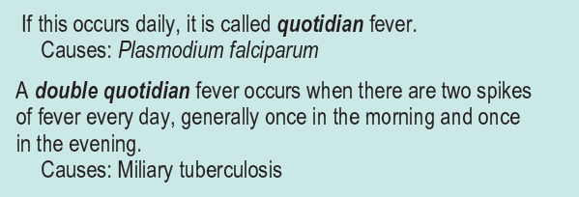
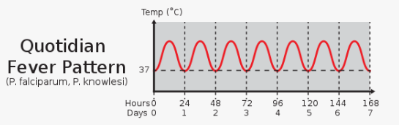
If fever occurs daily ,it is quotidian fever
Plasmodium falciparum
5
Reference : Hutchison’s clinical methods ,24th edition

Slide 36
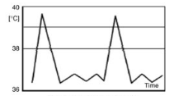
A double quotidian fever
two spikes of fever every day, once in the morning and once in the evening.
Miliary tuberculosis
8 A.M.
6 P.M.
Reference : Hutchison’s clinical methods ,24th edition

Slide 37
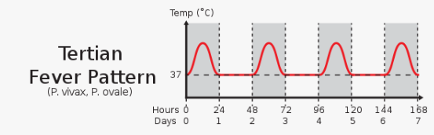
If fever occurs every 48 hours it is called tertian fever
Plasmodium falciparum
Plasmodium vivax,
Plasmodium ovale
Reference : Hutchison’s clinical methods ,24th edition

Slide 38
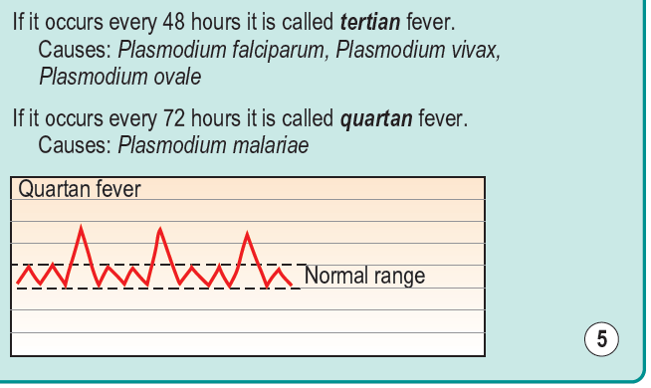
If fever comes in every 72 hours , it is quartan
Plasmodium malariae
Reference : Hutchison’s clinical methods ,24th edition

Slide 39
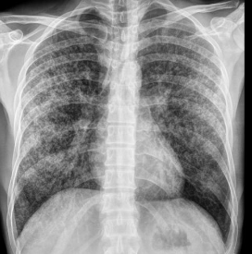
Inverse fever: The temperature rises in the early hours of morning rather than in the evening
Some cases of military tuberculosis
Reference : Hutchison’s clinical methods, 24th edition

Slide 40
Night sweats:
Body temperature rises only in the evening or late at night when patient is woken up sweating
7
Tuberculosis
Leukaemia
Lymphoma
Autoimmune disorders
Reference : Hutchison’s clinical methods ,24th edition

Slide 41
Temperature-pulse disparity:
Counter-intuitive response of a slower pulse associated with a high fever
Typhoid fever.
Reference : Hutchison’s clinical methods, 24th edition
Notes:
Brucelosis, leptospirosis, some drug induced fever , factitious fever

Slide 42
Causes of fever
Infections
Non-infectious inflammatory diseases
Autoimmune inflammatory
Auto-inflammatory
Vasculitis
Malignancy
Miscellaneous causes such as drug reactions
Undiagnosed
Reference : Hutchison’s clinical methods, 24th edition

Slide 43
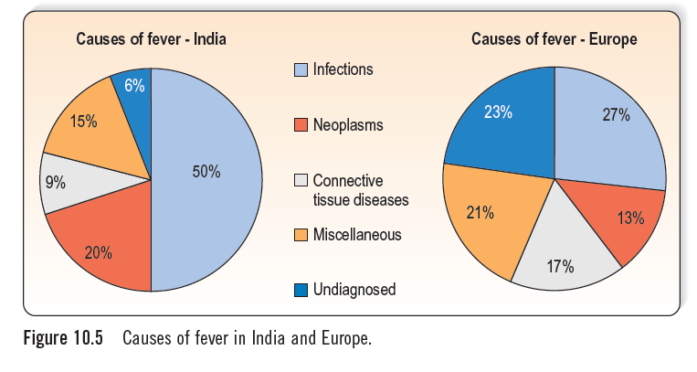
Reference : Hutchison’s clinical methods ,24th edition

Slide 44
Clinical evaluation
History
H/o presenting complaint
Personal history
H/o associated & constitutional symptoms
Physical examination
Past medical & surgical history
Systematic history

Slide 45
History of presenting complaint
Duration
Pattern of fever
Documentation
Worse in the morning or night
Onset of fever :
sudden
gradual
Associated symptoms
Subsidence

Slide 46
Personal history
Occupation , hobbies & sports
Living arrangements
Recreational habits : drug use or tattooes
Sexual habits : h/o unprotected extra-marital sexual exposure

Slide 47
Food habits –
Ingestion of un-pasteurized milk or cheese
Travel history –
Malaria endemic zone
Kala-azar endemic zone

Slide 48
Points should be kept in mind during giving description of FEVER
Primary description of fever
Etiological perspective
Systemic inquiry

Slide 49
Primary description of fever
“Fever for 10 days , which is intermittent ,high grade , highest recorded temp. was 104 °F ,more marked in the evening , comes with chills & rigor & subsided by taking anti-pyretics or spontaneously with profuse sweating.”

Slide 50
Etiological perspective
“There was no h/o travelling to malaria or kala-azar and dengue endemic zone or recent travel to abroad, He/she not IV drug or substances abuser and denies of sexual promiscuity”

Slide 51
Systemic enquiry
“There is no cough , chest pain , resp. distress , no h/o abdominal pain ,nausea or vomiting , they denied any history of frequency , urgency & burning sensation during micturition. No H/O joint pain and swelling”

Slide 52
Past medical and surgical history
Past medical history
IHD , HTN , DM ,COPD , Asthma , RHD ,TB
Immune compromises – history of HIV , medications like steroid or chemotherapy or history of splenectomy
History of recent hospitalization
Surgery, invasive procedures, medical devices, implants and transfusions

Slide 53
Systematic history
Respiratory tract
Sore throat , nasal discharge , sneezing- URTI
Sinus pain & headache – sinusitis
Cough , sputum , wheeze & breathlessness – LRTI

Slide 54
Genitourinary tract :
Frequency of micturition ,dysuria , loin pain & vaginal or urethral discharge suggesting
Urinary tract infection
Pelvic inflammatory disease
Sexually transmitted disease

Slide 55
Gastrointestinal system
Diarrhoea with or without blood , wight loss & abdominal pain suggests
Gastroenteritis
Inflammatory bowel disease
Intra abdominal sepsis
Malignancy

Slide 56
General examinations in patients with fever
Temperature –
Oral or ear temp. is preferred to axillary temp.
Pulse –
Tachycardia is characteristic
Every 1° rises in temp. Pulse rises 10 beats/min
Respiratory rate –
Every 1° rises in temp. Resp. rate rises 4 breaths/min

Slide 57
Blood pressure –
Hypotension – severe sepsis or septic shock
Jaundice –
Conjunctivae , nail bed , skin
Underlying haemolysis or liver disease
Eyes –
Localised eye infection or systemic
Roth spot – retina
Miliary tubercle - choroid

Slide 58
Ears –
External ear – otitis externa
Eardrum – otitis media
Mouth –
White lesion –oral thrush
Throat & tonsils - erythema & exudates
Ulcer – in & around the mouth
Dry mouth – non infectious inflammatory disease

Slide 59
Skin –
Rash, petechiae , redness , swelling
Open wounds , ulcer , bite marks , eschar
Intravascular devices or injection sites

Slide 60
Hands & nails –
Palms & nail beds : splinter haemorrhage
Scaly ,itchy lesion b/w fingers – scabies mites
Typical nail deformities – non infectious disease , psoriasis

Slide 61
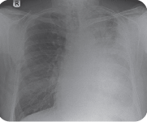
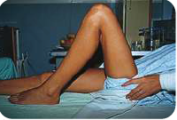
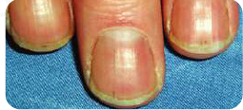
Common conditions that a patient with fever may present with

Slide 62
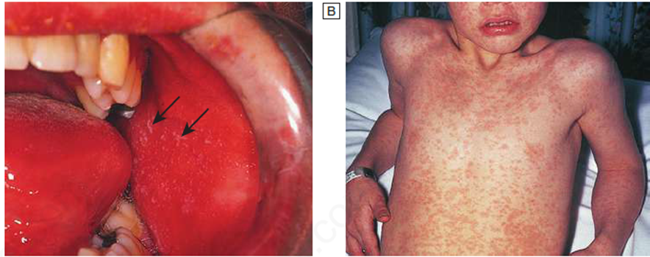
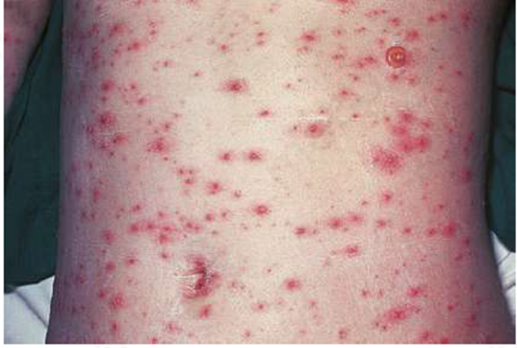

Slide 63
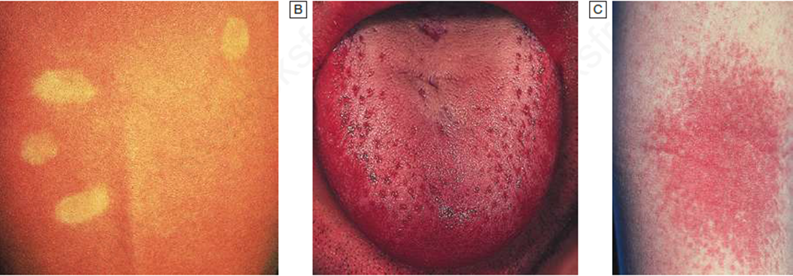

Slide 64
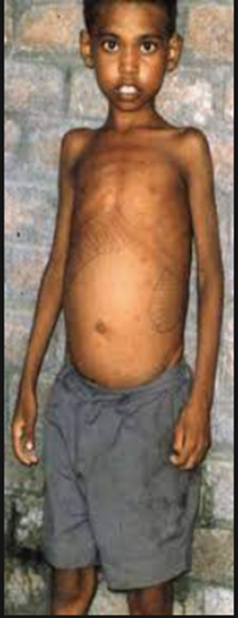
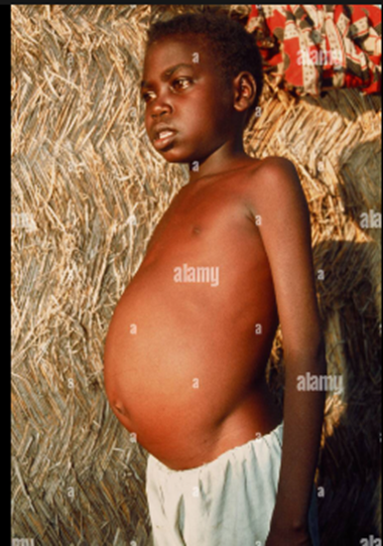
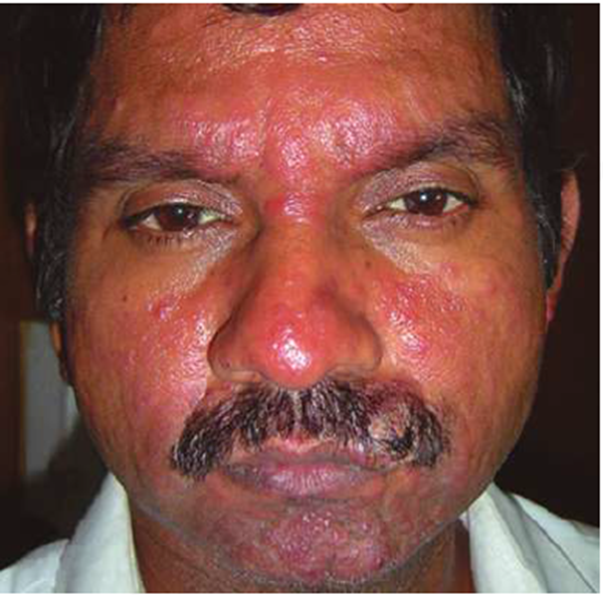

Slide 65
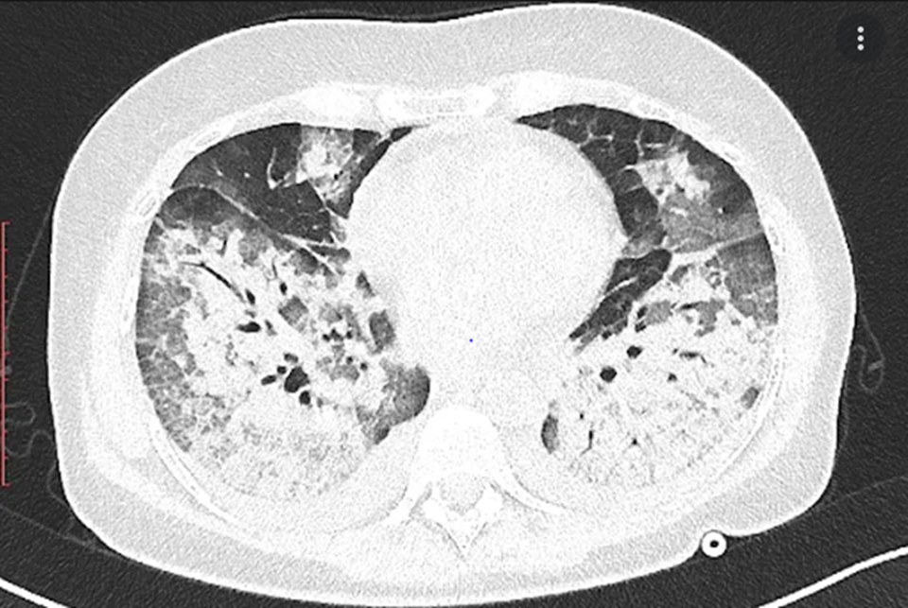
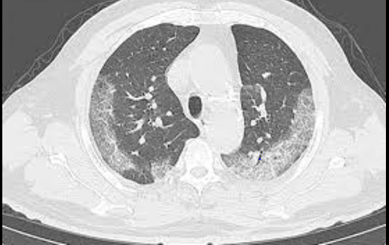

Slide 66
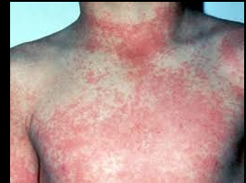
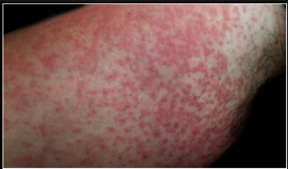

Slide 67
Investigations
Initial investigations :
FBC
Urea and electrolytes,
LFTs
Blood glucose
Muscle enzymes
ESR & CRP
Reference : Davidson’s principles & practice of medicine

Slide 68
Antibodies to HIV-1
Autoantibodies- (ANA)
Chest X-ray and ECG
Urine R/E and urine C/S
Blood culture
Throat swab for culture or PCR
Reference : Davidson’s principles & practice of medicine

Slide 69
Other specimens, as per history and examination,
e.g. wound swab;
sputum culture;
Stool culture , microscopy for ova and parasites
Clostridium difficile toxin assay
Reference : Davidson’s principles & practice of medicine

Slide 70
Specific tests and their priority
malaria films on 3 consecutive days or
malaria rapid diagnostic test
NS1 in dengue
Blood cultures for Salmonella Typhi
Abdominal ultrasound
Reference : Davidson’s principles & practice of medicine

Slide 71
Should you always treat a fever?
As fever is a physiological response of the body
it must have some inherent value
So is there a need to always be so quick to reduce it?

Slide 72
Benefits of having a high temperature
Increase in the phagocytic and bactericidal activity of neutrophils cytotoxic effects of lymphocytes
Impairment of the growth and virulence of bacteria
Survival benefit for individuals with an elevated body temperature in response to infection.

Slide 73
Negative effects of a raised body temperature
Oxygen consumption and fluid and calorie requirements increase
Increased metabolic activity can increase stress if organs are failing
Inflammatory cytokines increase muscle breakdown and
Fever can reduce mental acuity, cause delirium
Fever can trigger convulsions, especially in children.

Slide 74
Treat fever without delay
Pregnant women
Children
Impaired organ function
High temperature of >106.7°F

Slide 75
Treatment
Stabilization of hypothalamic set point
Facilitate heat loss.
Management of the underlying cause
Notes:
Reducing fever with antipyretics.also reduces headache , arthralgia, myalgia
Oral aspirin & NSAIDs can reduce fever but adverse effects

Slide 76
Pyrexia of unknown origin
Temp ≥ 38.0°C on multiple occasions
≥ 3 weeks,
without diagnosis,
despite initial investigation in hospital for 1 week.
Up to one-third of cases of PUO remain undiagnosed
Reference : Davidson’s principles & practice of medicine
Notes:
Subsets of PUO are-
HIV-1 related
Immune deficient
Nosocomial

Slide 77
Causes of PUO
Infections -30%
Malignancy -20%
Connective tissue disorder – 15%
Miscellaneous – 20%
Idiopathic – 15%
Reference : Davidson’s principles & practice of medicine

Slide 78
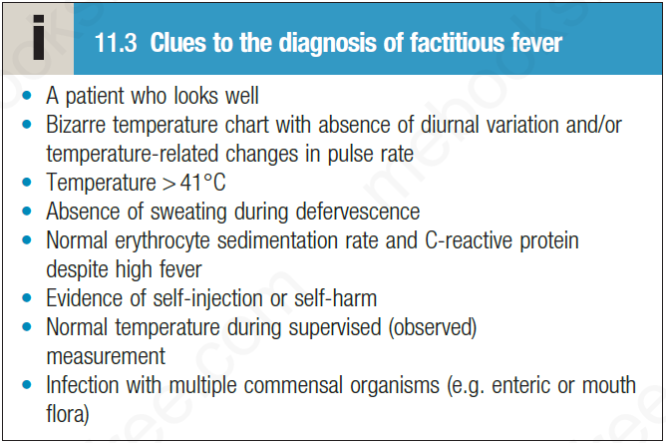
Factitious fever
Reference : Davidson’s principles & practice of medicine

Slide 79
Fever with rash
“Very sick person must take double egg” 1st day – Varicella 2nd day – Scarlet fever 3rd day – Small pox 4th day – Measles , Rubella 5th day – Typhus 6th day – Dengue fever 7th day – Enteric fever

Slide 80
Fever with hepato-splenomegaly
Malaria Kala-azar Lymphoma CML Tuberculosis A . leukaemia SLE Adult still’s disease

Slide 81
Fever with jaundice | Fever , jaundice & unconsciousness
A.Viral hepatitis Leptospirosis Cerebral malaria Liver abscess Cholangitis Septicaemia Drug reaction | Cerebral malaria Fulminant hepatic failure Leptospirosis Septicaemia

Slide 82
Fever with bleeding
“MD eat VADKA” M- Malaria D – Dengue haemorrhagic fever V- Viral haemorrhagic fever A – A. leukaemia D – DIC / septicaemia K – Kala-azar A – Aplastic anaemia

Slide 83
Drug fever
Drug causes fever via several mechanisms
This is a diagnosis by exclusion
A rash is not always present or eosinophilia
Fever coincides with drug administration & disappears when drug discontinued
Risk factors :
Elderly patients
Active HIV infection
Cystic fibrosis
Notes:
Mechanism – hypersensitivity ,altered thermoregulatory mechanisms , directly related to the administration of drug, idiosyncracy

Slide 84
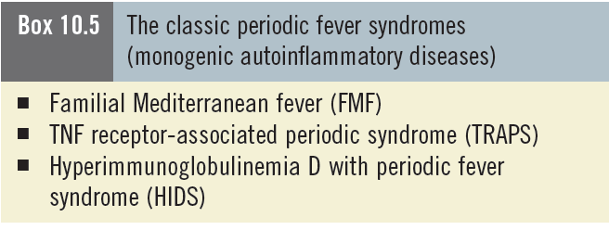
The classic periodic fever syndromes
(monogenic auto-inflammatory diseases)

Slide 85
Take home message
Fever is not a disease , but manifestation of many systemic diseases
Fever never occur without the elevation of the thermoregulatory set-point
Low grade fever or feverish feeling should be evaluated thoroughly with
Proper history
Physical examination
Necessary investigations

Slide 86

Thank You

