Slide 1
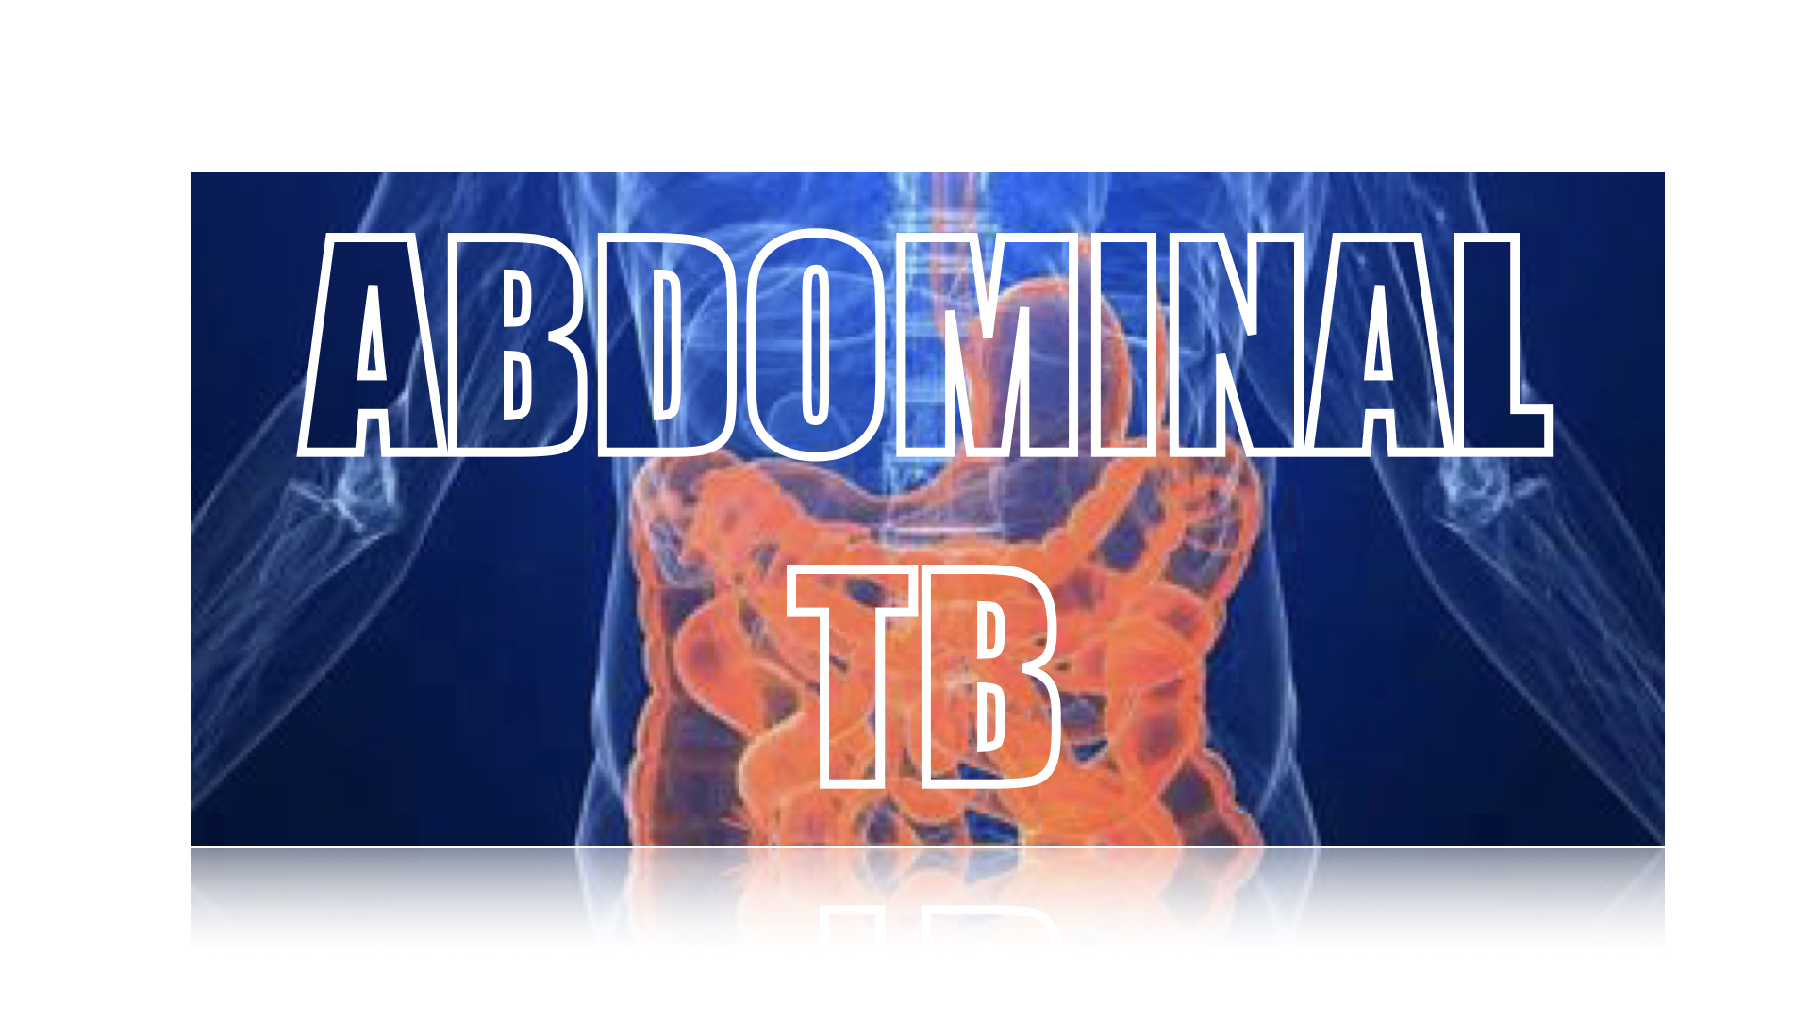
ABDOMINAL TUBERCULOSIS
Dr.Md.Mahmudul Hassan Mintu
Assistant Registrar,Medicine
Rangpur Medical College Hospital,Rangpur
2021

Slide 2
Scenerio
A 52 yrs old man presented with
Abdominal pain and swelling for 2 months
Fever for 1 month
Loss of weight for 1 month
On Examination:
Patient is anaemic,Ascites present,No organomegaly ,No Lymphadenopathy

Slide 3
Investigations reveals:
Hb% 9.0 gm/dl,ESR-80 mm at 1st hr,CRP-20
S.Albumin 2.5 gm/dl
Liver and Renal function –normal
Ascitic fluid study-Exudative,Protein >3.3 gm/dl,Lymphocyte >92%,ADA-48 U/L
USG of Abdomen-Thickened bowel wall,Ascites,Mesenteric thickening,Enlarged LN
Colonoscopy-Ulcerations,Mucosal nodules,deformed ileocaecal valve and mucosal oedema

Slide 4


Slide 5
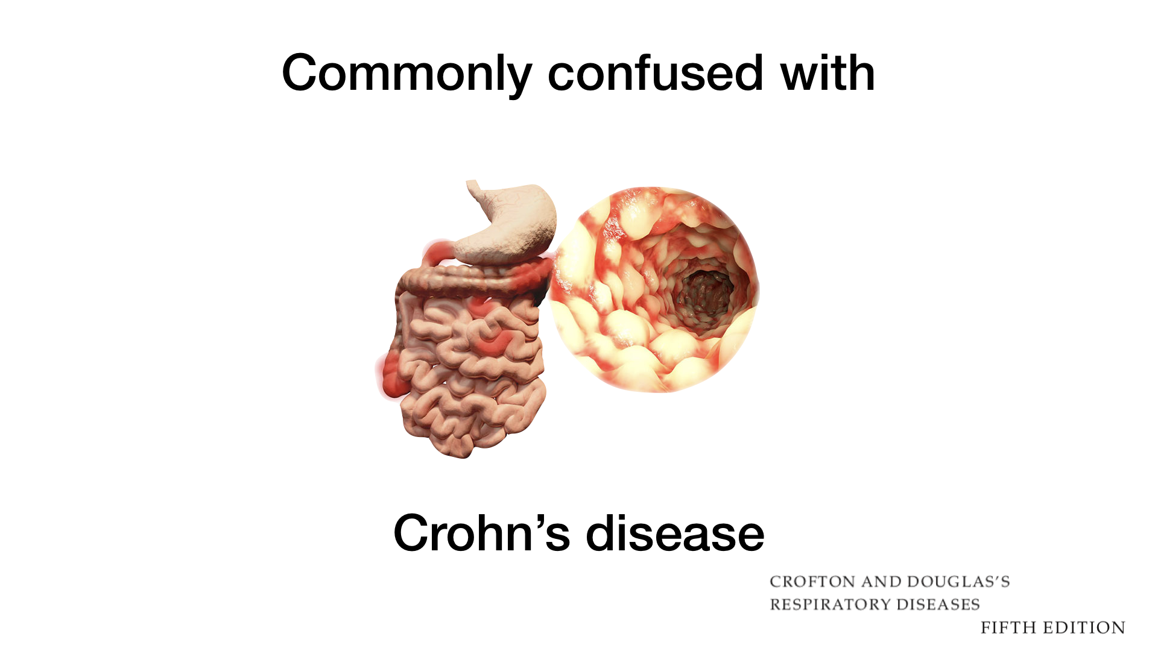

Slide 6
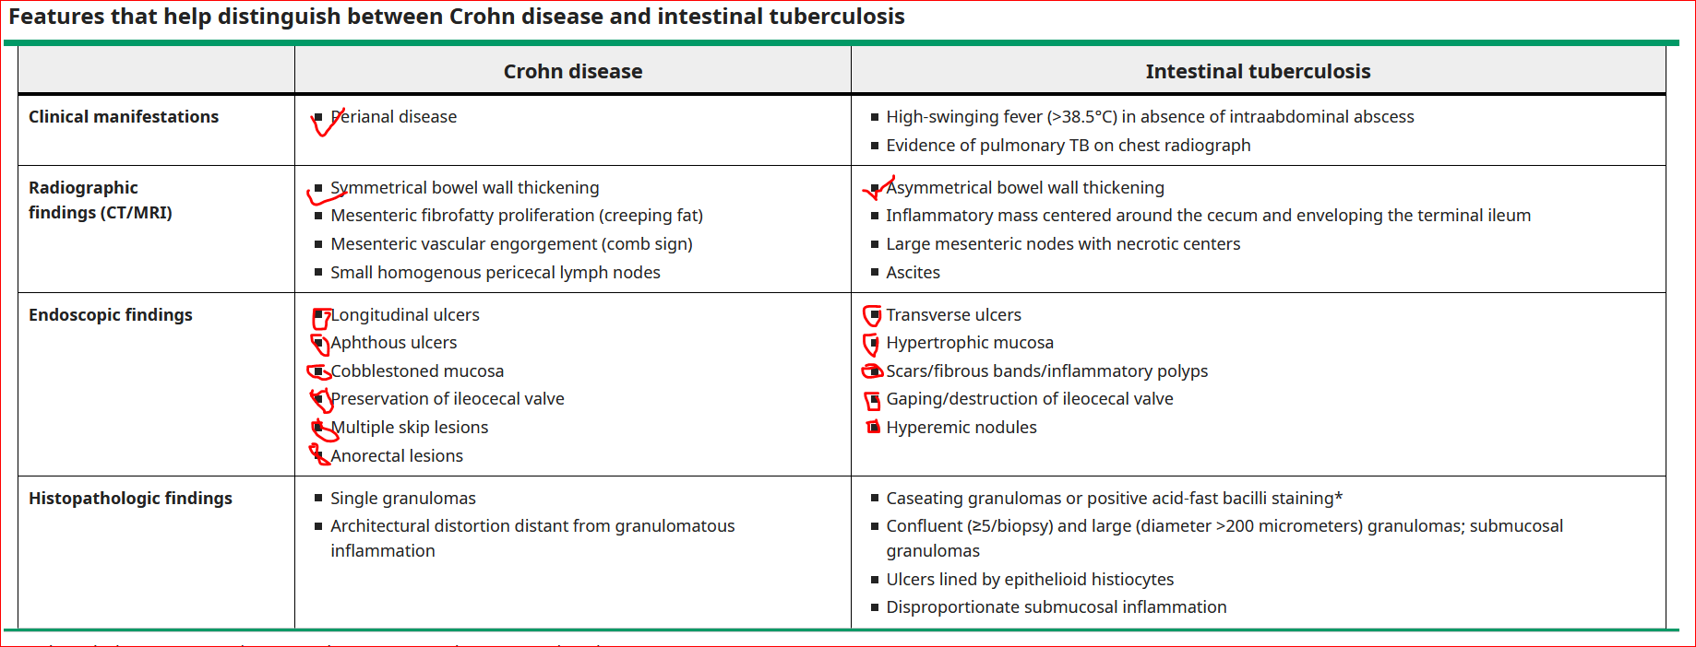

Slide 7
Abdominal Tuberculosis
Abdominal tuberculosis
the gastointestinal tract,
the peritoneum,
abdominal lymph nodes,
and solid organs in the abdomen(liver,pancrease,spleen).

Slide 8
common in developing countries,more frequently in poor socioeconomic condition.
Sixth most common type of extrapulmonary TB
accounts for 5% of the tuberculosis cases worldwide, out of which 1-3% is gastrointestinal tuberculosis.

Slide 9
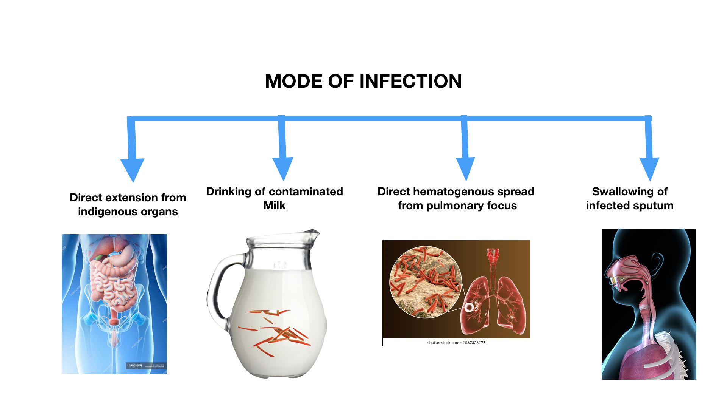

Slide 10
Risk factors(Abdominal TB)
Family history
Cirrhosis of liver
HIV Infection
DM
Malignancy
Anti-TNF-alfa
Peritoneal dialysis
Consumption of unpasteurizated milk

Slide 11
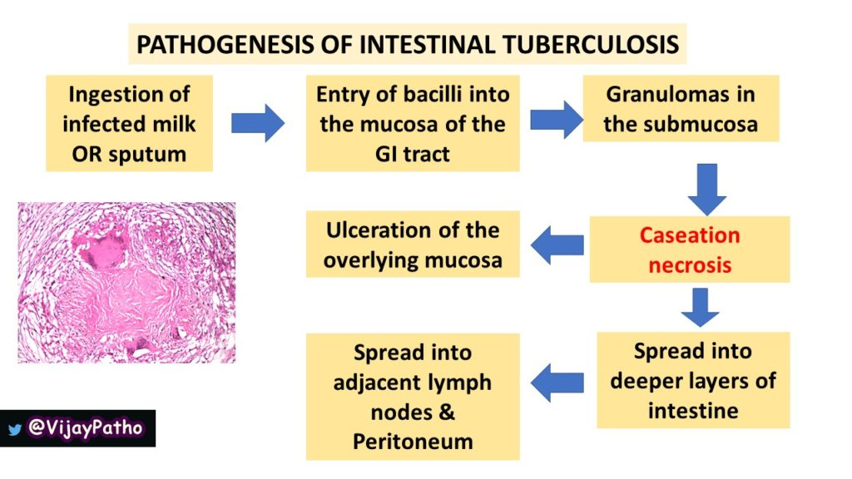
Pathogenesis

Slide 12
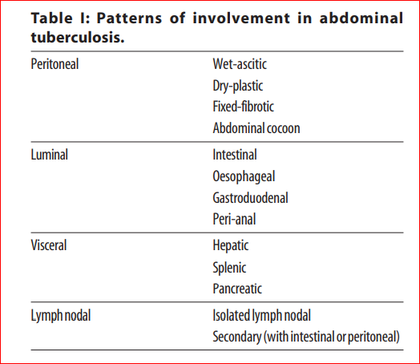
Types (Abdominal TB)
Abdominal Tuberculosis: Diagnosis and Management in 2018 Saurabh Dawra*, Harshal S Mandavdhare**, Harjeet Singh***, Vishal Sharma** Journal, Indian Academy of Clinical MedicinelVol. 18, No. 4 lOctober-December, 2017
:

Slide 13
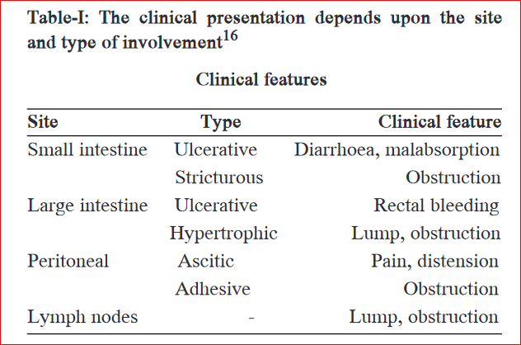
Clinical Features(Abdominal TB)

Slide 14
Intestinal Tuberculosis
accounts for 1% to 3 % of all TB cases worldwide.
can occur in the context of active pulmonary disease or as a primary infection without pulmonary involvement.
The ileocecal region is the most commonly affected site.

Slide 15
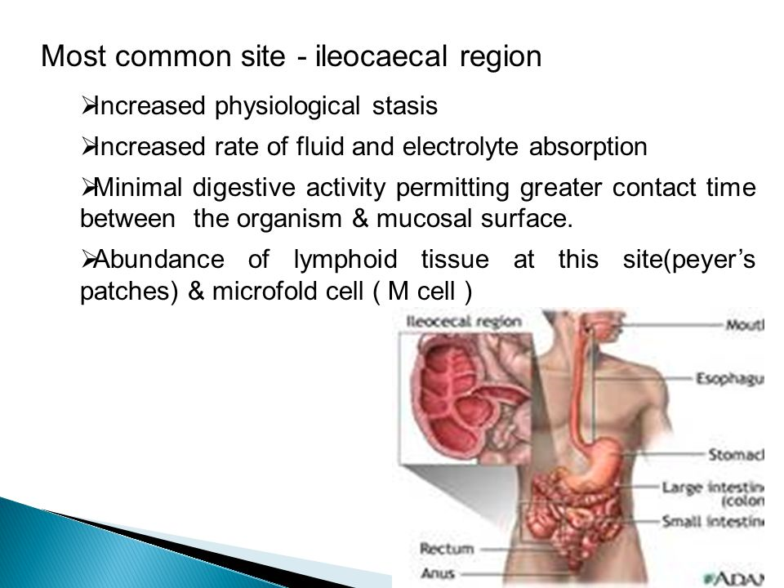
Why common in ileocecal region?

Slide 16
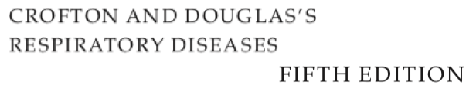
Intestinal TB cont…..
Diagnosis is challenging and is often delayed due to its non-specific presentation.
High clinical suspicion, early initiation of antituberculous therapy, and involvement of an interprofessional team are necessary for reducing morbidity and mortality.

Slide 17
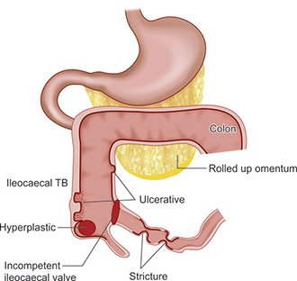
Type(Intestinal TB)
Four major forms have been reported:
Ulcerative(60%) –
Hypertrophic(10%) –
Ulcero-hypertrophic(30%) –
Fibrous stricturing –
Gastrointestinal Tuberculosis:Raja Chandra;Akshay M.Khatri www.ncbi.nlm.nih.gov/books/NBK556115

Slide 18
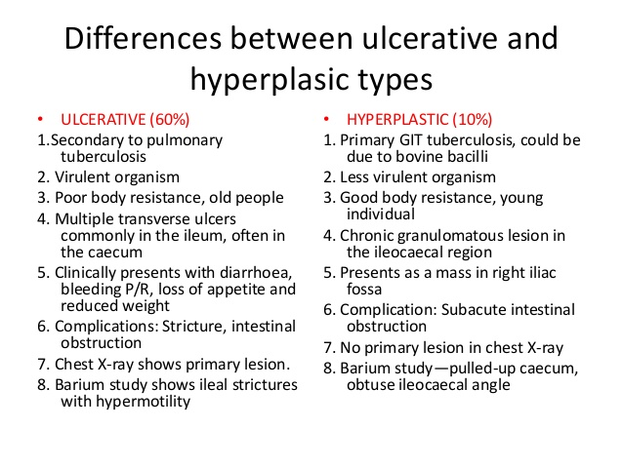
Intestinal TB cont…

Slide 19
Clinical features of Intestinal TB
abdominal pain
fever
a tender, fixed, palpable mass in the ileocecal area.
weight loss
anemia
night sweats
Patients may present with symptoms of obstruction
Hemorrhage and perforation
malabsorption

Slide 20
Physical Examination(Intestinal TB)
Anemia
May be icteric
Lypmhadenopathy
Features of malabsorption
Abdominal examination:
--May reveal no abnormality or only a doughy feel.
--A mobile mass is often palpable in the right lower quadrant of the abdomen.
-- Gurgling on palpation
-- Hepatosplenomegaly
-- abdominal lymph node

Slide 21
Prognosis(Intestinal TB)
Six to 20% mortality rate and may lead to complications that need surgical intervention.

Slide 22
Complications(Intestinal TB)
There are multiple complications reported due to gastrointestinal tuberculosis:
Upper and lower gastrointestinal bleeding
Fistula occurring at different sites
Obstruction of lumen of the gut
Stricture formation
Intussusception
Perforation
Anemia
Malnutrition, malabsorption
weight loss
and deficiency of essential vitamins and minerals

Slide 23
Tuberculus peritonitis
This is the second most common form of abdominal TB.
Method of infection:
(a) Extension from caseating and breaking down glands,
from loculated area of peritonitis,
by direct continuity or
by lymphatic spread.
(b) Haematogenous spread

Slide 24
Types of Peritoneal Tuberculosis
Wet/Ascitic form
Dry/Plastic form–Sub acute intestinal obstruction due to tuberculous small bowel adhesions.
Fibrous form-Abdominal pain,distention,ill defined,irregular,tender abdominal mass
Kumar & Clark’s Clinical Medicine 10th Edition(P-1223)

Slide 25
Pathogenesis(Tuberculus peritonitis)
Infection of the peritoneum
    Secondary to haematogenous spread from a pulmonary focus.
Rarely from Adjacent organs-
    Intestine or the fallopian tubes.

Slide 26
Clinical features(Tuberculous peritonitis)
TBP is usually a subacute disease and its symptoms evolve over a period of several weeks to months
Way of presentation:
The disease can present in three different forms which are: the wet‐ascitic, fibrotic‐fixed and the dry‐plastic form.
They have similar clinical manifestations except for abdominal distension which does not occur in the dry‐plastic form.

Slide 27
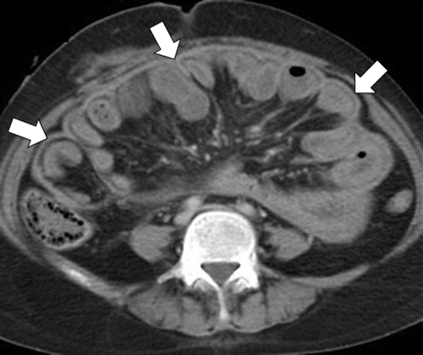

Tubercular Abdominal cocoon/Fibroadhesive /Sclerosing encapsulating peritonitis
Abdominal cocoon is a rare complication of abdominal tuberculosis and also a rare cause of intestinal obstruction .
Characterised by thickening and fibrosis of peritoneum with subsequent wrapping of the variable length of small and sometimes, large bowel .
Early recognition, early management may prevent the need for operative intervention or bowel resection

Slide 28
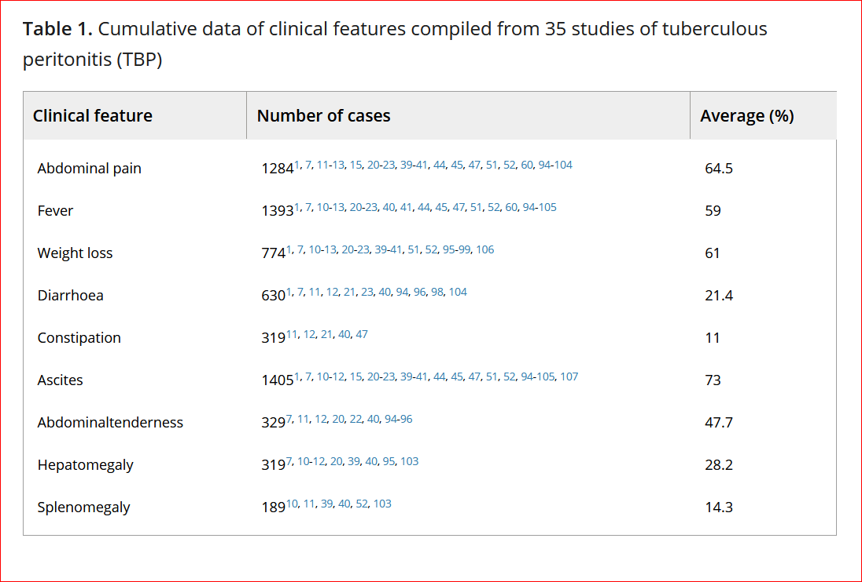
Clinical Features cont….TBP

Slide 29
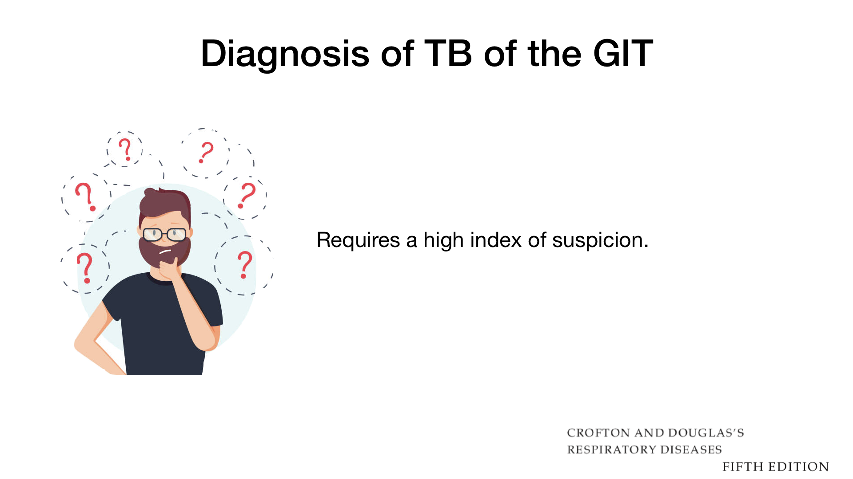
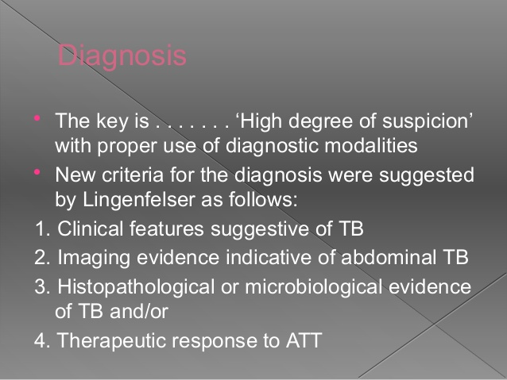
Diagnosis Of Abdominal TB

Slide 30
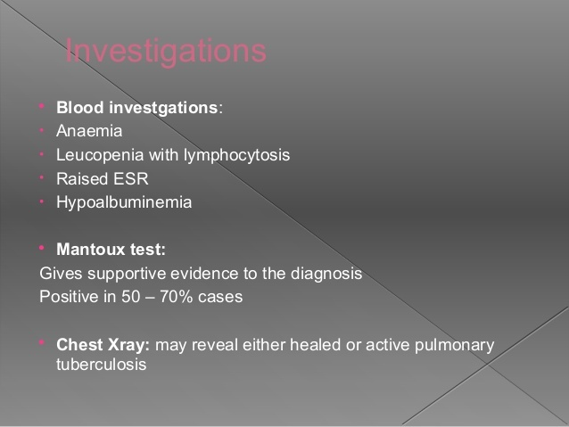
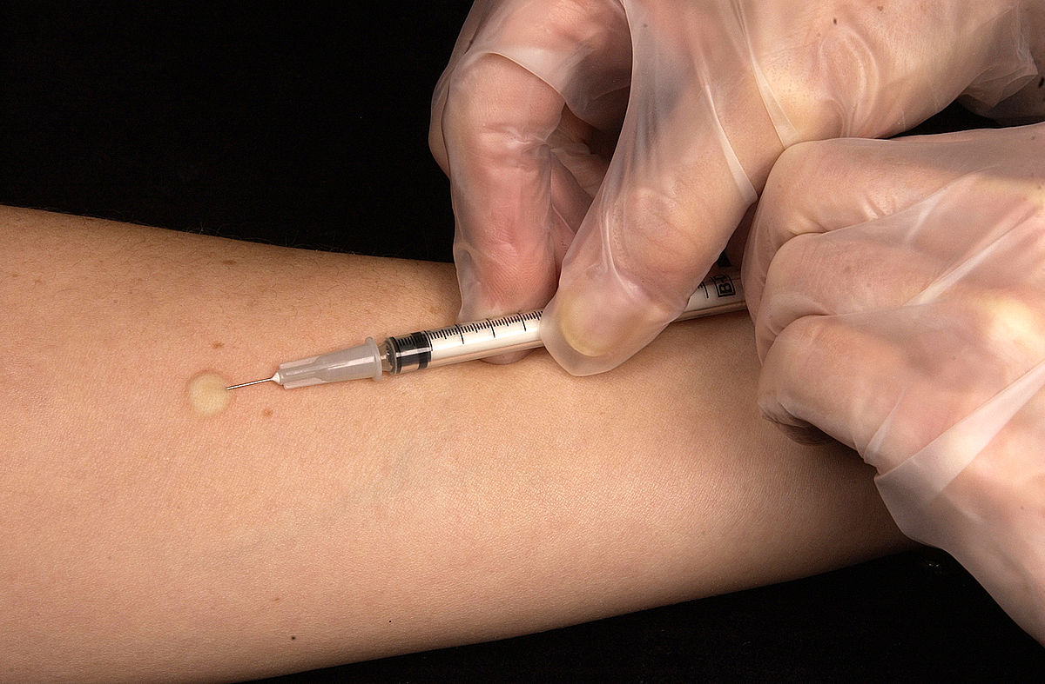
Diagnosis and Investigations cont..

Slide 31
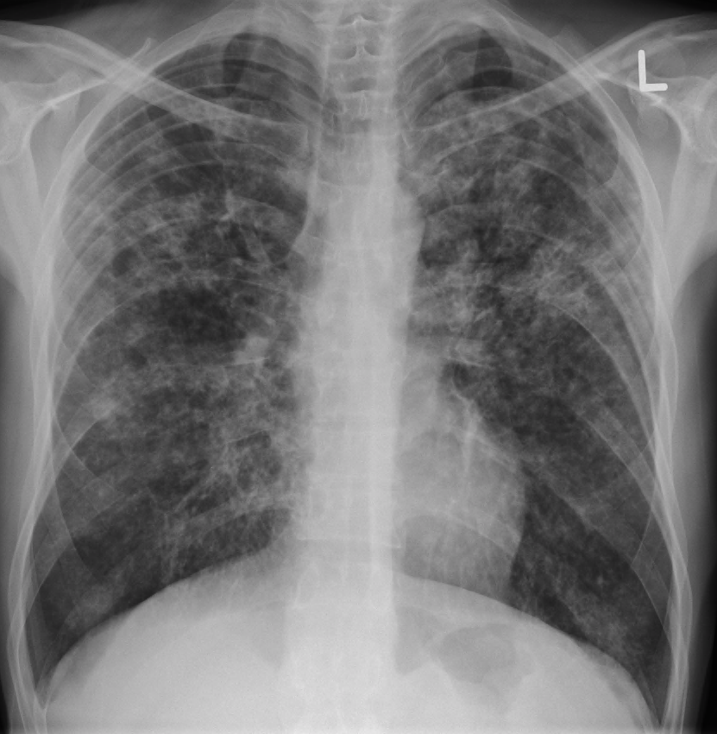
Chest X-RAY
Evidence of TB in a chest X-ray supports the diagnosis but a normal chest X-ray does not rule it out.
May show co-existing active or old healed pulmonary lesions.

Slide 32
Plain X-Ray Abdomen
May show-
  features of obstruction i.e., dilated bowel loops with
  multiple air fluid levels,
  evidence of ascitis,
  perforation
  intussusception.
  Enteroliths:Calculus formed anywhere in the GIT
In addition, there may be-
  calcified lymph nodes,
  calcified granulomas

Slide 33
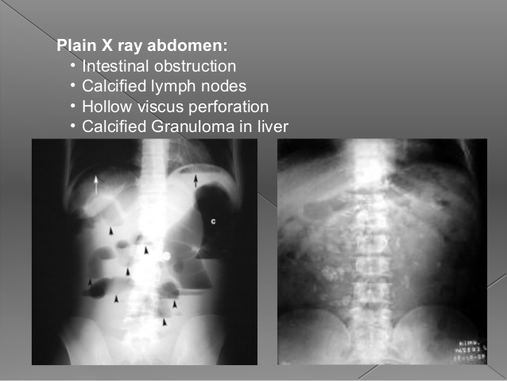

Slide 34
Small bowel barium meal
The features may be seen:
  accelerated intestinal transit;
  hypersegmentation of the barium column (“chicken intestine”),
  luminal stenosis with smooth but stiff contours (“hour glass stenosis”), multiple strictures with segmental dilatation of bowel loops

Slide 35
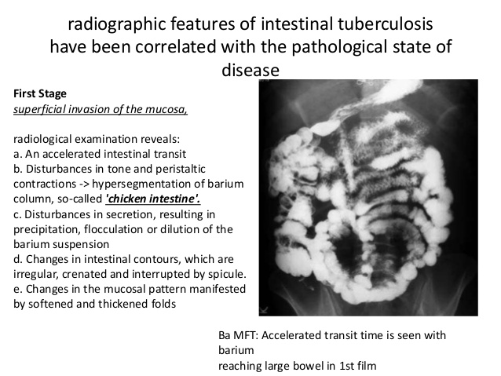

Chicken intestine in Barium meal

Slide 36

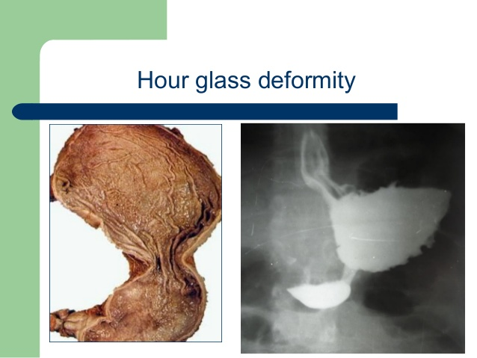
Hourglass deformity

Slide 37
Barium enema
The following features may be seen:
Spasm and oedema of the ileocaecal valve(In early involvement)
Thickening of the lips of the ileocaecal valve and/or wide gaping of the valve with narrowing of the terminal ileum (“Fleischner” or “inverted umbrella sign”).

Slide 38
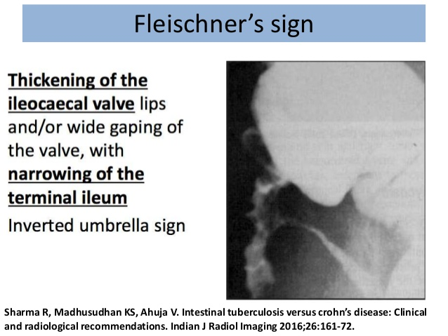

Inverted umbrella sign

Slide 39
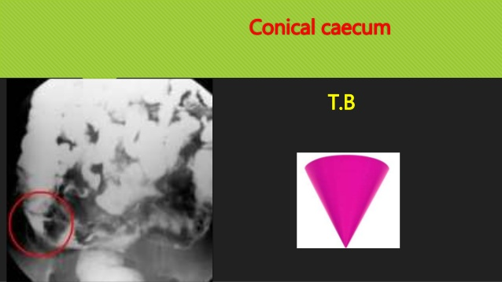
Barium enema cont….
“Conical caecum”, shrunken in size & pulled out of the iliac fossa due to contraction & fibrosis of the mesocolon.

Slide 40
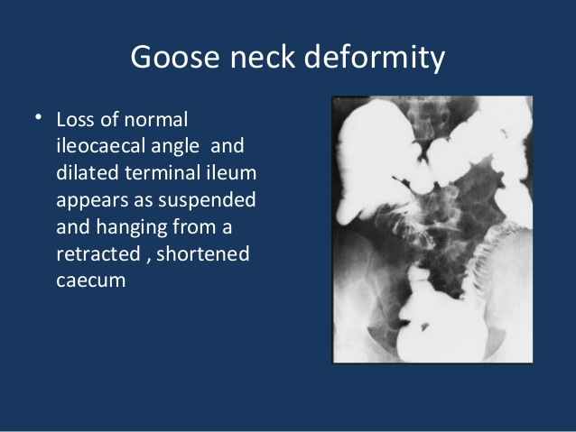

Barium enema cont……
Loss of normal ileocaecal angle & dilated terminal ileum (“goose neck deformity”).

Slide 41
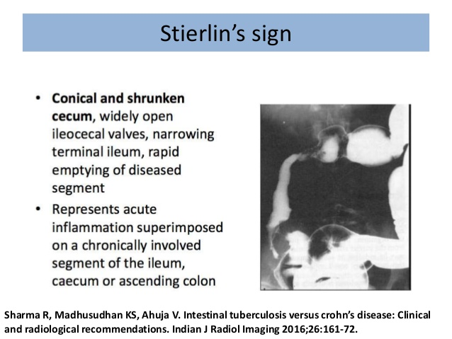

Slide 42
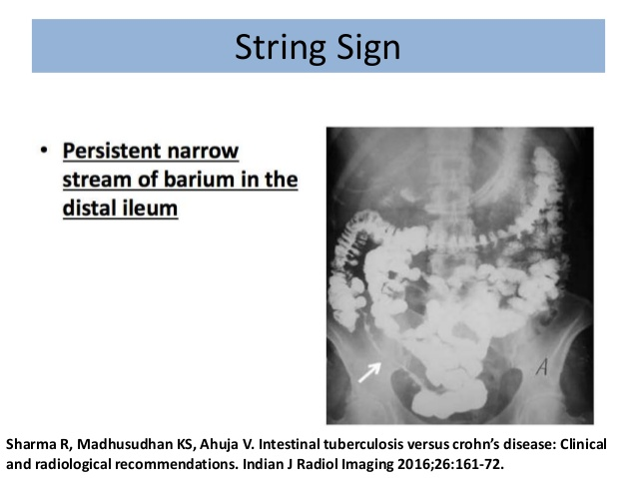
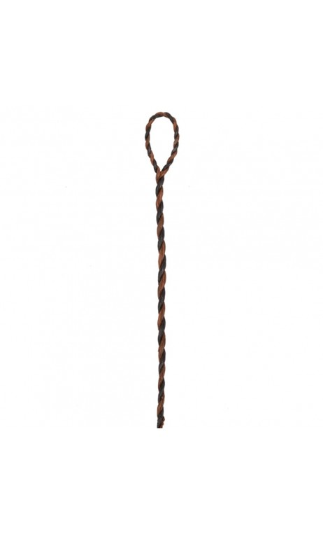
Barium enema cont….
“String sign” – persistant narrow stream of barium indicating stenosis.
Both Stierlin and String signs can also be seen in Crohn's disease and hence are not specific for TB.

Slide 43
USG
The following features may be seen, usually in combination.
(i) Loculated or interloop ascites(with debri and septae).
(ii) “Club sandwich” or “sliced bread” sign is due to localized fluid between radially oriented bowel loops, due to local exudation from the inflammed bowel (interloop ascitis).

Slide 44
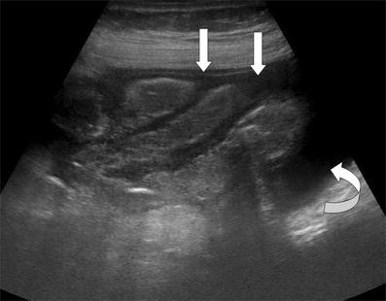

Club Sandwitch sign

Slide 45
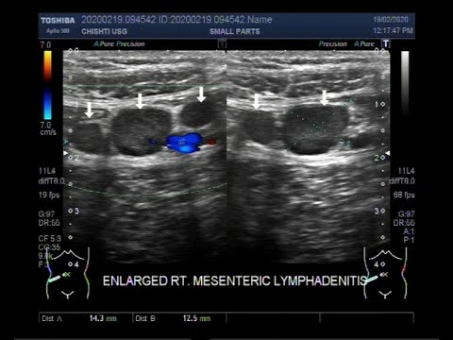
USG cont….
iii) Lymphadenopathy may be discrete or matted.

Slide 46
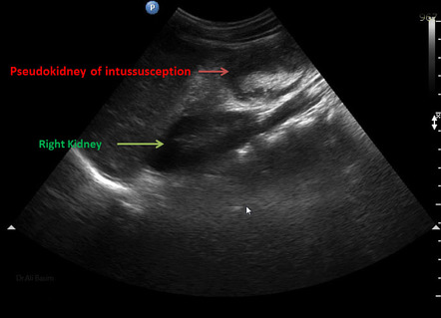
(iv) Bowel wall thickening.
(v) Pseudokidney sign (pulled up caecum)– involvement of the ileocaecal region which is pulled up to a subhepatic position.

Slide 47
Computed tomography (CT) scan
Ileocaecal tuberculosis is usually hyperplastic and well evaluated on CT scan.
High density ascites
Lympadenopathy with ascites
Bowel wall thickening
Omental thickening-omental cake appearance
Complications of perforation, abscess and obstruction are also seen.

Slide 48
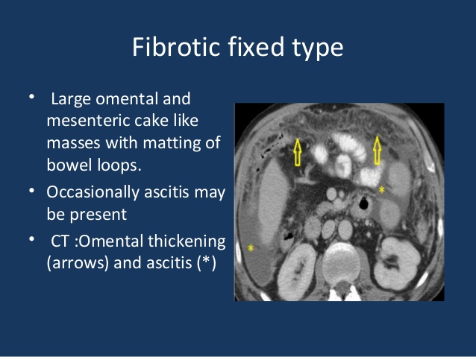

CT Scan cont…
Thickened peritoneum and enhancing peritoneal nodules
The mesenteric, mesenteric root, celiac, porta hepatis and peripancreatic nodes are characteristically involved.

Slide 49
Colonoscopy
Ulcearation is the most common finding
Ileocaecal valve may be oedematous or deformed
Nodules,ulcers,pseudopolyps may be seen
Biopsies should be taken from the edge of the ulcers.
A combination of histology and culture of the biopsy material can be expected to establish the diagnosis in over 80% of cases.

Slide 50
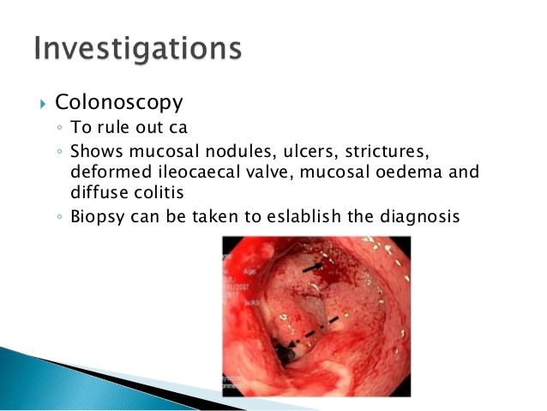

Slide 51
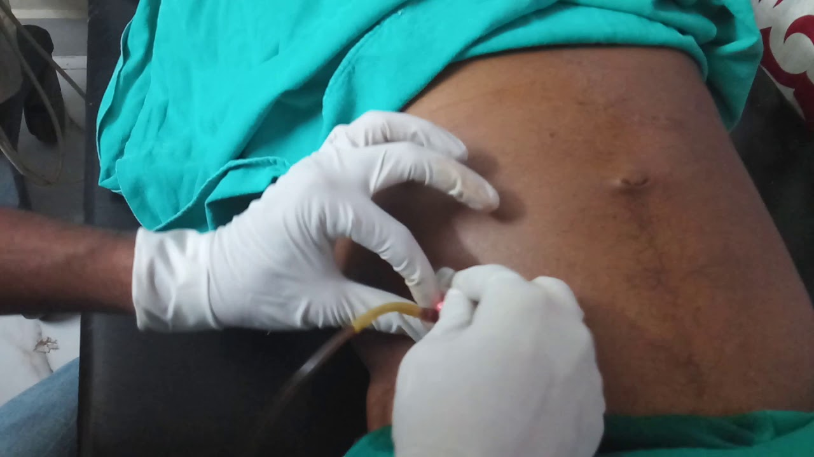
Ascitic fluid Study

Slide 52
Ascitic fluid examination
The ascitic fluid is straw coloured with protein >2.5 g/dl.
Total cell count of 150-4000/μl, consisting predominantly of lymphocytes (>70%).
The ascites to blood glucose ratio is less than 0.96
Serum ascitis albumin gradient is less than 1.1 g/dl.

Slide 53
Ascitic fluid cont….
AFB staining is positive in less than 3% of cases.
Culture is positive in less than 20% of cases and it takes 6-8 wk.
By centrifusing 1 L ascitic fluid culture positivity rate is about 83%.(Singh et al ).

Slide 54
ADA
Sensitivity 98% and specificity 95% ,Cut of value 33%
ADA is increased in tuberculous ascitic fluid due to the stimulation of T-cells by mycobacterial antigens.

Slide 55
IGRA
I IFN-Gamma is produced by T-Cells to activate the macrophages and increase their bactericidal activity.
Results are reported as positive, negative, or indeterminate.
IFN-Gamma is increased in tubercular ascites.

Slide 56
CA-125
CA-125 level elevated to 188.6 U/mL (normal range, <35 U/mL).
CA-125, the common tumor marker of ovarian cancer, elevated in pulmonary and extrapulmonary tuberculosis (Yilmaz et al., 2001).
This is because CA-125 antigen is a large transmembrane glycoprotein derived from coelomic (pericardium, pleura, peritoneum) and Mullerian (fallopian tube, endometrial, and endocervical) epithelium.

Slide 57
Diagnostic laparoscopy
Direct visualization
Inflammed thickened peritoneum studded with whitish yellow miliary tubercle
Collect ascitic fluid
Take biopsy from mass,omentum or peritoneum

Slide 58
FNAC
provides an inexpensive, quick and safe alternative to histopathology for the diagnosis of tuberculosis.
It’s a patient friendly technique and provides a good assessment of cytomorphological features.

Slide 59
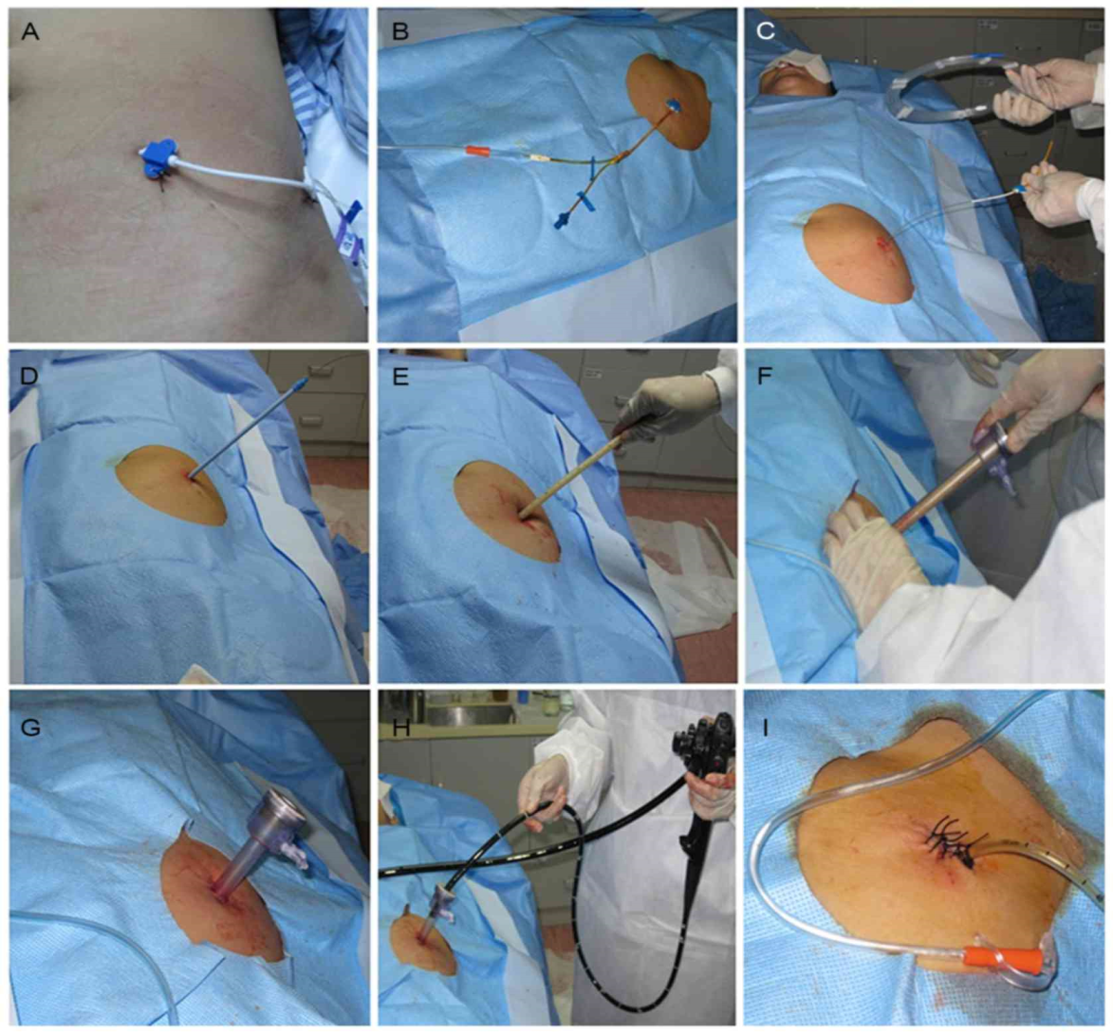
Peritoneal biopsy

Slide 60
PCR
PCR is the most promising new approach for the diagnosis of GITB.
Sensitivity 92%,Specificity 99%

Slide 61
Management
The drug treatment of abdominal TB is similar to that for pulmonary tuberculosis .(Kumar and Clark-10th).
As soon as the diagnosis is established the patient should be put on anti-tuberculosis drugs.
All patients should receive conventional antitubercular therapy for at least 6 months.

Slide 62
The diet should also be a low residue one and even this may be further modified in patients with diarrhea.
General supportive treatment with rest, nutritious food, high protein, high calorie diet, supplementary vitamins and iron is recommended

Slide 63
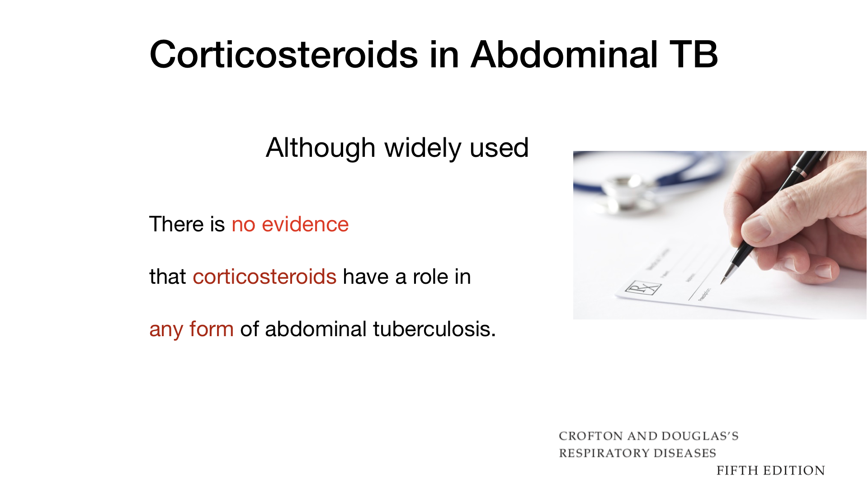
Role of steroid in Abdominal TB

Slide 64
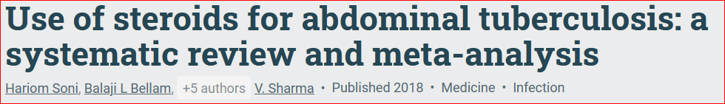
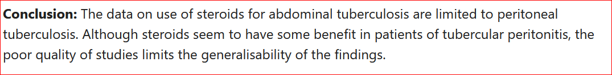
Meta-analyses showed adjunctive steroids, with ATT is more effective than ATT alone in tuberculous peritonitis patients for the prevention of composite end point , symptomatic stricture and intestinal obstruction .

Slide 65
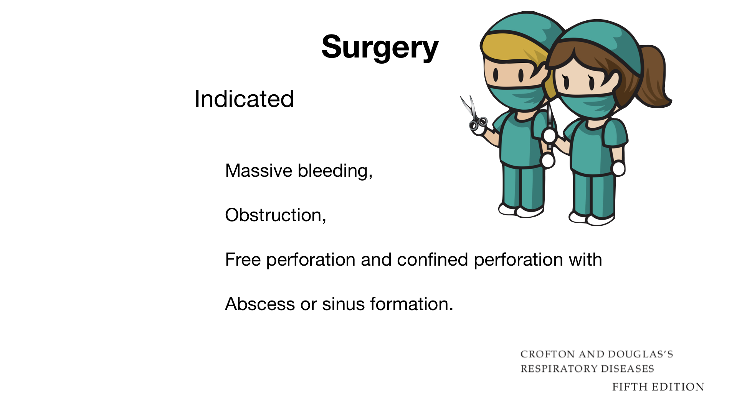
Indications for surgery

Slide 66
SUMMARY
Abdominal tuberculosis is the infection of peritoneum, hollow or solid abdominal organs with Mycobacterium bacilli.
The ileocaecal region and the peritoneum are most likely sites of infection.
In most cases hematogenous spread or through swallowing of infected sputum
PTB is apparent in less than 50% of the patients.

Slide 67
SUMMARY
Patients usually present with abdominal pain.
Usually diagnosis is made through a combination of radiologic, endoscopic, microbiologic, histologic and molecular techniques.
Antimicrobial treatment is the same as for pulmonary tuberculosis.
Surgery is occasionally required.

Slide 68


