Slide 1
ABG INTERPRETATION
DR.SAJIB KUMAR SARKAR
REGISTRAR (MEDICINE)
RANGPUR MEDICAL COLLEGE, HOSPITAL

Slide 2


Slide 3
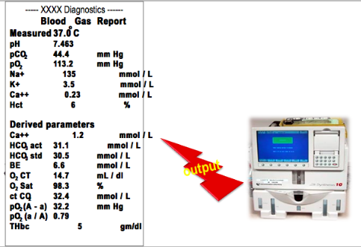
ABG machine

Slide 4
Information from ABG
pH
PaO₂
PaCO₂
HCO₃⁻
Base excess / deficit
Oxygen saturation

Slide 5
WHAT to do now
To find out ….
Acidosis / Alkalosis / Mixed disorder
Primary cause ( Metabolic / Respiratory )
Uncompensated / Compensated

Slide 6
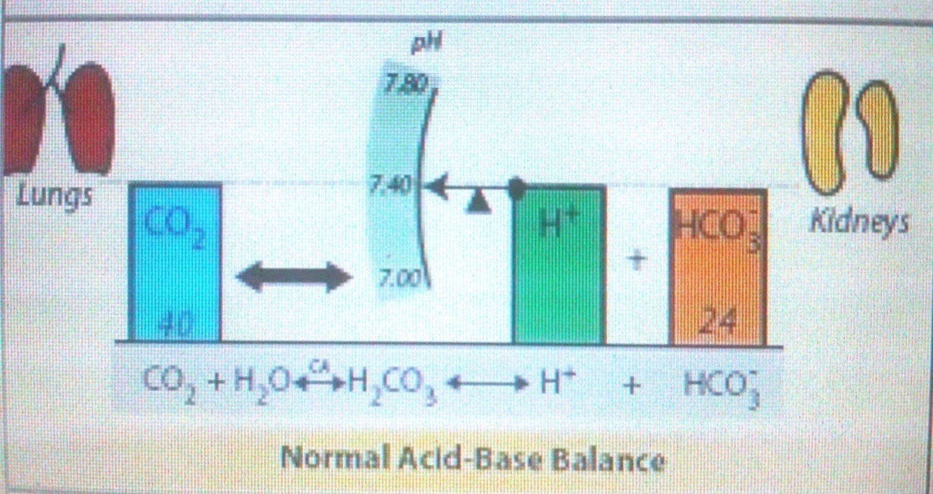
Normal Acid base Balance

Slide 7
Henderson Hasselbalch equation
CO₂ + H₂O ← → H₂CO₃ ← → H⁺ + HCO₃⁻
pH = pK + log₁₀ HCO₃ / 0.03 X PaCO₂
pH α [ HCO₃⁻ ]
PaCO₂

Slide 8
Basic knowledge about acidosis & alkalosis
Metabolic acidosis
↓ pH α ↓ [ HCO₃⁻ ]
PaCO₂
pH and HCO₃⁻ go to same direction

Slide 9
Basic knowledge about acidosis & alkalosis
Metabolic alkalosis
↑ pH α ↑ [HCO₃⁻]
PaCO₂
pH and HCO₃⁻ go to same direction

Slide 10
Basic knowledge about acidosis & alkalosis
Respiratory acidosis
↓ pH α [ HCO₃⁻ ]
↑ PaCO₂
pH and PaCO₂ go to opposite direction

Slide 11
Basic knowledge about acidosis & alkalosis
Respiratory alkalosis
↑ pH α [ HCO₃⁻ ]
↓ PaCO₂
pH and PaCO₂ go to opposite direction

Slide 12
Basic knowledge about acidosis & alkalosis
Compensation
Metabolic problem is compensated by Respiratory system.
Respiratory problem is compensated by Renal system.

Slide 13
Basic knowledge about acidosis & alkalosis
If compensating
Compensated Metabolic acidosis
↓ pH α ↓ [ HCO₃⁻ ]
↓ PaCO₂ *** HCO₃⁻ and PaCO₂ go to
Compensated Metabolic alkalosis same direction.
↑ pH α ↑ [ HCO₃⁻ ]
↑ PaCO₂

Slide 14
Basic knowledge about acidosis & alkalosis
If compensating
Compensated Respiratory acidosis
↓ pH α ↑ [ HCO₃⁻ ]
↑ PaCO₂ *** HCO₃⁻ and PaCO₂ go to
Compensated Respiratory alkalosis same direction.
↑ pH α ↓ [ HCO₃⁻ ]
↓ PaCO₂

Slide 15
ACID BASE STATUS-NORMAL VALUES
 | Mean | Normal ( 1 SD) | Normal ( 2 SD)
pH | 7.40 | 7.38 – 7.42 | 7.35 – 7.45
PaCO₂ | 40 | 38 – 42 | 35 – 45
_{PaO2} | 100 |  | 80-100 mmHg
HCO₃ | 24 | 23 – 25 | 22 – 26
_{BE} | 0 |  | -2 to +2 mmol/L
SaO₂ | 95% |  | 92 – 100 %
_{TCO2} | 25 |  | 23 - 27

Slide 16
Approach to solve acid-base disorders
11 step approach

Slide 17
Approach to solve acid-base disorders
Step 1 | Check pH : Acidosis / Alkalosis
Step 2 | Check PaCO₂ : Is Respiratory the primary cause
Step 3 | Check HCO₃⁻ : Is Metabolic the primary cause
Step 4 | Is the body compensating?
Step 5 | Initial classification
Step 6 | Determine if compensation is appropriate or are there other primary disorders
Step 7 | Determine Anion gap and Bicarbonate gap
Step 8 | Determine oxygenation status
Step 9 | Assess the patient
Step 10 | Check for accuracy
Step 11 | Final interpretation

Slide 18
step 1
Check pH :
Normal / increase / decrease

Slide 19
Step 2
Check PaCO₂ : Is Respiratory the primary cause
Is PaCO₂ Normal, ↑ or ↓ ?
If pH and PaCO₂ go to opposite direction then it is a respiratory cause.

Slide 20
Step 3
Check HCO₃⁻ : Is Metabolic the primary cause
Is HCO₃⁻ Normal, ↑ or ↓ ?
If pH and HCO₃⁻ go to same direction then it is metabolic cause.

Slide 21
Step 4
Is the body compensating?
If HCO₃⁻ and PaCO₂ go to same direction then YES, the body is
compensating.
Compensation: ↑PaCO₂ and ↑ HCO₃
or
↓PaCO₂ and ↓HCO₃

Slide 22
Step 5
Initial classification

Slide 23
Classification of acid-base disorder
A) Functional classification
i) Metabolic acidosis iv) Chronic respiratory acidosis
ii) Metabolic alkalosis v) Acute respiratory alkalosis
iii) Acute respiratory acidosis vi) Chronic respiratory alkalosis
Technical classification
i) Uncompensated
ii) Partially compensated
iii) Maximum compensated

Slide 24
Classification characteristics
SINGLE DISORDERS
Metabolic disorder | pH and HCO₃⁻ go to same direction
Respiratory disorder | pH and PaCO₂ go to opposite direction
Compensating | HCO₃⁻ and PaCO₂ go to same direction
MIXED DOSORDERS
Same direction disorder : Respiratory and metabolic acidosis Respiratory and metabolic alkalosis | HCO₃⁻ and PaCO₂ go to opposite direction
Opposite direction disorder : Respiratory acidosis and metabolic alkalosis Respiratory alkalosis and metabolic acidosis | HCO₃⁻ and PaCO₂ go to same direction
MIXED METABOLIC DISORDERS

Slide 25
Respiratory acidosis
Acute and Chronic
↑PaCO₂
> 45 mmHg
Compensated by Renal system : ↑ HCO₃⁻

Slide 26
Respiratory acidosis
For every 10 mmHg acute increase of PaCO_{2,} pH will decrease 0.08 and HCO₃⁻ will increase 1 mEq/L.
For every 10 mmHg chronic increase of PaCO_{2,} pH will decrease 0.03 and HCO₃⁻ will increase 4 mEq/L.

Slide 27
Acute respiratory acidosis with a PaCO₂ of 60 mmHg
Expected pH | Expected HCO₃⁻
7.40 – (0.08 x ∆ Paco₂ ) 10 | 24 + ( 1 x ∆ Paco₂ ) 10
7.40 – ( 0.08 x 60 - 40 ) 10 | 24 + ( 1 x 60 - 40 ) 10
7.40 – 0.16 = 7.24 | 24 + 2 = 26

Slide 28
Chronic respiratory acidosis with a PaCO₂ of 60 mmHg
Expected pH | Expected HCO₃⁻
7.40 – (0.03 x ∆ PaCO₂ ) 10 | 24 + ( 4 x ∆ PaCO₂ ) 10
7.40 – ( 0.03 x 60 - 40 ) 10 | 24 + ( 4 x 60 - 40 ) 10
7.40 – 0.06 = 7.34 | 24 + 8 = 32

Slide 29
Respiratory alkalosis
Acute and Chronic
↓ PaCO₂
< 35 mmHg
Compensated by Renal system : ↓ HCO₃⁻

Slide 30
Respiratory alkalosis
For every 10 mmHg acute decrease of PaCO_{2,} pH will increase 0.08 and HCO₃⁻ will decrease 2 mEq/L.
For every 10 mmHg chronic decrease of PaCO_{2,} pH will increase 0.03 and HCO₃⁻ will decrease 5 mEq/L.

Slide 31
If HCO₃⁻ level is higher than expected Secondary metabolic alkalosis
If HCO₃⁻ level is lower than expected Secondary metabolic acidosis

Slide 32
Metabolic acidosis
↓ HCO₃
< 22 mmHg
Compensated by Respiratory system : Hyperventilation

Slide 33
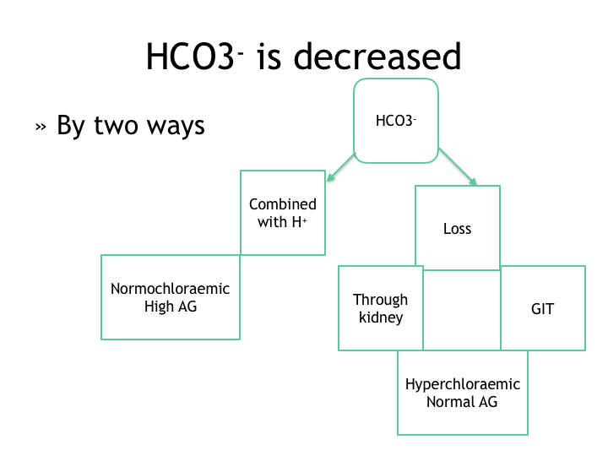

Slide 34
Metabolic acidosis
Calculate expected PaCO₂
Is there secondary respiratory acidosis / alkalosis?
Calculate Anion Gap (AG)
Is it high anion gap / normal anion gap metabolic acidosis?
Calculate Bicarbonate gap
Is it mixed metabolic disorder?

Slide 35
Metabolic acidosis
For every 1 mEq/L decrease of HCO₃⁻, pH will decrease 0.015 and PaCO₂ will decrease 1.5 mmHg.

Slide 36
WINter’s formula
Expected PaCO₂ = [ ( 1.5 x HCO₃⁻ ) + 8 ] ± 2
OR
Expected PaCO₂ = ( HCO₃⁻ +15 ) ± 2
OR
Expected PaCO₂ = Last 2 digits of pH

Slide 37
Metabolic alkalosis
↑ HCO₃
> 26 mmHg
Compensated by Respiratory system : Hypoventilation

Slide 38
Metabolic alkalosis
For every 1 mEq/L increase of HCO₃⁻, pH will increase 0.015 and PaCO₂ will increase 0.9 mmHg.
Expected PaCO₂ = ( HCO₃⁻ +15 ) ± 2
Expected PaCO₂ = ( 0.9 x HCO₃⁻ ) + ( 21 ± 2 )

Slide 39
If PaCO₂ level is higher than expected Secondary respiratory acidosis
If PaCO₂ level is lower than expected Secondary respiratory alkalosis

Slide 40
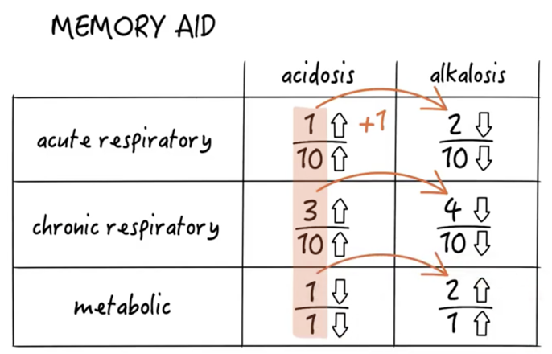

Slide 41
Step 6
Determine if compensation is appropriate or are there other primary disorders:
Due to Homeostasis mechanism, primary changes in PaCO₂ leads to secondary changes of HCO₃⁻ . Thus pH remains constant.
The higher the PaCO₂ (respiratory acidosis), the greater the HCO₃⁻ reabsorption by kidney (compensation).
The lower the PaCO₂ (respiratory alkalosis), the lesser the HCO₃⁻ reabsorption by kidney (compensation).

Slide 42
compensation
As the respiratory system compensation is usually immediate, functionally, there is usually no time distinction between acute and chronic metabolic disorders. So in case of metabolic disorders, the term “Acute” or “Chronic” are often omitted.
Because of limitation of lungs or kidneys to fully compensate “full” or “complete” compensation is more appropriately referred to as maximal compensation.

Slide 43
Step 7
Calculate Anion gap.
If Anion gap acidosis present then calculate Bicarbonate gap.

Slide 44
ANION GAP concept In ECF
Cations
Na⁺ | 140 mmol/L
K⁺ | 4.5 mmol/L
Mg²⁺ | 1.5 mmol/L
Ca²⁺ | 5 mmol/L
Total | 151 mmol/L
Anions
Cl⁻ | 104 mmol/L
HCO₃⁻ | 24 mmol/L
Protein | 15 mmol/L
Organic acids | 5 mmol/L
PO4²⁻ | 2 mmol/L
SO4²⁻ | 1 mmol/L
Total | 151 mmol/L

Slide 45
ANION GAP CONCEPT
Normally in ECF all cations and anions are equal in number that means ECF is electrically neutral. So the equation is,
( Na⁺ + K⁺ ) + UC = ( Cl⁻ + HCO₃⁻ ) + UA
( Na⁺ + K⁺ ) - ( Cl⁻ + HCO₃⁻ ) = UA - UC = Anion gap
Anion Gap = UA – UC
AG = Na⁺ - ( Cl⁻ + HCO₃⁻ )
Normal value = 12 – 16 mEq/L

Slide 46
Anion gap concept
Anion gap is an artifact because some anions are not measured
Gap is mainly due to unmeasured proteins, phosphate and sulfate.

Slide 47
bicarbonate gap / corrected HCO₃⁻
BG = Patient’s HCO₃⁻ + ∆ AG
∆ AG = Delta gap
= Patient’s AG – Normal AG
= Patient’s AG – 12
Normal BG = 24. It indicates single disorder ( AG metabolic acidosis )
< 20 = AG Metabolic acidosis + Non AG metabolic acidosis
> 28 = AG Metabolic acidosis + Metabolic alkalosis

Slide 48
Step 8 : Determine oxygenation status
Hypoxemia | PaO₂ | SpO₂
Mild | 60-79 | 90-94
Moderate | 40-59 | 75-89
Severe | <40 | <75

Slide 49
Step 9: assess the patient
Check patient condition.
Treat the patient not the lab test numbers.
Serial ABGs are more important than a single one.

Slide 50
Step 10: check for accuracy / errors
Check patient – does the ABG line up with patient’s clinical condition?

Slide 51
Step 11: final interpretation
Final interpretation is often quiet different from the initial technical or functional classification.

Slide 52
Examples

Slide 53
EX 01

Slide 54
A 40 years old man presenting with sudden breathlessness. ABG : pH = 7.2, HCO₃ = 26 mmol/l, PaCO₂ = 60 mm hg.
pH = 7.2 ( ↓ ) : Acidosis
PaCO₂ = 60 ( ↑ ) : Respiratory Acidosis
Expected HCO₃⁻ = Rule 1 / 10
= 24 + 2
= 26
Patient’s HCO₃⁻ = 26
Diagnosis = Acute Respiratory acidosis Uncompensated

Slide 55
Ex 02

Slide 56
A 40 yrs old man presented with anorexia, weight loss, abdominal lump and projectile vomiting. His pH = 7.5, HCO₃ = 30 mmol/l, PaCO₂ = 44 mm Hg
pH = 7.5 ( ↑ ) : Alkalosis
HCO₃⁻ = 30 ( ↑ ) : Metabolic alkalosis
Expected PaCO₂ = Rule 2 / 1
= 40 + 3
= 43
Patient’s PaCO₂ = 44
Diagnosis = Metabolic alkalosis with partial compensation

Slide 57
Ex 03

Slide 58
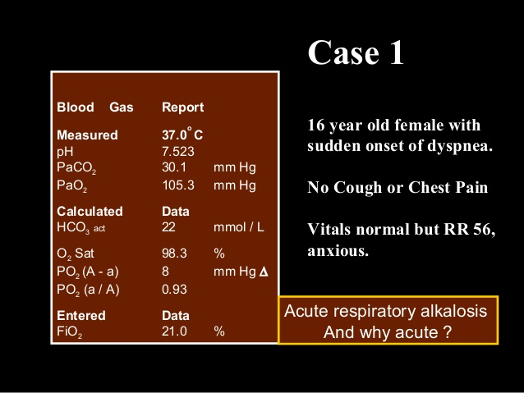

Slide 60
pH = 7.52 ( ↑ ) : Alkalosis
PaCO₂ = 30 ( ↓ ) : Respiratory Alkalosis
Expected HCO₃⁻ = Rule 2 / 10
= 24 - 2
= 22
Patient’s HCO₃⁻ = 22
Diagnosis = Acute Respiratory alkalosis Uncompensated

Slide 61
Ex 04

Slide 62
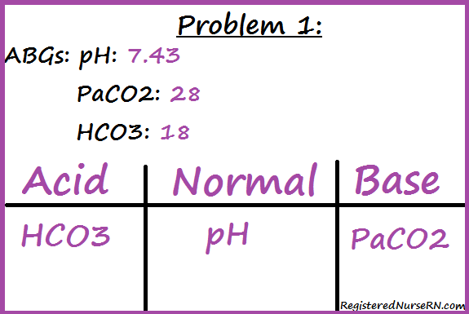
Chronic Respiratory Alkalosis with maximal compensation

Slide 63
Ex 05

Slide 64
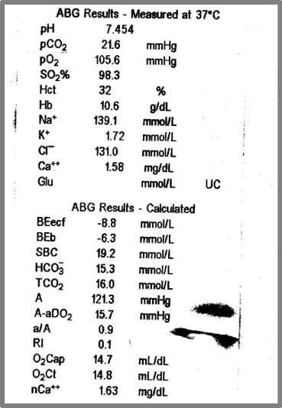
Chronic
Respiratory
Alkalosis
with maximal compensation
Heart attack.
Pain.
Asthma.
Fever.
COPD
infection.
Pulmonary embolism.

Slide 65
Explanation
pH = 7.454 ( ↑ ) : Alkalosis
PaCO₂ = 21.6 ( ↓ ) : Respiratory Alkalosis
Expected HCO₃⁻ = Rule = 4 / 10
= 8 / 20
Patient’s HCO₃⁻ = 15.3 ( within expectation)
Diagnosis = Chronic Respiratory alkalosis
with maximum compensation

Slide 66
Ex 06

Slide 67
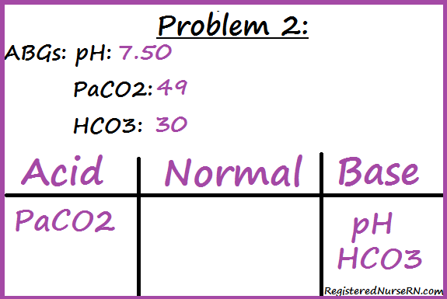
Metabolic Alkalosis Partial compensation
Respiratory acidosis

Slide 68
Ex 07

Slide 69
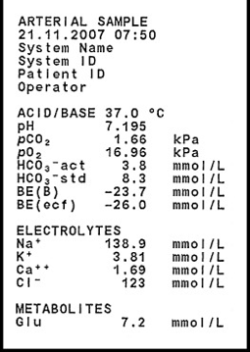
Normal anion gap
Hyperchloraemic
Diarrhoea
RTA
iliostomy fluid loss
Acetazolamide
Topiramate
Metabolic
Acidosis
Partial compensation
Respiratory Alkalosis
HCO3/PCO2=1/1
16/28
CO2 washed out more than HCO3

Slide 70
EXplanation
pH = 7.195 ( ↓ ) : Acidosis
HCO₃⁻ = 8.3 ( ↓ ) : Metabolic acidosis
Expected PaCO₂ = Rule 1 / 1 ( 16 / 16 )
= 16 / 28
Patient’s PaCO₂ = 12.53
= Respiratory alkalosis
Anion gap = 138.9 – ( 8.3 + 123 )
= 7.6
= Normal Anion gap
Diagnosis = Normal Anion gap Hyperchloraemic Metabolic acidosis + Respiratory alkalosis

Slide 71
Ex 08

Slide 72
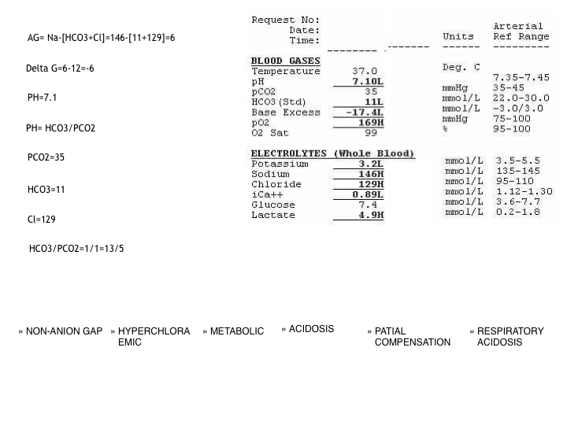
A 25 years old man was rushed to the emergency department with sudden onset of weakness in all four limbs. He is a heavy smoker, normotensive and non diabetic. No H/O diarrhoea, vomiting prior to his illness. He had H/O several attack of same type of illness . On neurological examination , all modalitites of neurological findings were normal but power was 2/5 in all four limbs. ABG and electrolytes shows …..
Normal Anion gap
Hyperchloraemic
Metabolic
Acidosis
Uncompensated
Respiratory Acidosis

Slide 73
Explanation
pH = 7.1 ( ↓ ) : Acidosis
HCO₃⁻ = 11 ( ↓ ) : Metabolic acidosis
Expected PaCO₂ = Rule 1 / 1 ( 13 / 13 )
= 13 / 5
Patient’s PaCO₂ = 35
= Respiratory acidosis
Anion gap = 146 – ( 11 + 129 )
= 16
= Normal Anion gap metabolic acidosis
Diagnosis = Normal Anion gap Hyperchloraemic Metabolic acidosis + Respiratory acidosis

Slide 74
Ex 09

Slide 75
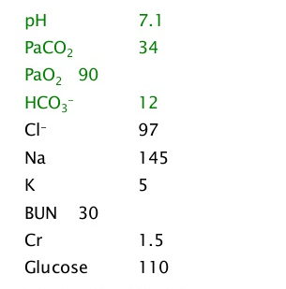
Uncontrolled DM, COPD
Lactic acidosis
Kidney disease
Severe CNS depression
High anion gap
Metabolic
Acidosis
Uncompensated
Associated respiratory acidosis
Metabolic alkalosis

Slide 76
Explanation
pH = 7.1 ( ↓ ) : Acidosis
HCO₃⁻ = 12 ( ↓ ) : Metabolic acidosis
Expected PaCO₂ = Rule 1/ 1 ( 12 / 12 )
= 12 / 6
Patient’s PaCO₂ = 34
= Respiratory acidosis
AG = 145 – ( 12 + 97 )
= 36 ( ↑ )
= High Anion gap Metabolic acidosis
BG = 36
= Metabolic alkalosis
Diagnosis = Uncompensated AG Metabolic acidosis + Respiratory acidosis + Metabolic alkalosis

Slide 77


