Slide 1
WELCOME TO JOURNAL PRESENTATION
PRESENTED BY
DR.SAJIB KUMAR SARKAR
IMO
RANGPUR MEDICAL COLLEGE & HOSPITAL

Slide 2
Alirocumab and Cardiovascular Outcomes after Acute
Coronary Syndrome
G.G. Schwartz, P.G. Steg, M. Szarek

Slide 3
ORIGINAL ARTICLE
Published in THE NEW ENGLAND JOURNAL OF MEDICINE
Published on November 07,2018
Vol 379. No 29
DOI: 10.1056/NEJMoa1801174
Funded by Sanofi and Regeneron Pharmaceuticals
ClinicalTrials.gov number, NCT01663402

Slide 4
BACKGROUND
Patients who have had an acute coronary syndrome are at high risk for recurrent ischemic cardiovascular events.
Whether alirocumab therapy improve cardiovascular outcomes after acute coronary syndrome in patients receiving high-intensity statin therapy is unknown.

Slide 5
METHOD
Trial Design : Multicenter, randomized, double-blind, placebo-controlled trial
Study in 57 countries
From November 2013 to November 2017

Slide 6
INCLUSION CRITERIA
40 years of age or older
Hospitalized with acute coronary syndrome 1 to 12 months earlier.
LDL cholesterol level of at least 70 mg/dl
Non−HDL level of at least 100 mg/dl
Apolipoprotein B level of at least 80 mg/dl
Receiving statin therapy for at least 2 weeks

Slide 7
EXCLUSION CRITERIA
Age less than 40 years
Receiving statin therapy less than 2 weeks
ACS < 1 months and > 12 months earlier
LDL and Non HDL not full fill inclusion criteria
Unwilling to study

Slide 8
TRIAL PROCEDURES
Alirocumab at a dose of 75 mg administered subcutaneously
or
Matching placebo in every 2 weeks.

Slide 9
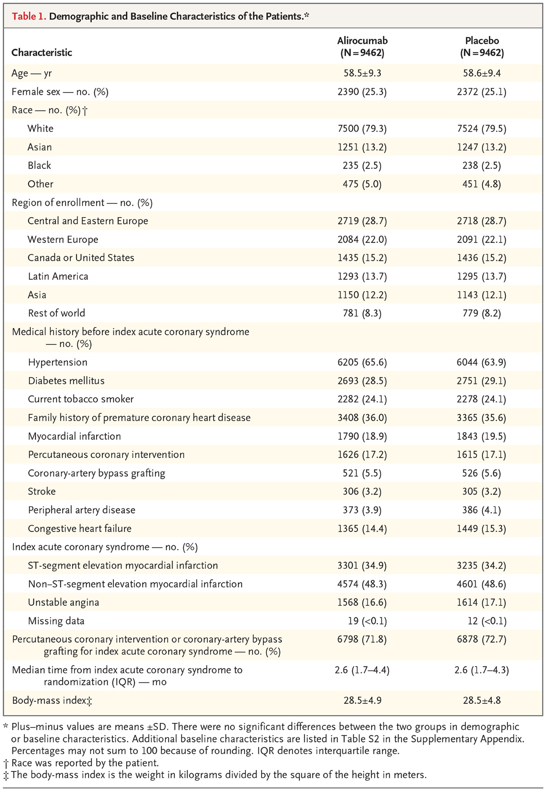

Slide 10
PRIMARY EFFICACY OUTCOME
A composite primary end point event occurred
in 903 patients (9.5%) in Alirocumab group
and in 1052 patients (11.1%) in the Placebo group
Hazard ratio 0.85;
Confidence Interval [CI],0.78 to 0.93;
P< 0.001

Slide 11
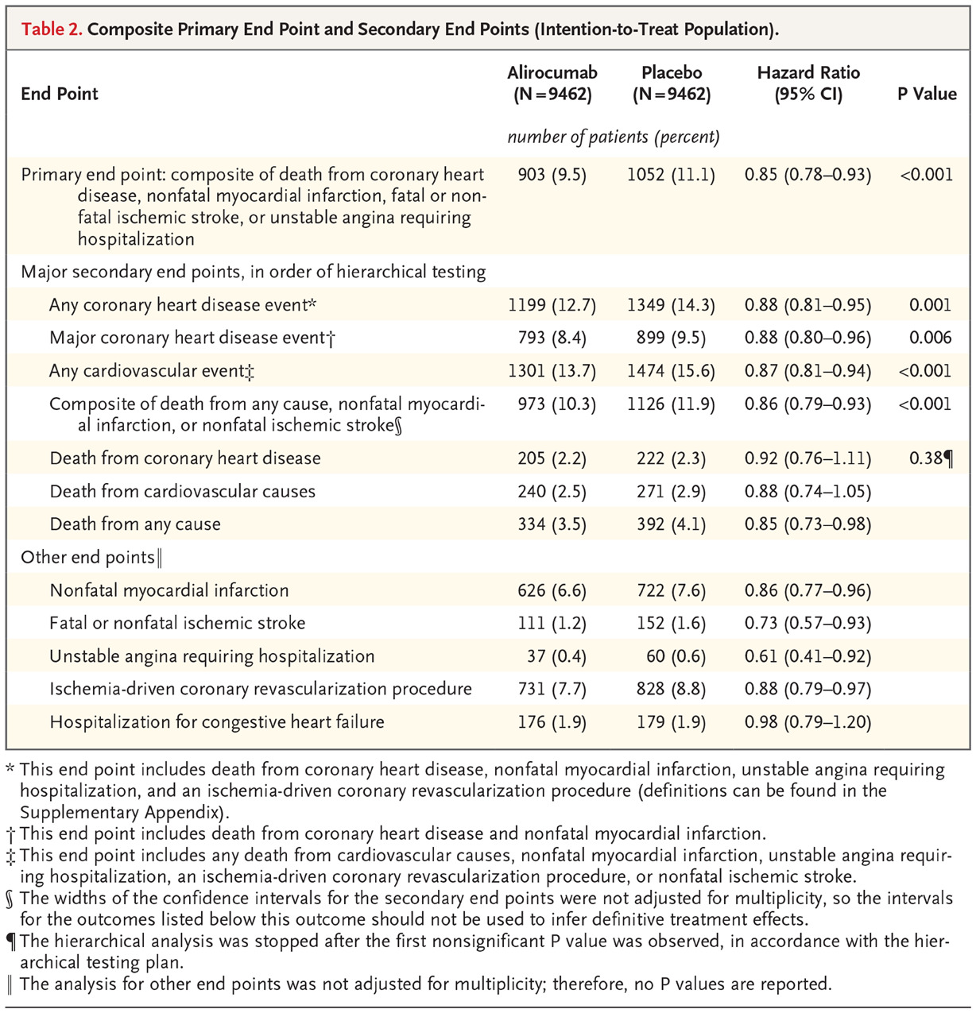

Slide 12
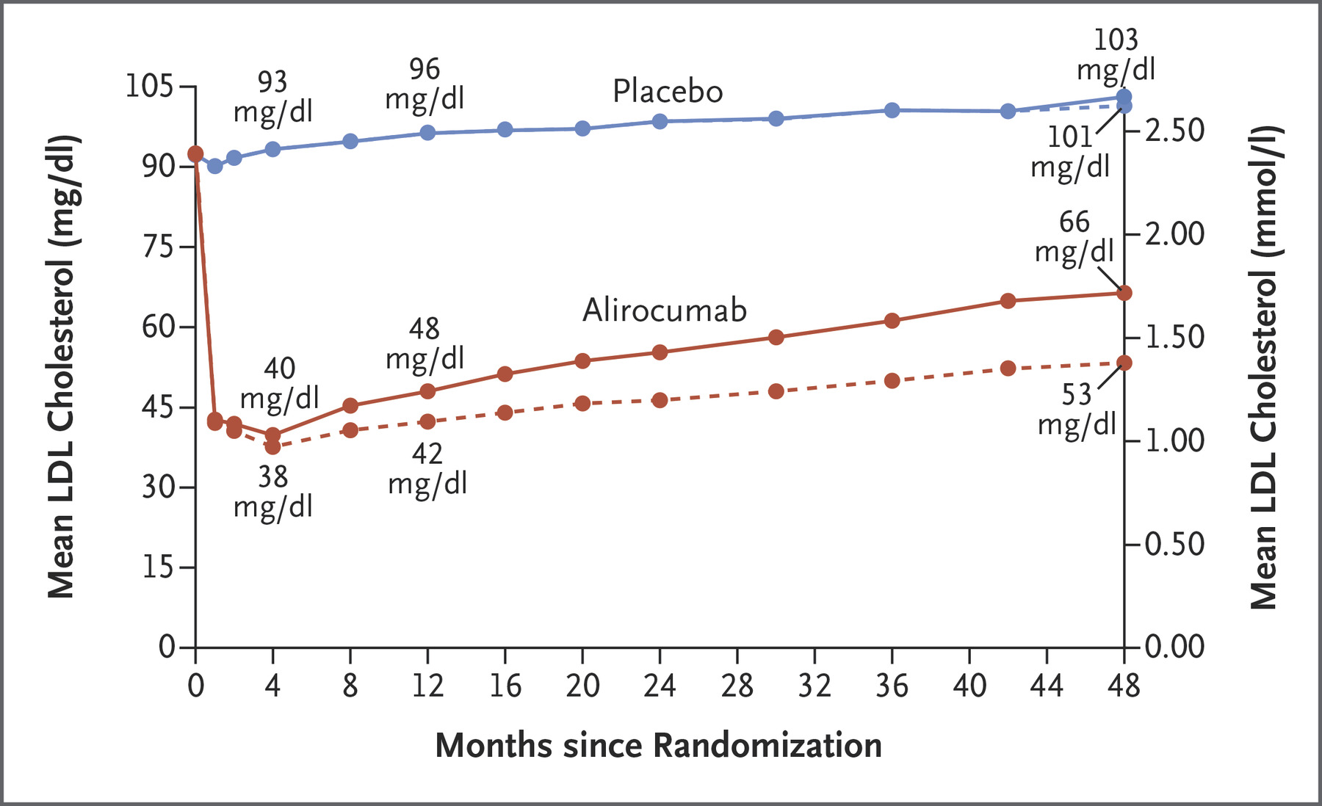

Slide 13
SECONDARY EFFICACY AND SAFETY OUTCOME
Adverse events – death, general allergic
reaction, worsening of DM, new onset DM,
neurocognitive disorder, hepatic disorder,
cataracts, haemorrhagic stroke did not differ
significantly between two groups except local
injection site reaction (3.8% in Alirocumab and
2.1% in placebo)

Slide 14
SECONDARY EFFICACY AND SAFETY OUTCOME
Laboratory abnormalities
raised ALT, AST, total bilirubin,creatine kinase
did not differ significantly between two groups

Slide 15
SECONDARY EFFICACY AND SAFETY OUTCOME
The rate of permanent discontinuation of the
trial regimen owing to adverse event did not
differ significantly between the two treatment
groups

Slide 16
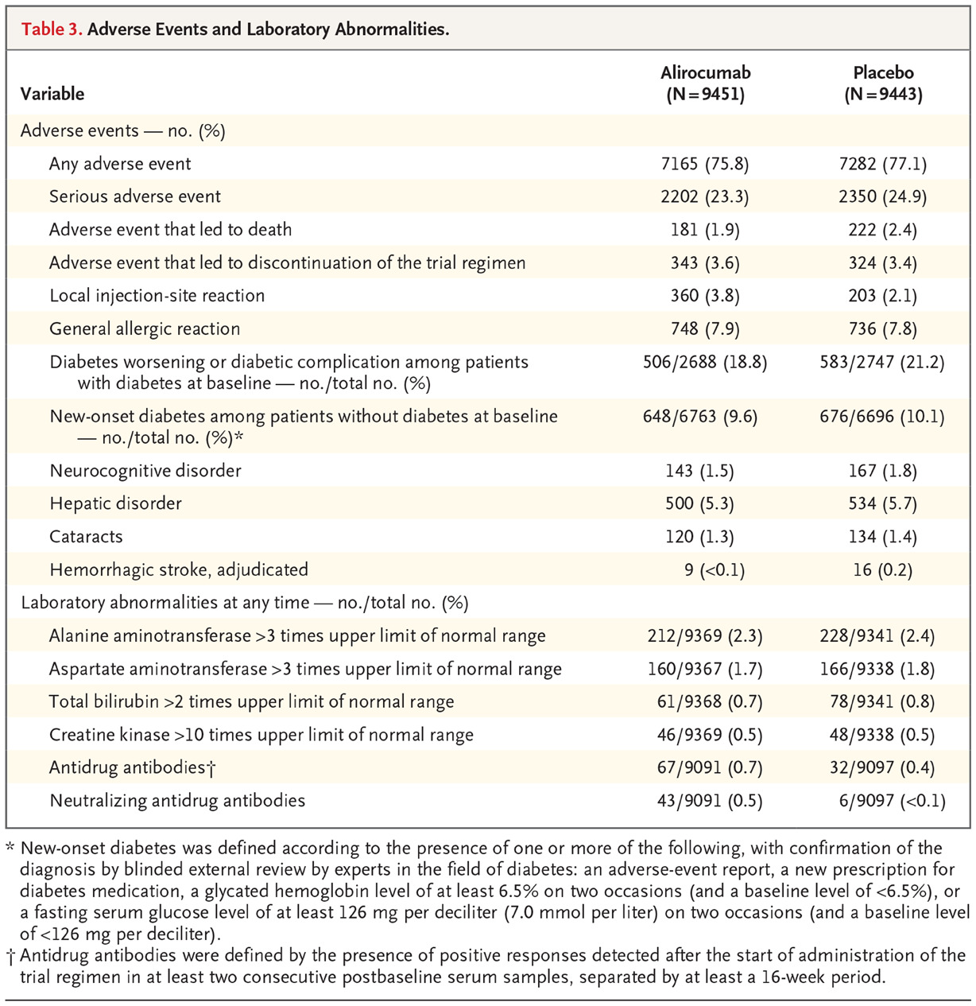

Slide 17
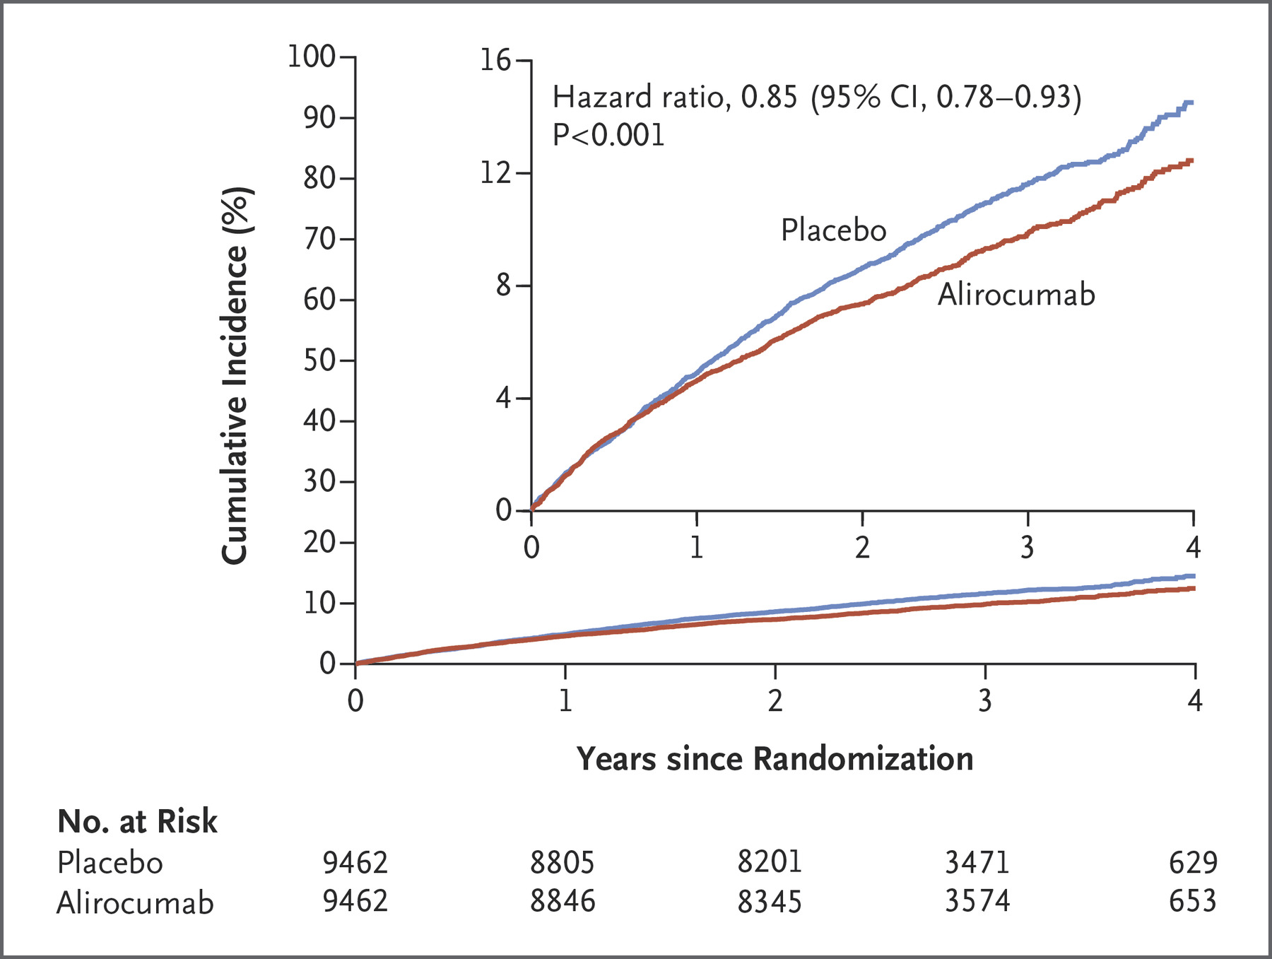

Slide 18
STRENGTH OF STUDY
Large sample size
Double blind randomized control trial
Less chance of biasness

Slide 19
LIMITATION
After enrollment and starting this
study,infrequent use of ezetimibe,for which
cardiovascular efficacy was established.

Slide 20
CONCLUSION
Alirocumab therapy resulted in a significantly
reduction of risk of recurrent ischemic
cardiovascular events among patients with
previous ACS,treating with high intensity
statin than placebo therapy.

Slide 21
CONCLUSION
And except local injection site reaction,there is
no significant difference regarding adverse
events.

Slide 22
THANK YOU

