Slide 1
WELCOME TO JOURNAL PRESENTATION PRESENTATOR DR.SAJIB KUMAR SARKAR IMO RANGPUR MEDICAL COLLEGE & HOSPITAL

Slide 2
Efficacy and Safety of Low-Dose Colchicine after Myocardial Infarction
Jean-Claude Tardif, Simon Kouz, David D. Waters

Slide 3
ORIGINAL ARTICLE
Published in THE NEW ENGLAND JOURNAL OF MEDICINE
Published on November 16, 2019, at NEJM.org.
Vol 381. No 26
DOI: 10.1056/NEJMoa1912388
Funded by the Government of Quebec, the Canadian Institutes of Health Research and the Philanthropic foundations.
Clinical Trials.gov number, NCT02551094.

Slide 4
BACKGROUND
Inflammation is widely believed to play a central role in the
pathogenesis of atherosclerosis and acute coronary events. Although
treatments with proven benefits for secondary prevention of coronary
artery disease (e.g. statins and aspirin) appear to have salutary effects
on inflammation, the identification of an effective treatment
specifically targeting inflammation has been elusive.

Slide 5
Patients who have had an acute coronary syndrome are at high risk for recurrent ischemic cardiovascular events.
Colchicine is a potent anti-inflammatory drug.
Whether anti inflammatory therapy improve ischemic cardiovascular events after acute coronary syndrome in patients receiving aspirin and statin therapy is unknown.

Slide 6
METHOD
Trial Design : Randomized, double-blind, placebo- controlled, investigator -initiated trial
Study in 12 countries
From December 2015 to August 2018

Slide 7
INCLUSION CRITERIA
Myocardial infarction occurred within 30 days before enrollment
Had completed any planned percutaneous revascularization procedures
Were treated according to national guidelines that included the intensive use of statins.

Slide 8
EXCLUSION CRITERIA
Severe heart failure
Left ventricular ejection fraction of less than 35%
Stroke within the previous 3 months
Coronary-bypass surgery either within the previous 3 years or planned
History of noncutaneous cancer within the previous 3 years
Inflammatory bowel disease or chronic diarrhea
Neuromuscular disease or a nontransient creatine kinase level that was greater than three times the upper limit of the normal range (unless due to infarction)
Clinically significant nontransient hematologic abnormalities
Severe renal disease with a serum creatinine level that was greater than two times the upper limit of the normal range
Severe hepatic disease, drug or alcohol abuse
Current or planned long-term systemic glucocorticoid therapy
History of clinically significant sensitivity to colchicine

Slide 9
TRIAL PROCEDURES
Colchicine at a dose of 0.5 mg orally daily
or
Matching Placebo daily

Slide 10
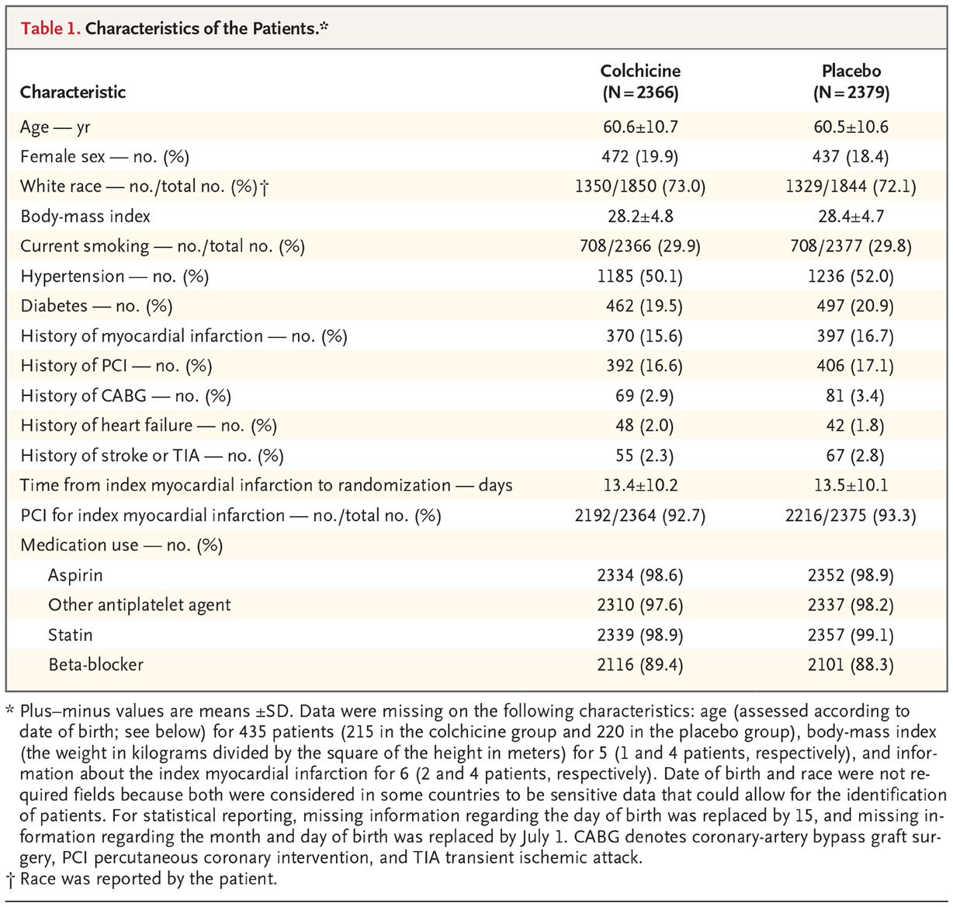

Slide 11
Patients were enrolled a mean of 13.5 days after myocardial infarction
The mean age of the patients was 60.6 years, 19.2% of the patients were women
20.2% had diabetes
Most patients (93.0%) underwent percutaneous coronary intervention for their index myocardial infarction
Aspirin, a different antiplatelet agent, and a statin were taken by 98.8%, 97.9% and 99.0% of the patients, respectively.

Slide 12
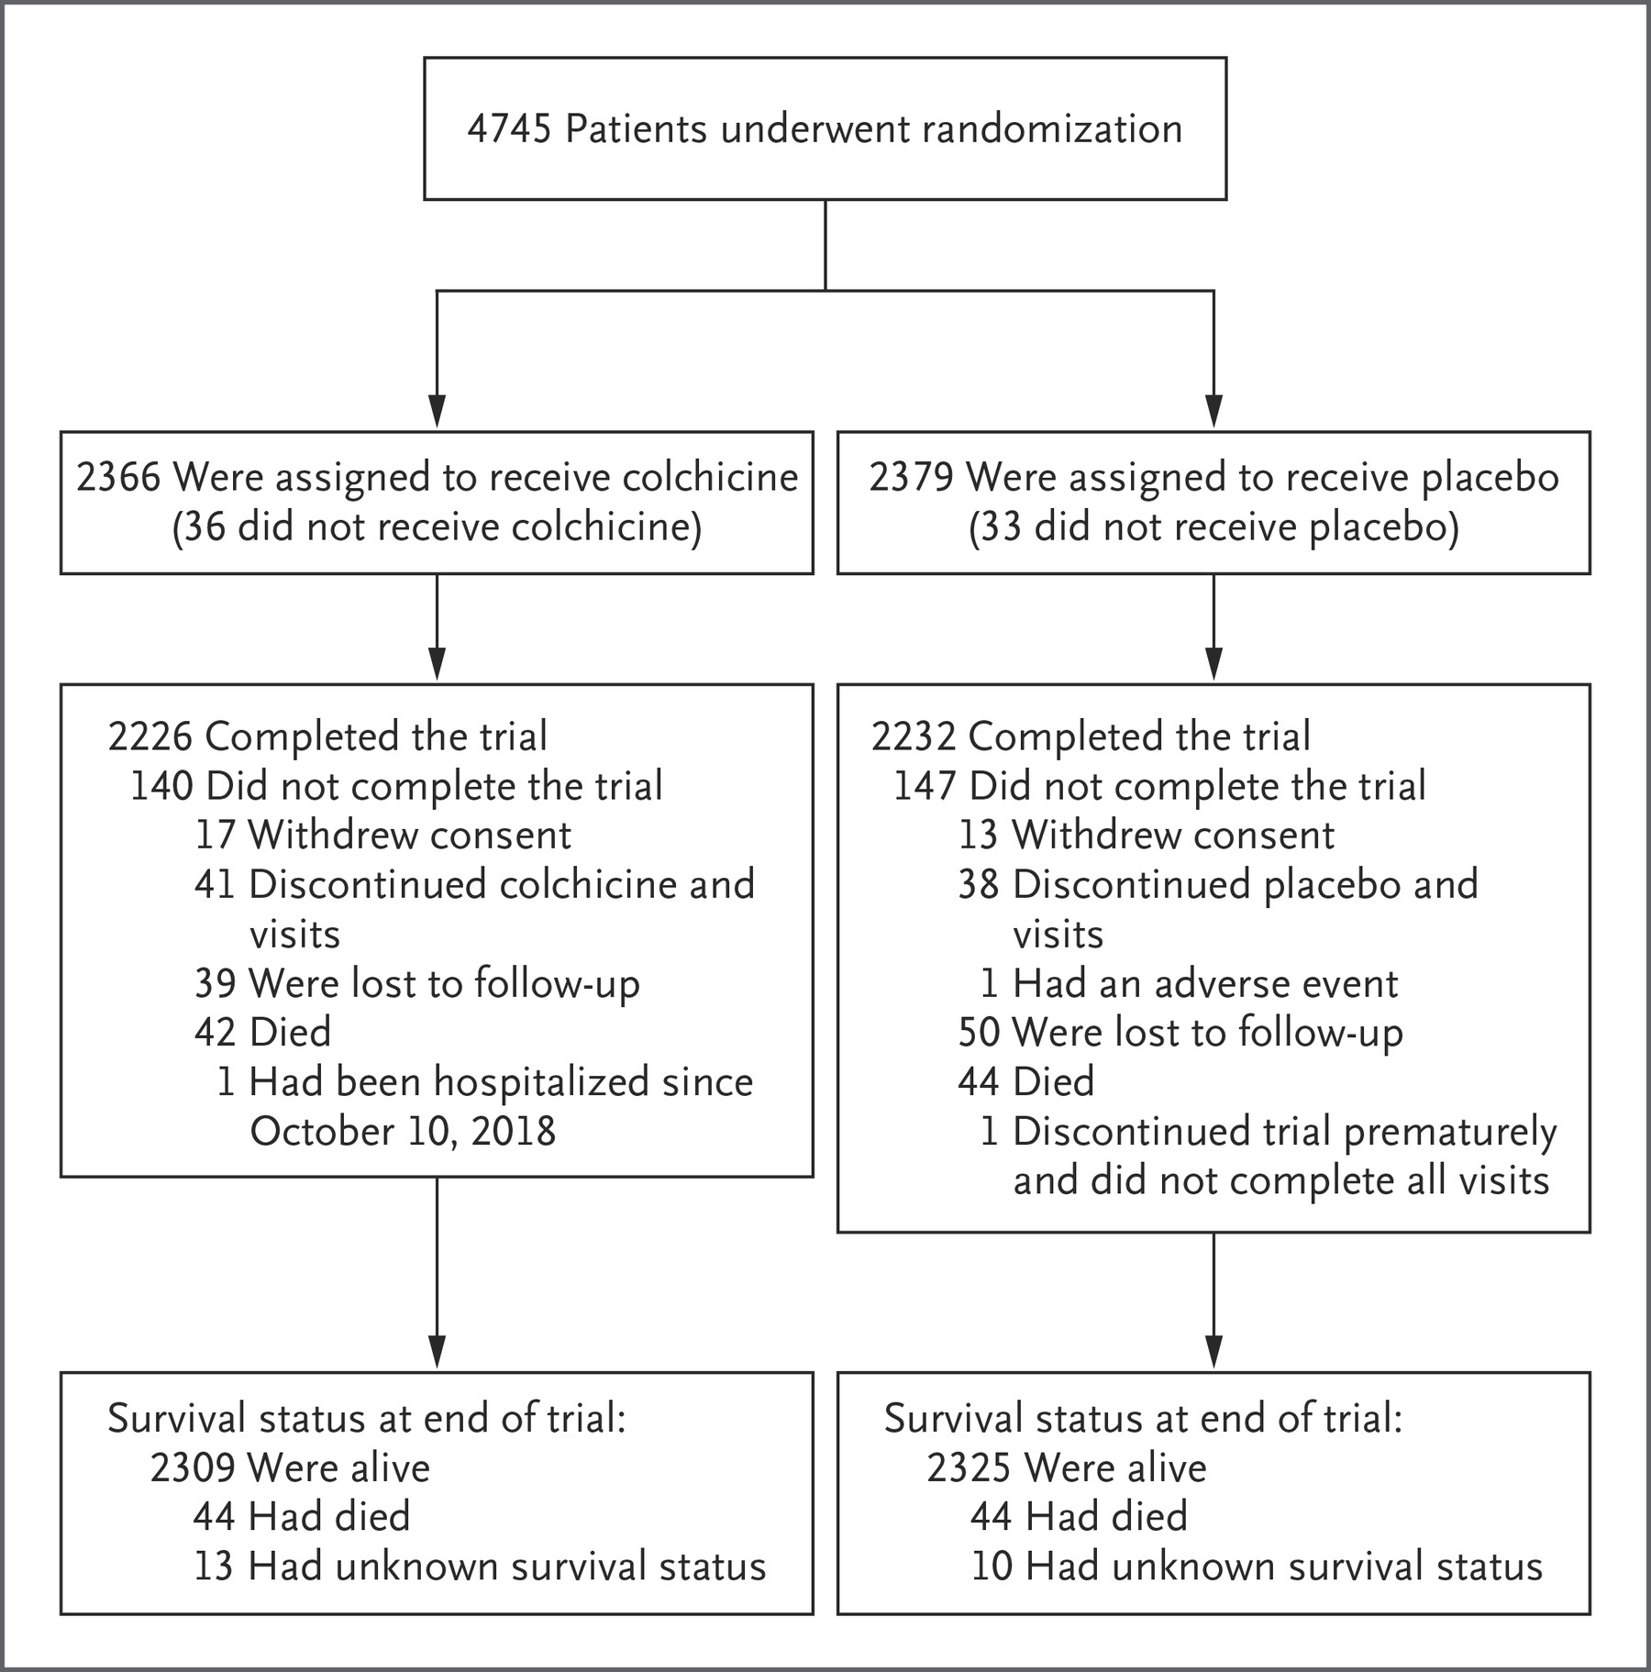

Slide 13
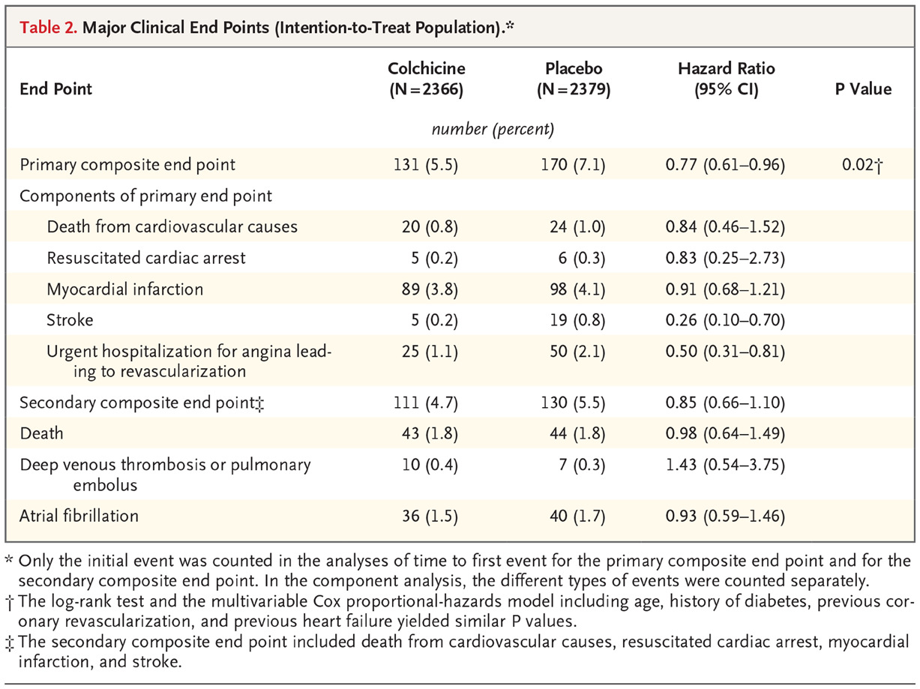

Slide 14
PRIMARY EFFICACY OUTCOME
The primary efficacy end point was a composite of death from cardiovascular causes, resuscitated cardiac arrest, myocardial infarction, stroke and urgent hospitalization for angina leading to coronary revascularization.

Slide 15
PRIMARY EFFICACY OUTCOME
A primary end-point event occurred in 5.5% of the patients in the colchicine group, as compared with 7.1% of those in the placebo group
hazard ratio 0.77
confidence interval [CI] 0.61 to 0.96
P value = 0.02

Slide 16
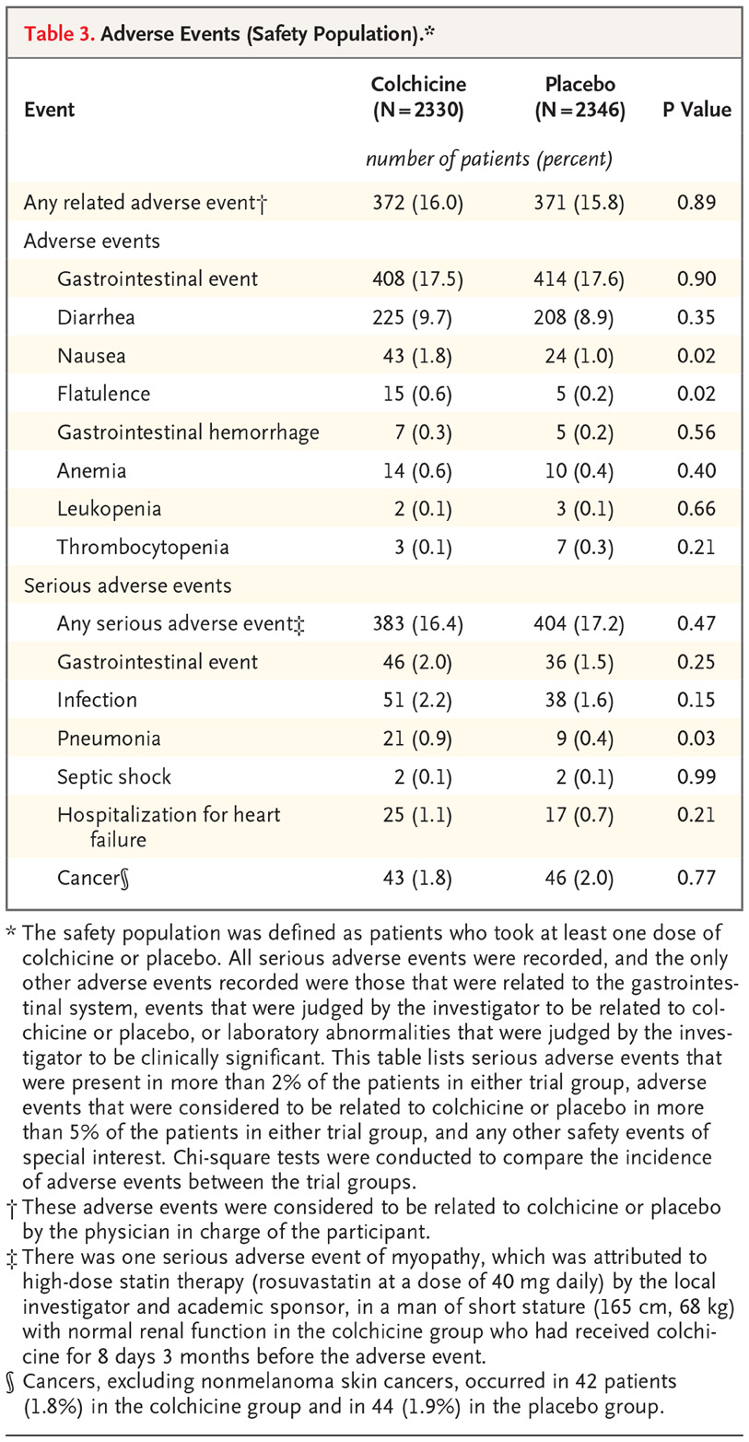

Slide 17
SAFETY AND ADVERSE EVENTS
Adverse events- Diarrhea ,Nausea, Flatulence, Gastrointestinal hemorrhage ,Anaemia, Leukopenia, Thrombocytopenia, Pneumonia, Septic shock.

Slide 18
SAFETY AND ADVERSE EVENTS
The incidence of adverse events that were considered to be related to the active drug or placebo was 16.0% in the colchicine group and 15.8% in the placebo group, not differ significantly.
The overall incidence of serious adverse events was 16.4% in colchicine group and 17.2% in placebo group, not differ significantly.
Diarrhea occurred more in colchicine group (9.7%) than placebo (8.9%) (P = 0.35)

Slide 19
SAFETY AND ADVERSE EVENTS
Nausea was more common in the colchicine group than in the placebo group (1.8% vs. 1.0%, P = 0.02)
Anaemia was more common in colchicine group than in the placebo group (0.6% vs 0.4%)
Pneumonia was reported as a serious adverse event in 0.9% of the patients in the colchicine group, as compared with 0.4% of those in the placebo group (P = 0.03).

Slide 20
STRENGTH OF STUDY
Large sample size
Double blind randomized control trial
Less chance of biasness

Slide 21
CONCLUSION
Among patients with a recent myocardial infarction, colchicine at a dose of 0.5 mg daily led to a significantly lower percentage of patients with ischemic cardiovascular events than placebo.
Except diarrhoea and pneumonia the overall adverse events were not significantly differ between two groups.

Slide 22
THANK YOU

